Slide 1
Developing Pricing Strategies and Programs
Price is the one element of the marketing mix that produces revenue; the other elements produce costs.
Price also communicates the company’s intended value positioning of its product or brand.

Slide 2
Developing Pricing Strategies and Programs
Ryanair, with its an unusual pricing strategy.. value positioning of its product or brand. A well-designed and marketed product can still command a price premium and reap big profits.
But new economic realities have caused many consumers to reevaluate what they are willing to pay for products and services, and companies have had to carefully review their pricing strategies as a result.

Slide 3
Developing Pricing Strategies and Programs
حققت شركة رايان إير، شركة الطيران الأوروبية منخفضة التكلفة، أرباحًا هائلة بفضل نموذج أعمالها الثوري. والسر في ذلك يكمن في ذهنية مؤسسها الذي يفكّر كتاجر تجزئة، حيث يفرض أسعاراعلى الركاب مقابل كل شيء، باستثناء مقاعدهم.

Slide 4
Developing Pricing Strategies and Programs
I-Understanding Pricing
Price comes in many forms and performs many functions:
Rent, tuition, fares, fees, rates, tolls, retainers, wages, and commissions are all prices for some goods or services.
Price also has many components. If you buy a new car, the sticker price may be adjusted by rebates and dealer incentives

Slide 5
Developing Pricing Strategies and Programs
I-Understanding Pricing
Throughout most of history, prices were set by negotiation (Bargaining) between buyers and sellers.

Slide 6
Developing Pricing Strategies and Programs
I-Understanding Pricing
Nowadays, price is operating as a major determinant of buyer choice. Consumers who have access to price information put pressure on retailers to lower their prices. Retailers in turn put pressure on manufacturers to lower their prices.

Slide 7
Developing Pricing Strategies and Programs
I-Understanding Pricing
Downward price pressure coincided with the ICT devlopment. For some years now, the Internet has been changing the way buyers and sellers interact:

Slide 8
Developing Pricing Strategies and Programs
I-Understanding Pricing
Buyers with the internet can:
Get instant price comparisons from vendors
Check prices at the point of purchase
Name their price and have it met
Get products for free.

Slide 9
Developing Pricing Strategies and Programs
I-Understanding Pricing
Sellers with the internet can:
Monitor customer behavior and tailor offers to individuals.
Give certain customers access to special prices

Slide 10
Developing Pricing Strategies and Programs
I-Understanding Pricing
Both buyers and sellers now can:
Negotiate prices in online auctions and exchanges or even in person

Slide 11
Developing Pricing Strategies and Programs
II-A CHANGING PRICING ENVIRONMENT
Pricing practices have changed significantly, due to recession in 2008–2009, a slow recovery, and rapid technological advances.
Instead of buying, renting, borrowing, and sharing are becoming valid options to many of the new millennial generation.

Slide 12
Developing Pricing Strategies and Programs
II-A CHANGING PRICING ENVIRONMENT
Some say these new behaviors are creating a sharing economy in which consumers share bikes, cars, clothes, apartments, tools, and skills and extracting more value from what they already own:
“We’re moving from a world where we’re organized around ownership to one organized around access to assets.”

Slide 13
Developing Pricing Strategies and Programs
II-A CHANGING PRICING ENVIRONMENT
Two pillars of a sharing economy are bartering and renting:
Bartering: Trade exchange companies like Florida Barter and Web sites like www.swap.com connect people and businesses seeking win-win solutions.
Renting: RentTheRunway: offers affordable rentals of designer dresses.

Slide 14
Developing Pricing Strategies and Programs
III-HOW COMPANIES PRICE
In small companies, the boss often sets prices. In large companies, division and product line managers do.
Where pricing is a key competitive factor, companies often establish a pricing department to set or assist others in setting appropriate prices. This department reports to the marketing department, finance department, or top management.

Slide 15
Developing Pricing Strategies and Programs
III-HOW COMPANIES PRICE
Consumer Psychology and Pricing:
Purchase decisions are based on how consumers perceive prices. Understanding how consumers arrive at their perceptions of prices is an important marketing priority. Here we consider three key topics—
reference prices,
price–quality inferences, and
price endings.

Slide 16
Developing Pricing Strategies and Programs
III-HOW COMPANIES PRICE
Consumer Psychology and Pricing:
Understanding how consumers arrive at their perceptions of prices is an important marketing priority. Here we consider three key topics—
reference prices,
price–quality inferences, and
price endings.

Slide 17
Developing Pricing Strategies and Programs
III-HOW COMPANIES PRICE
Consumer Psychology and Pricing:
Price endings: Many sellers believe prices should end in an odd number. Customers perceive an item priced at $299 to be in the $200 rather than the $300 range; they tend to process prices “left to right” rather than by rounding

Slide 18
Developing Pricing Strategies and Programs
IV- Setting the Price
A firm must set a price for the first time when it:
develops a new product,
introduces its regular product into a new distribution channel or geographical area,
enters bids on new contract work.

Slide 19
Developing Pricing Strategies and Programs
IV- Setting the Price
The firm must decide where to position its product on quality and price.
Most markets have three to five price points. Having a range of price points allows a firm to cover more of the market and to give any one consumer more choices.

Slide 20
Developing Pricing Strategies and Programs
IV- Setting the Price
Marriott Hotels is good at developing different brands or variations of brands for different price points: Marriott Vacation Club — Vacation Villas (highest price), Marriott Marquis (high price), Marriott (high-medium price), Renaissance (medium-high price), Courtyard (medium price), TownePlace Suites (medium-low price), and Fairfield Inn (low price).

Slide 21
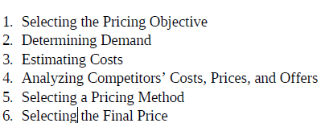
Developing Pricing Strategies and Programs
IV- Setting the Price

Slide 22
Developing Pricing Strategies and Programs
IV- Setting the Price
Step 1: Selecting the Pricing Objective:
Survival,
Maximize current profits
Maximize market share
Maximize market skimming
Product-quality leadership

Slide 23
Developing Pricing Strategies and Programs
IV- Setting the Price
Step 2: Determining Demand:
Each price will lead to a different level of demand and have a different impact on a company’s marketing objectives. The normally inverse relationship between price and demand is captured in a demand curve

Slide 24
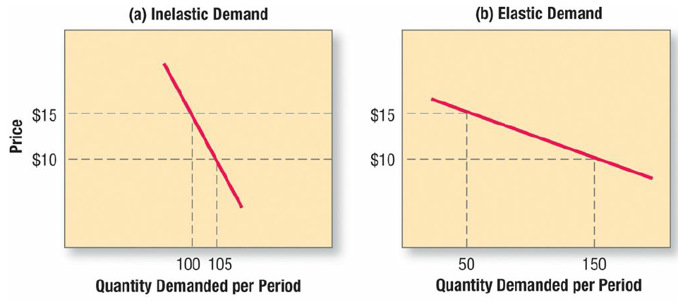
Developing Pricing Strategies and Programs
IV- Setting the Price

Slide 25
Developing Pricing Strategies and Programs
IV- Setting the Price
Step 2: Determining Demand:
The first step in estimating demand is to understand what affects price sensitivity.
Factors That can Reduce Price Sensitivity are:

Slide 26
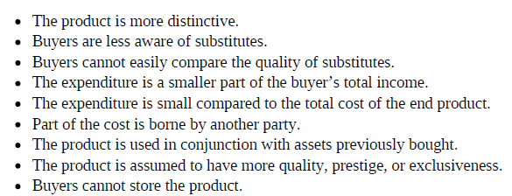
Developing Pricing Strategies and Programs
IV- Setting the Price
Step 2: Determining Demand:
The first step in estimating demand is to understand what affects price sensitivity.

Slide 27
Developing Pricing Strategies and Programs
IV- Setting the Price
Step 3: Estimating Costs:
Demand sets a ceiling on the price the company can charge for its product. Costs set the floor.
The company wants to charge a price that covers its cost of producing, distributing, and selling the product, including a fair return for its effort and risk. Yet when companies price products to cover their full costs, profitability isn’t always the net result.

Slide 28
Developing Pricing Strategies and Programs
IV- Setting the Price
Step 3: Estimating Costs:
Fixed costs, also known as overhead
Variable costs vary directly with the level of prod.
Total costs
Average cost is the cost per unit at that level of prod.
To price intelligently, management needs to know how its costs vary with different levels of production.

Slide 29
Developing Pricing Strategies and Programs
IV- Setting the Price
Step 4: Analyzing Competitors’ Costs, Prices, and Offers:
If the firm’s offer contains features not offered by the nearest competitor, it should evaluate its offer to the customer and add that value to the competitor’s price.
If the competitor’s offer contains some features not offered by the firm, the firm should subtract their value from its own price.

Slide 30
Developing Pricing Strategies and Programs
IV- Setting the Price
Step 5: Selecting a Pricing Method
The Three Cs Model for Price Setting

Slide 31
Developing Pricing Strategies and Programs
IV- Setting the Price

Slide 32
Developing Pricing Strategies and Programs
IV- Setting the Price
Step 5: Selecting a Pricing Method
There exist several price-setting methods, among them are: markup pricing, target-return pricing, perceived value pricing, value pricing, EDLP, going-rate pricing, and auction-type pricing.

Slide 33
Developing Pricing Strategies and Programs
IV- Setting the Price
Step 5: Selecting a Pricing Method
MARKUP PRICING:

Slide 34
Developing Pricing Strategies and Programs
IV- Setting the Price
Step 5: Selecting a Pricing Method
MARKUP PRICING:

Slide 35
Developing Pricing Strategies and Programs
IV- Setting the Price
Step 5: Selecting a Pricing Method
TARGET-RETURN PRICING :

Slide 36
Developing Pricing Strategies and Programs
IV- Setting the Price
Step 5: Selecting a Pricing Method
PERCEIVED-VALUE PRICING : which is made up of a number of inputs, such as the buyer’s image of the product performance, the channel deliverables, the warranty quality, the supplier’s reputation, trustworthiness, and esteem.

Slide 37
Developing Pricing Strategies and Programs
IV- Setting the Price
Step 5: Selecting a Pricing Method
VALUE PRICING : charging a fairly low price for a high-quality offering. It means reengineering the company’s operations to become a low-cost producer for high quality Products

Slide 38
Developing Pricing Strategies and Programs
IV- Setting the Price
Step 5: Selecting a Pricing Method
EDLP : everyday low pricing charges a constant low price with little or no price promotion or special sales.

Slide 39
Developing Pricing Strategies and Programs
IV- Setting the Price
Step 5: Selecting a Pricing Method
GOING-RATE PRICING : The firm bases its price largely on competitors’ prices.

Slide 40
Developing Pricing Strategies and Programs
IV- Setting the Price
Step 5: Selecting a Pricing Method
AUCTION-TYPE PRICING : is becoming more popular, especially with scores of electronic marketplaces selling everything.
English auctions (ascending bids), Dutch auctions (descending bids), Sealed-bid auctions.

Slide 41
Developing Pricing Strategies and Programs
IV- Setting the Price
Step 6: Selecting the Final Price
In selecting the price, the company must consider additional factors, including the impact of other marketing activities, company pricing policies, gain-and-risk-sharing pricing, and the impact of price on other parties.

Slide 42
Developing Pricing Strategies and Programs
VI- Other Considerations in Pricing Strategy
Adapting the Price (GEOGRAPHICAL PRICING)
PRICE DISCOUNTS AND ALLOWANCES (PROMOTIONAL PRICING)
DIFFERENTIATED PRICING (Price discrimination)
Initiating and Responding to Price Changes (PRICE CUTS, PRICE INCREASES
ANTICIPATING COMPETITIVE RESPONSES (RESPONDING TO COMPETITORS’ PRICE CHANGES)

