Slide 1
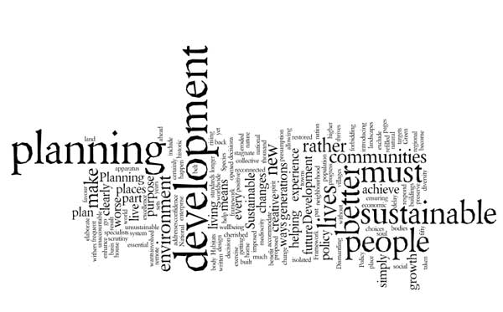
English for Urban Technic Management
Dr Hamza Benacer

Slide 2
“The essence of urban planning transcends the mere layout of cities. It delves deep into fostering public spaces that promote community interactions, facilitating areas that blend diverse backgrounds, and ensuring that the residential areas are conducive to the well-being of its inhabitants. Through the ages, the design of cities has mirrored the cultural, social, and economic priorities of societies. The very infrastructure of a city can either promote social inclusivity or lead to segregation, impacting the very fabric of societal interactions.”
Termes essentiels
Public space (espace public)
Residential area (zone résidentielle)
Infrastructure (infrastructure)

Slide 3
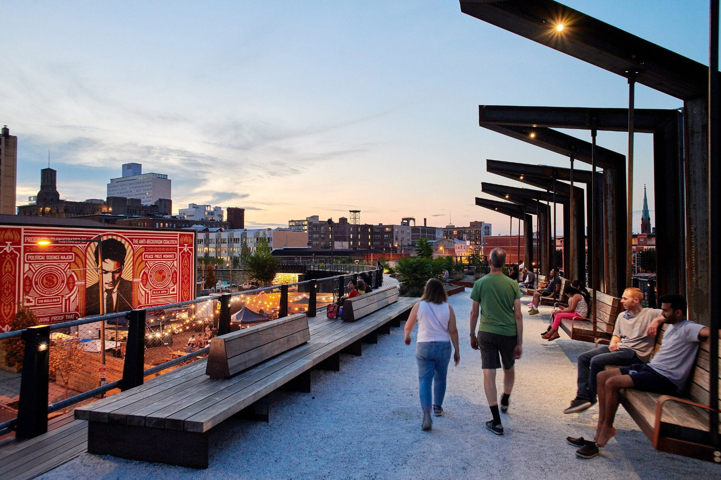
Public space (espace public)

Slide 4
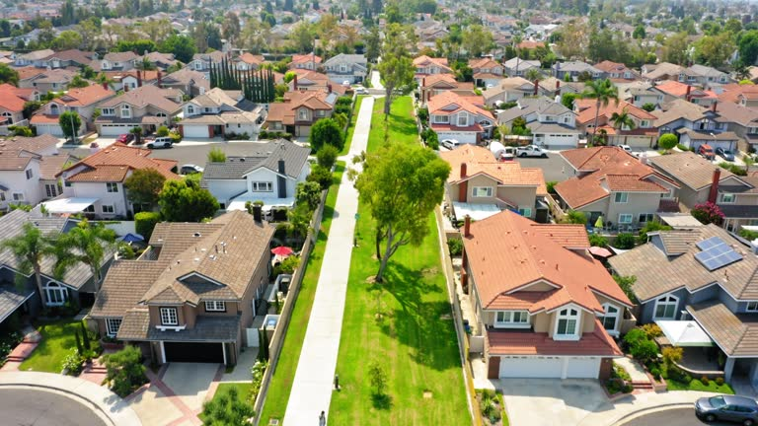
Residential area (zone résidentielle)

Slide 5
Infrastructure (infrastructure)

Slide 6
Exercices
Question d’inférence: What can be inferred about the relationship between urban planning and society from the passage?
Urban planning has no significant impact on societal interactions.
The design of cities always promotes social inclusivity.
The layout of a city can influence societal interactions and cultural values.
The economic priorities of societies are irrelevant to urban planning.
Question de vocabulaire: In the passage, the term “segregation” most likely means:
Integration
Separation
Celebration
Concentration
Réponses et commentaires
C. The layout of a city can influence societal interactions and cultural values (Le texte évoque comment la conception des villes peut influencer les interactions sociales et les valeurs culturelles.)
B. Separation (“Segregation” signifie séparation ou isolement d’un groupe par rapport aux autres.)

