Slide 1
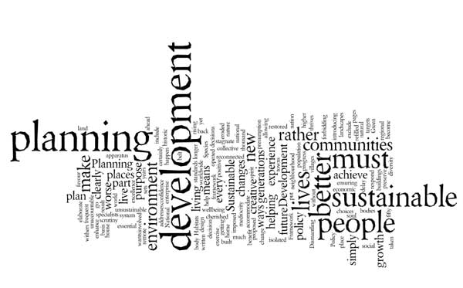
English for Urban Technic Management
Dr Hamza Benacer

Slide 2
“Urban planning, as we know it, has roots in ancient civilizations. From the layout of the Indus Valley cities, termed as the early agglomeration, to the systematic planning by the Greeks and Romans, the art and science of city design has evolved significantly. Over time, as societies expanded and their needs grew more complex, urban centers became more intricate. The evolution of cities and urbanization became particularly pronounced during the Middle Ages, with the establishment of trade routes and the rise of empires, setting the stage for modern urban design principles.”
Termes essentiels
Agglomeration (agglomération)
Urbanization (urbanisation)
Planning (planification)

Slide 3
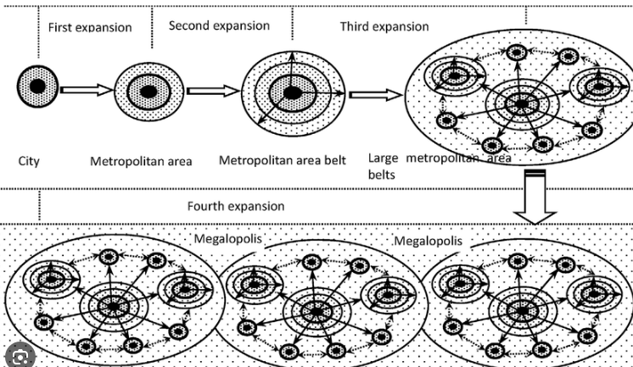
Agglomeration (agglomération)

Slide 4
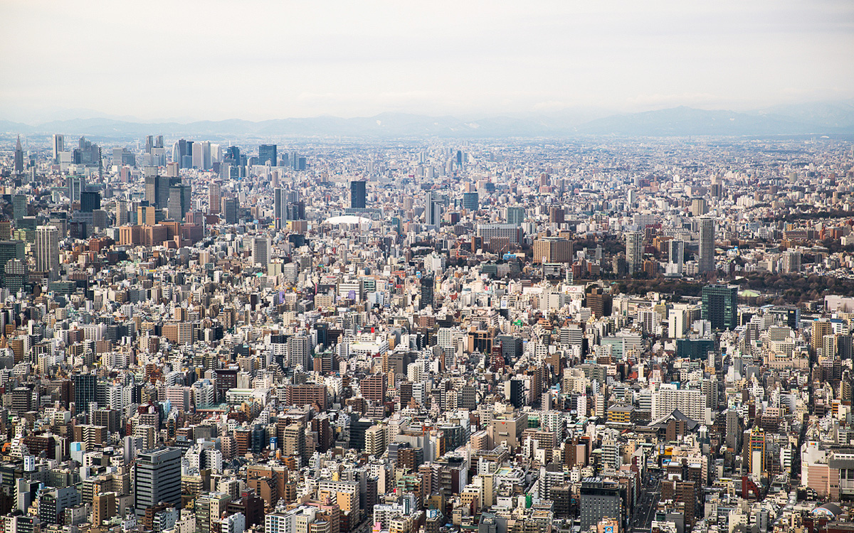
Urbanization (urbanisation)

Slide 5
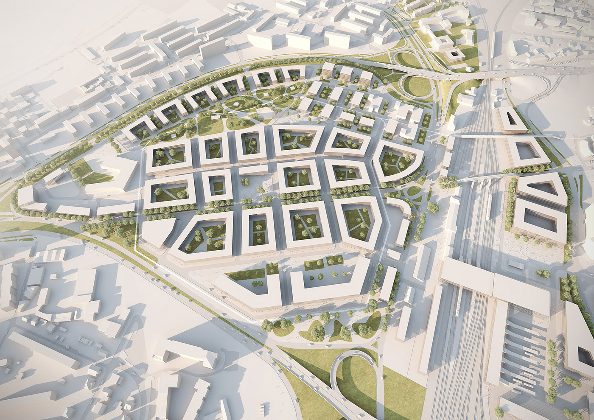
Planning (planification)

Slide 6
Exercices
Question de vocabulaire: In the passage, the term “agglomeration” is closest in meaning to:
  Spread out
  Disintegration
  Cluster
  Isolation
Question d’inférence: What can be inferred about the role of trade routes in the development of cities?
  They led to the decline of cities.
  They played a negligible role.
  They were instrumental in city growth.
  They were introduced only in modern times.
Answears:
C. Cluster (“Agglomeration” se réfère à une collection ou un groupe de choses. Dans ce contexte, il décrit la formation de villes ou de centres urbains.)
C. They were instrumental in city growth (Les routes commerciales étaient essentielles pour le développement et la croissance des villes, car elles permettaient le commerce, l’échange culturel et l’expansion.)

