Slide 1
Setting Product Strategy
At the heart of a great brand is a great product. To achieve market leadership, firms must offer products and services of superior quality that provide unsurpassed customer value. Lexus has conquered the luxury car market in the United States and elsewhere, in part due to a relentless focus on product and service quality.

Slide 2
Setting Product Strategy
Marketing planning begins with formulating an offering to meet target customers’ needs or wants. The customer will judge the offering on three basic elements: product features and quality, service mix and quality, and price (see Figure 13.1). Three elements—products, services, and pricing—must be meshed into a competitively attractive market offering.

Slide 3
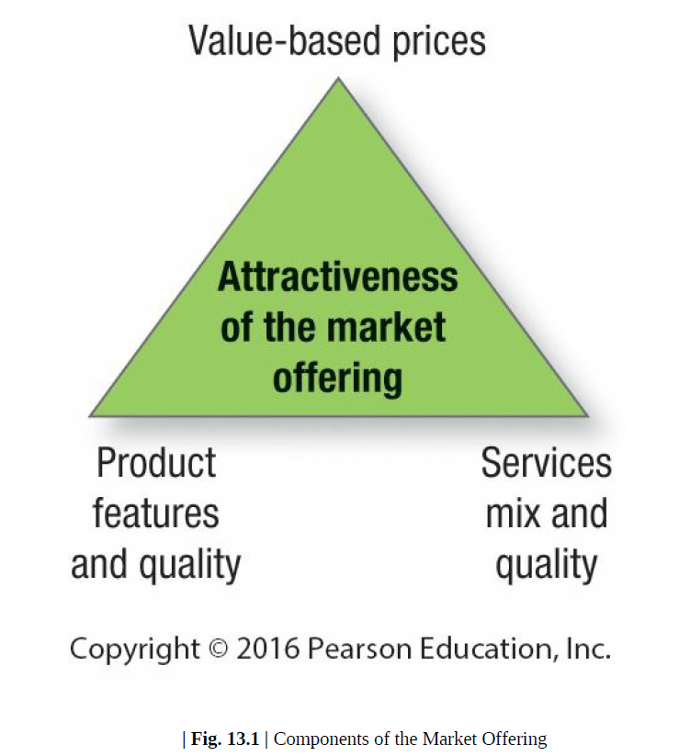
Setting Product Strategy
Marketing planning begins with formulating an offering to meet target customers’ needs or wants. The customer will judge the offering on three basic elements: product features and quality, service mix and quality, and price (see Figure 13.1). Three elements—products, services, and pricing—must be meshed into a competitively attractive market offering.

Slide 4
Setting Product Strategy
I-Product Characteristics and Classifications
Many people think a product is tangible, but technically a product is anything that can be offered to a market to satisfy a want or need, including physical goods, services, experiences, events, persons, places, properties, organizations, information, and ideas.

Slide 5
Setting Product Strategy
I-Product Characteristics and Classifications
1- PRODUCT LEVELS: THE CUSTOMER-VALUE HIERARCHY
In planning its market offering, the marketer needs to address five product levels (see Figure 13.2). Each level adds more customer value, and together the five constitute a customer-value hierarchy.

Slide 6
Setting Product Strategy
I-Product Characteristics and Classifications
1- PRODUCT LEVELS: THE CUSTOMER-VALUE HIERARCHY
The fundamental level is the core benefit: the service or benefit the customer is really buying. A hotel guest is buying rest and sleep. The purchaser of a drill is buying holes. Marketers must see themselves as benefit providers.

Slide 7
Setting Product Strategy
I-Product Characteristics and Classifications
1- PRODUCT LEVELS: THE CUSTOMER-VALUE HIERARCHY
At the second level, the marketer must turn the core benefit into a basic product. Thus a hotel room includes a bed, bathroom, towels, desk, dresser, and closet.

Slide 8
Setting Product Strategy
I-Product Characteristics and Classifications
1- PRODUCT LEVELS: THE CUSTOMER-VALUE HIERARCHY
At the third level, the marketer prepares an expected product, a set of attributes and conditions buyers normally expect when they purchase this product. Hotel guests minimally expect a clean bed, fresh towels, working lamps, and a relative degree of quiet.

Slide 9
Setting Product Strategy
I-Product Characteristics and Classifications
1- PRODUCT LEVELS: THE CUSTOMER-VALUE HIERARCHY
At the fourth level, the marketer prepares an augmented product that exceeds customer expectations. In developed countries, brand positioning and competition take place at this level. In developing and emerging markets such as India and Brazil, however, competition takes place mostly at the expected product

Slide 10
Setting Product Strategy
I-Product Characteristics and Classifications
1- PRODUCT LEVELS: THE CUSTOMER-VALUE HIERARCHY
At the fifth level stands the potential product, which encompasses all the possible augmentations and transformations the product or offering might undergo in the future. Here companies search for new ways to satisfy customers and distinguish their offering.

Slide 11
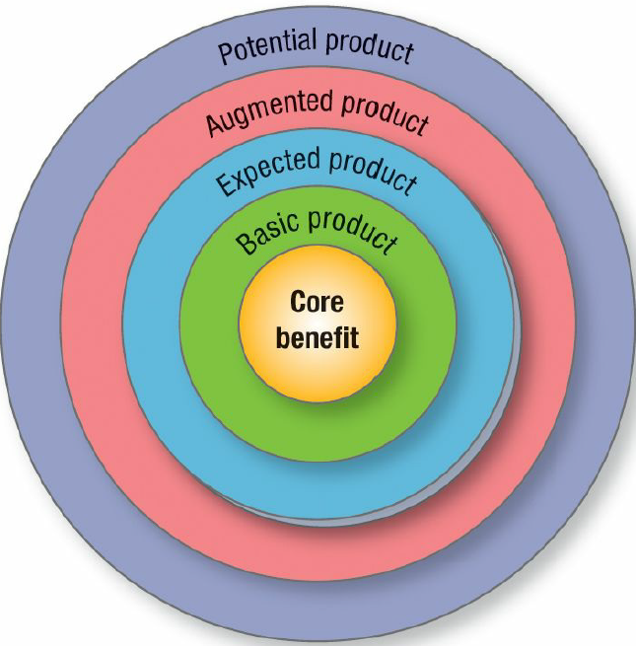
Setting Product Strategy
I-Product Characteristics and Classifications
1- PRODUCT LEVELS: THE CUSTOMER-VALUE HIERARCHY
At the fifth level stands the potential product, which encompasses all the possible augmentations and transformations the product or offering might undergo in the future. Here companies search for new ways to satisfy customers and distinguish their offering.

Slide 12
Setting Product Strategy
I-Product Characteristics and Classifications
1- PRODUCT LEVELS: THE CUSTOMER-VALUE HIERARCHY
Differentiation arises and competition increasingly occurs on the basis of product augmentation. Each augmentation adds cost, however, and augmented benefits soon become expected benefits and necessary points-of-parity in the category. If today’s hotel guests expect large-screen HD TVs, wireless Internet access, and a fully equipped fitness center, competitors must search for still other features and benefits to differentiate themselves.

Slide 13
Setting Product Strategy
I-Product Characteristics and Classifications
1- PRODUCT LEVELS: THE CUSTOMER-VALUE HIERARCHY
As some companies raise the price of their augmented product, others offer a stripped-down version for less. Thus, alongside the growth of expensive luxury hotels such as Four Seasons and Ritz-Carlton, we see lower-cost discount hotels and motels emerge such as Motel 6 and Comfort Inn, catering to clients who want simply the basic product. Marketers must be sure, however, that consumers not see lower quality or limited capability versions as unfair

Slide 14
Setting Product Strategy
I-Product Characteristics and Classifications
2- PRODUCT CLASSIFICATIONS:
Marketers classify products on the basis of durability, tangibility, and use (consumer or industrial). Each type has an appropriate marketing-mix strategy.

Slide 15
Setting Product Strategy
I-Product Characteristics and Classifications
2- PRODUCT CLASSIFICATIONS:
DURABILITY AND TANGIBILITY: Products fall into three groups:
1. Nondurable goods
2. Durable goods
3. Services

Slide 16
Setting Product Strategy
I-Product Characteristics and Classifications
2- PRODUCT CLASSIFICATIONS:
CONSUMER-GOODS:
When we classify the vast array of consumer goods on the basis of shopping habits, we distinguish among convenience, shopping, specialty, and unsought goods.

Slide 17
Setting Product Strategy
I-Product Characteristics and Classifications
2- PRODUCT CLASSIFICATIONS:
CONSUMER-GOODS:
convenience goods: The consumer usually purchases convenience goods frequently, immediately, and with minimal effort. Examples include soft drinks, soaps, and newspapers.

Slide 18
Setting Product Strategy
I-Product Characteristics and Classifications
2- PRODUCT CLASSIFICATIONS:
CONSUMER-GOODS:
Shopping goods: are those the consumer characteristically compares on such bases as suitability, quality, price, and style. Examples include furniture, clothing, and major appliances. (Homogeneous and Heterogeneous shopping goods)

Slide 19
Setting Product Strategy
I-Product Characteristics and Classifications
2- PRODUCT CLASSIFICATIONS:
CONSUMER-GOODS:
Specialty goods: have unique characteristics or brand identification for which enough buyers are willing to make a special purchasing effort. Examples include cars. Specialty goods don’t require comparisons; buyers invest time only to reach dealers carrying the wanted products..

Slide 20
Setting Product Strategy
I-Product Characteristics and Classifications
2- PRODUCT CLASSIFICATIONS:
CONSUMER-GOODS:
Unsought goods: are those the consumer does not know about or normally think of buying, such as smoke detectors. Other classic examples are life insurance, cemetery plots, and gravestones. Unsought goods require advertising and personal-selling support.

Slide 21
Setting Product Strategy
I-Product Characteristics and Classifications
2- PRODUCT CLASSIFICATIONS:
INDUSTRIAL-GOODS:
We classify industrial goods in terms of their relative cost and the way they enter the production process:

Slide 22
Setting Product Strategy
I-Product Characteristics and Classifications
2- PRODUCT CLASSIFICATIONS:
INDUSTRIAL-GOODS:
Materials and parts: are goods that enter the manufacturer’s product completely. They fall into two classes: raw materials (farm products and natural products) and manufactured materials and parts (component materials and component parts).

Slide 23
Setting Product Strategy
I-Product Characteristics and Classifications
2- PRODUCT CLASSIFICATIONS:
INDUSTRIAL-GOODS:
Capital items are long-lasting goods that facilitate developing or managing the finished product. They fall into two groups: installations and equipment.

Slide 24
Setting Product Strategy
I-Product Characteristics and Classifications
2- PRODUCT CLASSIFICATIONS:
INDUSTRIAL-GOODS:
Supplies and business services are short-term goods and services that facilitate developing or managing the finished product. Supplies are of two kinds: maintenance and repair items (paint, nails, brooms) and operating supplies (lubricants, coal, writing paper, pencils)

Slide 25
Setting Product Strategy
I-Product Characteristics and Classifications
2- PRODUCT CLASSIFICATIONS:
INDUSTRIAL-GOODS:
Supplies and business services are short-term goods and services that facilitate developing or managing the finished product. Business services include maintenance and repair services (window cleaning, copier repair) and business advisory services (legal, management consulting, advertising).

Slide 26
Setting Product Strategy
II- Product Differentiation
To be branded, products must be differentiated. At one extreme are products that allow little variation: chicken, aspirin, and steel. Yet even here some differentiation is possible: Perdue chickens, Bayer aspirin, and India’s Tata Steel have carved out distinct identities in their categories. At the other extreme are products capable of high differentiation, such as automobiles, commercial buildings, and furniture. Here the seller faces an abundance of differentiation possibilities.

Slide 27
Setting Product Strategy
II- Product Differentiation
well-differentiated products can create significant competitive advantages.
Means for differentiation include form, features, performance quality, conformance quality, durability, reliability, repairability, design, and style.

Slide 28
Setting Product Strategy
II- Product Differentiation
FORM: Many products can be differentiated in form (the size, shape, or physical structure of a product). Consider the many possible forms of aspirin. Although essentially a commodity, it can be differentiated by dosage, size, shape, color, coating, or action time.

Slide 29
Setting Product Strategy
II- Product Differentiation
FEATURES: Most products can be offered with varying features that supplement their basic function. A company can identify and select appropriate new features by surveying recent buyers and then calculating customer value versus company cost for each potential feature. Marketers should consider how many people want each feature, how long it would take to introduce it, and whether competitors could easily copy it.

Slide 30
Setting Product Strategy
II- Product Differentiation
FEATURES: To avoid "feature fatigue," the company must prioritize features and tell consumers how to use and benefit from them. Marketers must also think in terms of feature bundles or packages. Auto
companies often manufacture cars at several "trim levels." This lowers manufacturing and inventory costs. Each company must decide whether to offer feature customization at a higher cost or a few standard packages at a lower cost.

Slide 31
Setting Product Strategy
II- Product Differentiation
PERFORMANCE QUALITY: Most products occupy one of four performance levels: low, average, high, or superior. Performance quality is the level at which the product’s primary characteristics operate. Quality is growing increasingly important for differentiation as companies adopt a value model and provide higher quality for less money. Firms should design a performance level appropriate to the target market and competition

Slide 32
Setting Product Strategy
II- Product Differentiation
CONFORMANCE QUALITY: Buyers expect a high conformance quality, the degree to which all produced units are identical and meet promised specifications. A product with low conformance quality will disappoint some buyers. Firms thoroughly test finished products to ensure conformance.

Slide 33
Setting Product Strategy
II- Product Differentiation
Durability: a measure of the product’s expected operating life under natural or stressful conditions, is a valued attribute for vehicles, kitchen appliances, and other durable goods. The extra price for durability must not be excessive, however, and the product must not be subject to rapid technological obsolescence, as personal computers, televisions, and cell phones have sometimes been.

Slide 34
Setting Product Strategy
II- Product Differentiation
RELIABILITY: Buyers normally will pay a premium for more reliable products. Reliability is a measure of the probability that a product will not malfunction or fail within a specified time period.
Repairability: measures the ease of fixing a product when it malfunctions or fails. Ideal repairability would exist if users could fix the product themselves with little cost in money or time.

Slide 35
Setting Product Strategy
II- Product Differentiation
Style: describes the product’s look and feel to the buyer and creates distinctiveness that is hard to copy. Car buyers pay a premium for Jaguars because of their extraordinary looks.
Strong style does not always mean high performance, however. A car may look sensational but spend a lot of time in the repair shop.

Slide 36
Setting Product Strategy
II- Product Differentiation
CUSTOMIZATION: customized products and marketing allow firms to be highly relevant and differentiating by finding out exactly what a person wants—and doesn’t want—and delivering on that.
NikeiD allows customers to personalize and design their own shoes and clothing either online or in store at NikeiD Studios, now generates hundreds of millions of dollars in revenue.

Slide 37
Setting Product Strategy
II- Product Differentiation
When the physical product cannot easily be differentiated, the key to competitive success may lie in adding valued services and improving their quality. Rolls-Royce PLC has ensured its aircraft engines are in high demand by continuously monitoring their health for 1,300 airplane engines around the world through live satellite feeds. Under its TotalCare and CorporateCare programs, airlines pay Rolls a fee for every hour an engine is in flight, and Rolls assumes the risks and costs of downtime and repairs

Slide 38
Setting Product Strategy
II- Product Differentiation
The main service differentiators are:
ordering ease,
delivery,
installation,
customer training,
customer consulting,
maintenance and repair, and
returns.

Slide 39
Setting Product Strategy
III- Product Design
As competition intensifies, design offers a potent way to differentiate and position a company’s products and services. Design is the totality of features that affect the way a product looks, feels,
and functions to a consumer. It offers functional and aesthetic benefits and appeals to both our rational and emotional sides.

Slide 40
Setting Product Strategy
III- Product Design
Some countries have developed strong reputations for their design skills and accomplishments, such as Italy in apparel and furniture and Scandinavia in products designed for functionality, aesthetics, and environmental consciousness. Finland’s Nokia was the first to introduce user changeable covers for cell phones, the first to have elliptical-shaped, soft, and friendly forms, and the first with big screens, all contributing to its remarkable ascent. When it later failed to innovate its smart-phone designs, its fortunes dramatically declined. Braun, a German division of Gillette, has elevated design to a high art in its electric shavers, coffee makers, hair dryers….

Slide 41
Setting Product Strategy
III- Product Design
In a visually oriented culture, transmitting brand meaning and positioning through design is critical. "In a crowded marketplace, aesthetics is often the only way to make a product stand out.“
Design is especially important with long-lasting durable goods such as automobiles.
Design can shift consumer perceptions to make brand experiences more rewarding.

Slide 42
Setting Product Strategy
III- Product Design
Given the creative nature of design, it’s no surprise there isn’t one widely adopted approach.
Some firms employ formal, structured processes. Design thinking is a very data-driven approach with three phases: observation, ideation, and implementation. Design thinking requires intensive ethnographic studies of consumers, creative brainstorming sessions, and collaborative teamwork
to decide how to bring the design idea to reality.

Slide 43
Setting Product Strategy
III- Product Design
The International Design and Excellence Awards (IDEA) are given each year based on benefit to the user, benefit to the client/business, benefit to society, ecological responsibility, appropriate aesthetics and appeal, and usability testing. IDEO has been one of the more successful design companies through the years. Then in 2013 Samsung Electronics won 10 awards, 3M four, and Coway, Lenovo, LG Electronics, Nokia, and PearsonLloyd three each.27 Samsung’s design accomplishments have been a result of a concerted effort.

Slide 44
Setting Product Strategy
III- Product Design
Environmental issues are also playing an increasingly important role in product design and manufacturing. Many firms are considering ways to reduce the negative environmental consequences of conducting business, and some are changing the manufacture of their products or the ingredients that go into them.

Slide 45
Setting Product Strategy
IV- THE PRODUCT HIERARCHY
هرمية المنتَج :
يرتبط كلّ منتوج هرميا بمنتجات أخرى، حيث يمكن معاينة ستة مستويات من هرمية المنتوج بدءا من الحاجة الأوّليّة المراد تلبيتها إلى المنتوج المعني بتلبية هذه الحاجة:-

Slide 46
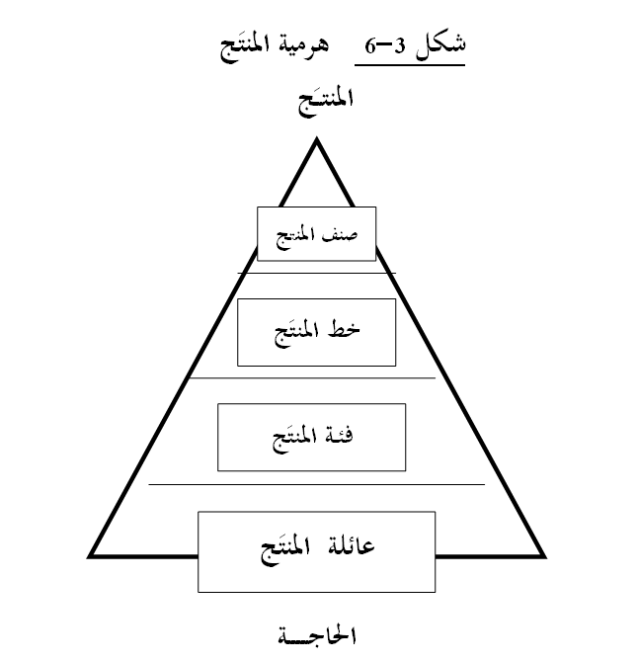
Setting Product Strategy
IV- THE PRODUCT HIERARCHY
هرمية المنتَج :
يرتبط كلّ منتوج هرميا بمنتجات أخرى، حيث يمكن معاينة ستة مستويات من هرمية المنتوج بدءا من الحاجة الأوّليّة المراد تلبيتها إلى المنتوج المعني بتلبية هذه الحاجة:-

Slide 47
Setting Product Strategy
IV- THE PRODUCT HIERARCHY
إذا كانت الحاجة هي: الأمل في المظهر الجميل
فعائلة المنتَج Product Family هي: كلّ فئات المنتَج التي بإمكانها تلبية الحاجة بطرق متفاوتة، كالرياضة، منتجات الزينة، الدواء، جراحة التجميل...
أمّا فئة المنتَج Product Class فهي: مجموعة المنتجات ضمن عائلة المنتج و التي لها قدرة معتبرة في تلبية الحاجة، منتجات الزينة مثلاُ.
في حين يعبّر خط المنتَج Product Line عن: مجموعة المنتجات ضمن فئة المنتج والتي ترتبط ببعضها ارتباطا وثيقا لأنّها ذات تأثير مماثل أو أنّها تباع لنفس الفئات من المستهلكين أو لأنّها توزّع عبر نفس المنافذ، كصابون الزّينة، أو العطور، أو المساحيق، و غيرها
صنف المنتَج Product Type فهو مجموع المنتجات ضمن خط المنتج و التي تشترك جميعها في الأشكال و المواصفات و الخصائص .

Slide 48
Setting Product Strategy
IV- THE PRODUCT HIERARCHY
قرارات مزيج المنتج :
يعرّف مزيج المنتج بأنّه عبارة عن تلك المجموعات من خطوط المنتوج و المنتجات المفردة التي تعرض أمام المشترين من طرف منتج أو بائع معيّن قصد إشباع حاجتهم .
و يعبّر عن خط المنتوج بمجموعة المنتجات المرتبطة ببعضها ارتباطا وثيقا من حيث أنّ لها تأثيرا مماثلا، أو أنّها تنتج من طرف منتِج واحد، أو لأنّها تباع لنفس الفئات من المستهلكين، أو لأنّها توزّع عن طريق نفس المنافذ.

Slide 49
Setting Product Strategy
IV- THE PRODUCT HIERARCHY
قرارات مزيج المنتج :
عند اتّخاذ القرارات التسويقية بخصوص مزيج المنتوج يجب التفريق بين:
- سعة مزيج المنتوج width، وتشير إلى عدد خطوط المنتوج التي تُؤدّيها
مؤسّسة ما،
- طول مزيج المنتوج length، وتشير إلى العدد الكلّي للمنتجات المفردة في
المزيج
- عمق مزيج المنتوج depth، وتشير إلى عدد الأشكال و النّماذج المختلفة
المقدّمة من كلّ منتوج مفرد
- تماسك مزيج المنتوج consistency، وتشير إلى مدى ارتباط مختلف خطوط
المنتوج من جهة الاستعمال، الإنتاج، التّوزيع، الخ

Slide 50
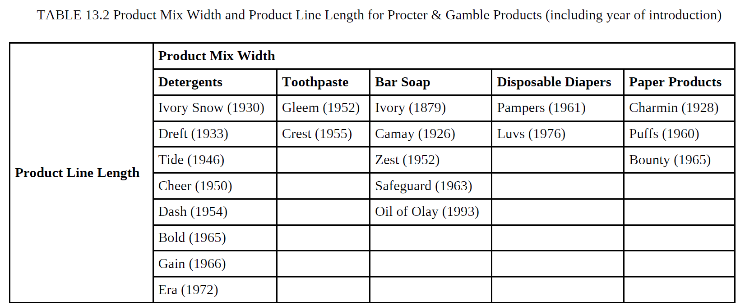
Setting Product Strategy
IV- THE PRODUCT HIERARCHY
قرارات مزيج المنتج :
عند اتّخاذ القرارات التسويقية بخصوص مزيج المنتوج يجب التفريق بين:
- سعة مزيج المنتوج width، وتشير إلى عدد خطوط المنتوج التي تُؤدّيها
مؤسّسة ما،
- طول مزيج المنتوج length، وتشير إلى العدد الكلّي للمنتجات المفردة في
المزيج
- عمق مزيج المنتوج depth، وتشير إلى عدد الأشكال و النّماذج المختلفة
المقدّمة من كلّ منتوج مفرد
- تماسك مزيج المنتوج consistency، وتشير إلى مدى ارتباط مختلف خطوط
المنتوج من جهة الاستعمال، الإنتاج، التّوزيع، الخ

Slide 51
Setting Product Strategy
IV- THE PRODUCT HIERARCHY
قرارات مزيج المنتج :
فالمؤسّسة تقرّر انطلاقا من إمكانياتها الخاصّة وظروف السّوق السّائدة إمّا توسعة مزيج منتوجها أو تضييقه بإضافة أو إنقاص بعض خطوط المنتجات، تطويل أو تقصير مزيج منتوجها بإضافة أو إلغاء بعض المنتجات المفردة، زيادة أو تخفيض عمق مزيج منتوجها بإضافة أشكال جديدة أو إلغاء أشكال قديمة، كما بإمكانها جعل مزيج منتوجها يكون أكثر أو أقلّ تركيزا.

Slide 52
Setting Product Strategy
IV- THE PRODUCT HIERARCHY
قرارات مزيج المنتج :
The product map shows the location of the various product line items of company X and four competitors, A, B, C, and D.

Slide 53
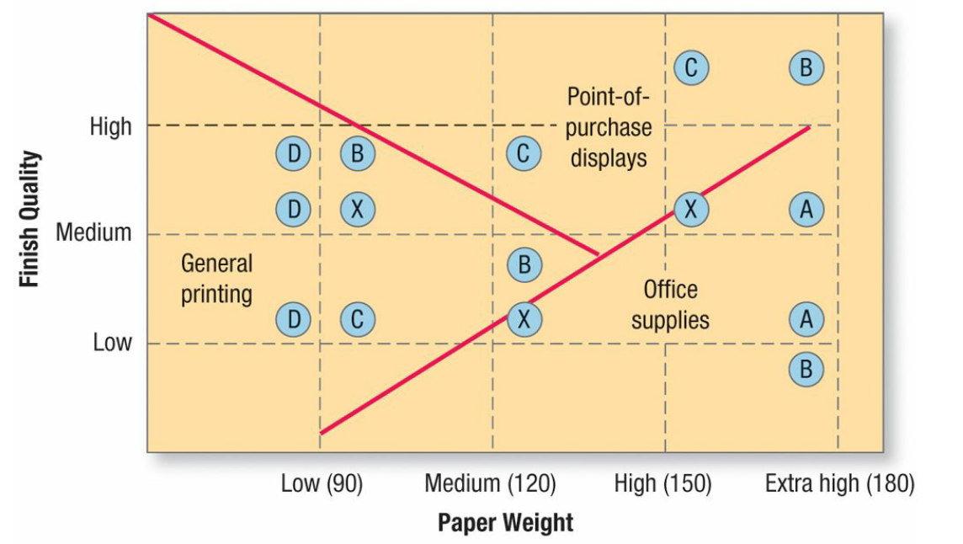
Setting Product Strategy
IV- THE PRODUCT HIERARCHY
قرارات مزيج المنتج :
فالمؤسّسة تقرّر انطلاقا من إمكانياتها الخاصّة وظروف السّوق السّائدة إمّا توسعة مزيج منتوجها أو تضييقه بإضافة أو إنقاص بعض خطوط المنتجات، تطويل أو تقصير مزيج منتوجها بإضافة أو إلغاء بعض المنتجات المفردة، زيادة أو تخفيض عمق مزيج منتوجها بإضافة أشكال جديدة أو إلغاء أشكال قديمة، كما بإمكانها جعل مزيج منتوجها يكون أكثر أو أقلّ تركيزا.

Slide 54
Setting Product Strategy
IV- THE PRODUCT HIERARCHY
قرارات مزيج المنتج :
The product map also shows which competitors’ items are competing against company X’s items. For example, company X’s low-weight, medium-quality paper competes against competitor D’s and B’s papers, but its highweight, medium-quality paper has no direct competitor. The map also reveals possible locations for new items. No manufacturer offers a high-weight, low-quality paper. If company X estimates a strong unmet demand and can produce this paper at low cost and price it accordingly, it could consider adding it to its line

Slide 55
Setting Product Strategy
IV- THE PRODUCT HIERARCHY
قرارات مزيج المنتج :
Another benefit of product mapping is that it identifies market segments. Figure 13.4 shows the types of paper, by weight and quality, preferred by the general printing industry, the point-ofpurchase display industry, and he office supply industry. The map shows that company X is well positioned to serve the needs of the general printing industry but less effective in serving the other two markets. Product line analysis provides information for two key decision areas: product line length and product mix pricing.

Slide 56
Setting Product Strategy
V- Packaging, Labeling, Warranties, and Guarantees
1- Packaging
Packaging includes all the activities of designing and producing the container for a product.
Packages might have up to three layers. Cool Water by Davidoff For Men cologne comes in a bottle (primary package) inside a cardboard box (secondary package), shipped in a corrugated box (shipping package) containing six dozen bottles in cardboard boxes.

Slide 57
Setting Product Strategy
V- Packaging, Labeling, Warranties, and Guarantees
1- Packaging
Packaging is important because it is the buyer’s first encounter with the product. A good package draws the consumer in and encourages product choice. In effect, it can act as a “fivesecond commercial” for the product. It also affects consumers’ later product experiences when they open it and use what’s inside. Some packages can even be attractively displayed at home.
Distinctive packaging is an important part of a brand’s equity.

Slide 58
Setting Product Strategy
V- Packaging, Labeling, Warranties, and Guarantees
1- Packaging
Several factors contribute to the growing use of packaging as a marketing tool:
644P.

Slide 59
Setting Product Strategy
V- Packaging, Labeling, Warranties, and Guarantees
1- Packaging
Formally, packaging must achieve a number of objectives:
1. Identify the brand.
2. Convey descriptive and persuasive information.
3. Facilitate product transportation and protection.
4. Assist at-home storage.
5. Aid product consumption.

Slide 60
Setting Product Strategy
V- Packaging, Labeling, Warranties, and Guarantees
1- Packaging
To achieve these objectives and satisfy consumers’ desires, marketers must choose the functional and aesthetic components of packaging correctly. Functionally, structural design is crucial. The packaging elements must harmonize with each other and with pricing, advertising, and other parts of the marketing program. Aesthetic considerations relate to a package’s size and shape, material, color, text, and graphics.

Slide 61
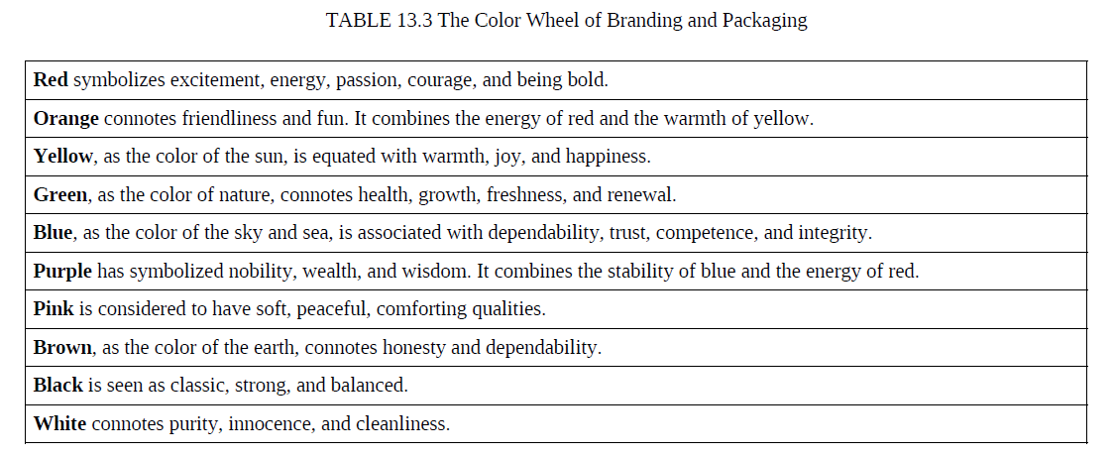
Setting Product Strategy
V- Packaging, Labeling, Warranties, and Guarantees
1- Packaging
To achieve these objectives and satisfy consumers’ desires, marketers must choose the functional and aesthetic components of packaging correctly. Functionally, structural design is crucial. The packaging elements must harmonize with each other and with pricing, advertising, and other parts of the marketing program. Aesthetic considerations relate to a package’s size and shape, material, color, text, and graphics.

Slide 62
Setting Product Strategy
V- Packaging, Labeling, Warranties, and Guarantees
1- Packaging
After the company designs its packaging, it must test it. Engineering tests ensure that the package stands up under normal conditions; visual tests, that the script is legible and the colors harmonious; dealer tests, that dealers find the packages attractive and easy to handle; and consumer tests, that buyers will respond favorably.

Slide 63
Setting Product Strategy
V- Packaging, Labeling, Warranties, and Guarantees
1- Packaging
Although developing effective packaging may require several months and several hundred thousand dollars, companies must consider growing environmental and safety concerns about excess and wasteful packaging. Fortunately, as discussed above, many firms have gone “green” and are finding creative new ways to package their wares.

Slide 64
Setting Product Strategy
V- Packaging, Labeling, Warranties, and Guarantees
2- LABELING
The label can be a simple attached tag or an elaborately designed graphic that is part of the package. It might carry a great deal of information, or only the brand name. Even if the seller prefers a simple label, the law may require more.

Slide 65
Setting Product Strategy
V- Packaging, Labeling, Warranties, and Guarantees
2- LABELING
A label performs several functions. First, it identifies the product or brand. It might also grade the product; canned peaches are grade labeled A, B, and C. The label might describe the product: who made it, where and when, what it contains, how it is to be used, and how to use it safely. Finally, the label might promote the product through attractive graphics.

Slide 66
Setting Product Strategy
V- Packaging, Labeling, Warranties, and Guarantees
2- LABELING
Labels eventually need freshening up. The label on Ivory soap has been redone at least 18 times since the 1890s, with gradual changes in the size and design of the letters. Companies with labels that have become icons need to tread very carefully in order to preserve key branding elements when undertaking a redesign.

Slide 67
Setting Product Strategy
V- Packaging, Labeling, Warranties, and Guarantees
2- LABELING
A long history of legal concerns surrounds labels and packaging. In 1914, the Federal Trade Commission Act held that false, misleading, or deceptive labels or packages constitute unfair competition. The Food and Drug Administration (FDA) has required processed-food producers to include nutritional labeling that clearly states the amounts of protein, fat, carbohydrates, and calories contained in products, as well as vitamin and mineral content as a percentage of the recommended daily allowance.

Slide 68
Setting Product Strategy
V- Packaging, Labeling, Warranties, and Guarantees
3- WARRANTIES AND GUARANTEES
All sellers are legally responsible for fulfilling a buyer’s normal or reasonable expectations.
Warranties are formal statements of expected product performance by the manufacturer. Products under warranty can be returned to the manufacturer or designated repair center for repair, replacement, or refund. Whether expressed or implied, warranties are legally enforceable.

Slide 69
Setting Product Strategy
V- Packaging, Labeling, Warranties, and Guarantees
3- WARRANTIES AND GUARANTEES
Many sellers offer either general or specific guarantees. A company such as Procter & Gamble promises general or complete satisfaction without being more specific—“If you are not satisfied for any reason, return for replacement, exchange, or refund.” A.T. Cross guarantees its Cross pens and pencils for life. The customer mails the pen to A.T. Cross and the pen is repaired or replaced at no charge.

Slide 70
Setting Product Strategy
V- Packaging, Labeling, Warranties, and Guarantees
3- WARRANTIES AND GUARANTEES
Guarantees reduce the buyer’s perceived risk. They suggest that the product is of high quality and the company and its service performance are dependable. They can be especially helpful when the company or product is not well known or when the product’s quality is superior to that of competitors. Hyundai’s and Kia’s highly successful 10-year or 100,000-mile power train warranty programs were designed in part to assure potential buyers of the quality of the products and the companies’ stability..

Slide 71
Setting Product Strategy
VI- Branding
One of the most valuable intangible assets of a firm is its brands. Building a strong brand is both an art and a science. It requires careful planning, a deep long-term commitment, and creatively designed and executed marketing. A strong brand commands intense consumer loyalty—and at its heart is a great product or service. Building a strong brand is a never-ending process.

Slide 72
Setting Product Strategy
VI- Branding
Strategic brand management combines the design and implementation of marketing activities and programs to build, measure, and manage brands to maximize their value. It has four main steps:
Identifying and establishing brand positioning
Planning and implementing brand marketing
Measuring and interpreting brand performance
Growing and sustaining brand value

Slide 73
Setting Product Strategy
VI- Branding
The American Marketing Association defines a brand as
“a name, term, sign, symbol, or design, or a combination of them, intended to identify the goods or services of one seller or group of sellers and to differentiate them from those of competitors.”

Slide 74
Setting Product Strategy
VI- Branding
The American Marketing Association defines a brand as
“اسم أو مصطلح أو علامة أو رمز أو تصميم، أو مزيج منها، يهدف إلى التعريف بسلع أو خدمات بائع واحد أو مجموعة من البائعين وتمييزها عن سلع أو خدمات المنافسين.”

Slide 75
Setting Product Strategy
VI- Branding
A brand is thus a product or service whose dimensions differentiate it in some way from other products or services designed to satisfy the same need. These differences may be functional, rational, or tangible— related to product performance of the brand. They may also be more symbolic, emotional, or intangible—related to what the brand represents or means in a more abstract sense.

Slide 76
Setting Product Strategy
VI- Branding
وبالتالي فإن العلامة التجارية هي منتج أو خدمة تتميز أبعادها بطريقة ما عن المنتجات أو الخدمات الأخرى المصممة لتلبية نفس الحاجة. وقد تكون هذه الاختلافات وظيفية أو عقلانية أو ملموسة - تتعلق بأداء المنتج. وقد تكون أيضًا رمزية أو عاطفية أو غير ملموسة - تتعلق بما تمثله العلامة التجارية أو تعنيه بمعنى أكثر تجريدًا.

Slide 77
Setting Product Strategy
VI- Branding
1- THE ROLE OF BRANDS:
Brands identify the maker of a product and allow consumers to assign responsibility for its performance to that maker or distributor. Brands perform a number of functions for both consumers and firms:

Slide 78
Setting Product Strategy
VI- Branding
FOR CONSUMERS:
Consumers may evaluate the identical product differently depending on how it is branded. They learn about brands through past experiences with the product and its marketing program, finding out which brands satisfy their needs and which do not. As consumers’ lives become more rushed and complicated, a brand’s ability to simplify decision making and reduce risk becomes invaluable.

Slide 79
Setting Product Strategy
VI- Branding
FOR CONSUMERS:
A brand is a promise between the firm and the consumer. It is a means to set consumers’ expectations and reduce their risk. In return for customer loyalty, the firm promises to reliably deliver a predictably positive experience and set of desirable benefits with its products and services. A brand fulfills or exceeds customer expectations in satisfying their needs and wants.

Slide 80
Setting Product Strategy
VI- Branding
FOR CONSUMERS:
Brands can also take on personal meaning to consumers and become an important part of their identity. They can express who consumers are or who they would like to be. For some consumers, brands can even take on human-like characteristics. Brand relationships, like any relationship, are not cast in stone, and marketers must be sensitive to all the words and actions that might strengthen or weaken consumer ties.

Slide 81
Setting Product Strategy
VI- Branding
FOR FIRMS:
Brands simplify product handling by helping organize inventory and accounting records. A brand also offers the firm legal protection for unique features or aspects of the product. The brand name can be protected through registered trademarks, manufacturing processes can be protected through patents, and packaging can be protected through copyrights and proprietary designs.

Slide 82
Setting Product Strategy
VI- Branding
FOR FIRMS:
A credible brand signals a certain level of quality so satisfied buyers can easily choose the product again. Brand loyalty provides predictability and security of demand for the firm, and it creates barriers to entry that make it difficult for other firms to enter the market. Loyalty also can translate into customer willingness to pay a higher price—often even 20 percent to 25 percent more than competing brands

Slide 83
Setting Product Strategy
VI- Branding
FOR FIRMS:
Although competitors may duplicate manufacturing processes and product designs, they cannot easily match lasting impressions left in the minds of individuals and organizations by years of favorable product experiences and marketing activity. In this sense, branding can be a powerful means to secure a competitive advantage. Sometimes marketers don’t see the real importance of brand loyalty until they change a crucial element of the brand, as the classic tale of New Coke illustrates

Slide 84
Setting Product Strategy
في عام 1985 قررت شركة كوكاكولا استبدال تركيبتها القديمة بنوع أكثر حلاوة أطلقت عليه اسم "نيو كوك". وقد أنفقت الشركة 4 ملايين دولار على أبحاث السوق، وأظهرت اختبارات التذوق العمياء أن شاربي كوكاكولا يفضلون التركيبة الجديدة الأكثر حلاوة. ولكن إطلاق كوكاكولا الجديدة أثار ضجة وطنية. فقد قام باحثو السوق بقياس الطعم ولكنهم فشلوا في قياس الارتباط العاطفي الذي يكنه المستهلكون لكوكاكولا بشكل كافٍ. وكانت هناك رسائل غاضبة واحتجاجات رسمية وحتى تهديدات بالدعاوى القضائية لإجبار الشركة على الاحتفاظ بـ "الشيء الحقيقي". وبعد عشرة أسابيع، أعادت الشركة تقديم تركيبتها التي يبلغ عمرها قرنًا من الزمان باسم "كلاسيك كوك". وفي النهاية فشلت الجهود الرامية إلى إحياء كوكاكولا الجديدة، واختفت العلامة التجارية حوالي عام 1992. ومن عجيب المفارقات أن فشل طرح كوكاكولا الجديدة انتهى في الواقع إلى إعطاء التركيبة القديمة مكانة أقوى بشكل ملموس في السوق، مع مواقف أكثر إيجابية ومبيعات أكبر نتيجة لذلك.

Slide 85
Setting Product Strategy
VI- Branding
FOR FIRMS:
For better or worse, branding effects are pervasive. One research study, that provoked much debate about the effects of marketing on children, showed that preschoolers felt identical food items—even carrots, milk, and apple juice—tasted better when wrapped in McDonald’s familiar packaging than when in unmarked wrappers

Slide 86
Setting Product Strategy
VI- Branding
1- THE ROLE OF BRANDS:
Brands identify the maker of a product and allow consumers to assign responsibility for its performance to that maker or distributor. Brands perform a number of functions for both consumers and firms:

Slide 87
Setting Product Strategy
VI- Branding
2- THE SCOPE OF BRANDING
Branding is the process of endowing products and services with the power of a brand. It’s all about creating differences between products. Marketers need to teach consumers “who” the product is—by giving it a name and other brand elements to identify it—as well as what the product does and why consumers should care. Branding creates mental structures that help consumers organize their knowledge about products and services in a way that clarifies their decision making and, in the process, provides value to the firm.

Slide 88
Setting Product Strategy
VI- Branding
2- THE SCOPE OF BRANDING
For branding strategies to be successful and brand value to be created, consumers must be convinced there are meaningful differences among brands in the product or service category. Brand differences often relate to attributes or benefits of the product itself.

Slide 89
Setting Product Strategy
VI- Branding
2- THE SCOPE OF BRANDING
Marketers can apply branding anywhere a consumer has a choice. It’s possible to brand a physical good, a service, a store, a person, a place, an organization, or an idea.
Branding has become of great importance in sports, arts, and entertainment. One of the world’s top sports brands comes from Madrid, Spain….PP.503

Slide 90
Setting Product Strategy
VI- Branding
3- Brand Equity
Brand equity is the added value endowed to products and services with consumers. It may be reflected in the way consumers think, feel, and act with respect to the brand, as well as in the prices, market share, and profitability it commands.

Slide 91
Setting Product Strategy
VI- Branding
3- Brand Equity
Marketers use various perspectives to study brand equity. Customer-based approaches view it from the perspective of the consumer—either an individual or an organization —and recognize that the power of a brand lies in what customers have seen, read, heard, learned, thought, and felt about the brand over time (Customers’ brand knowledge).

Slide 92
Setting Product Strategy
VI- Branding
3- Brand Equity
A brand has positive customer-based brand equity when consumers react more favorably to a product and the way it is marketed.
A brand has negative customer-based brand equity if consumers react less favorably to marketing activity for the brand.

Slide 93
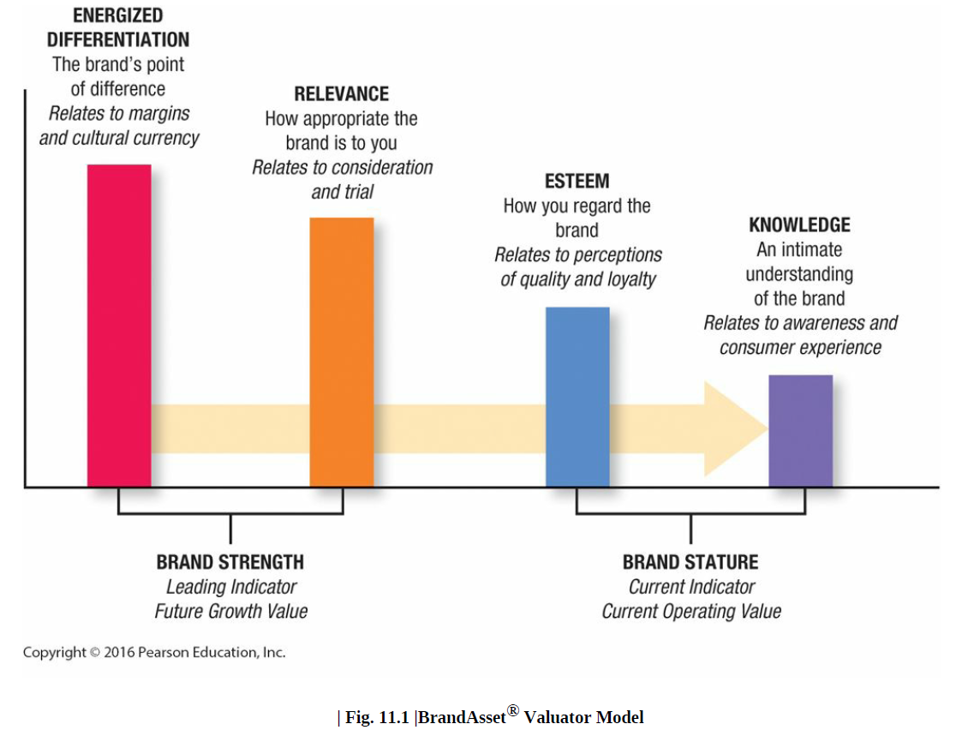
Setting Product Strategy
VI- Branding
3- Brand Equity
A brand has positive customer-based brand equity when consumers react more favorably to a product and the way it is marketed.
A brand has negative customer-based brand equity if consumers react less favorably to marketing activity for the brand.
There are three key ingredients of customer-based brand equity:

Slide 94
Setting Product Strategy
VI- Branding
3- Brand Equity
Marketers build brand equity by creating the right brand knowledge structures with the right consumers. The success of this process depends on all brand-related. There are three main sets of brand equity drivers:

Slide 95
Setting Product Strategy
VI- Branding
3- Brand Equity
The initial choices for the brand elements or identities making up the brand (brand names, URLs, logos, symbols, characters, spokespeople, slogans, jingles, packages, and signage)

Slide 96
Setting Product Strategy
VI- Branding
3- Brand Equity
The product and service and all accompanying marketing activities and supporting marketing programs.

Slide 97
Setting Product Strategy
VI- Branding
3- Brand Equity
Other associations indirectly transferred to the brand by linking it to some other entity (a person, place, or thing)

Slide 98
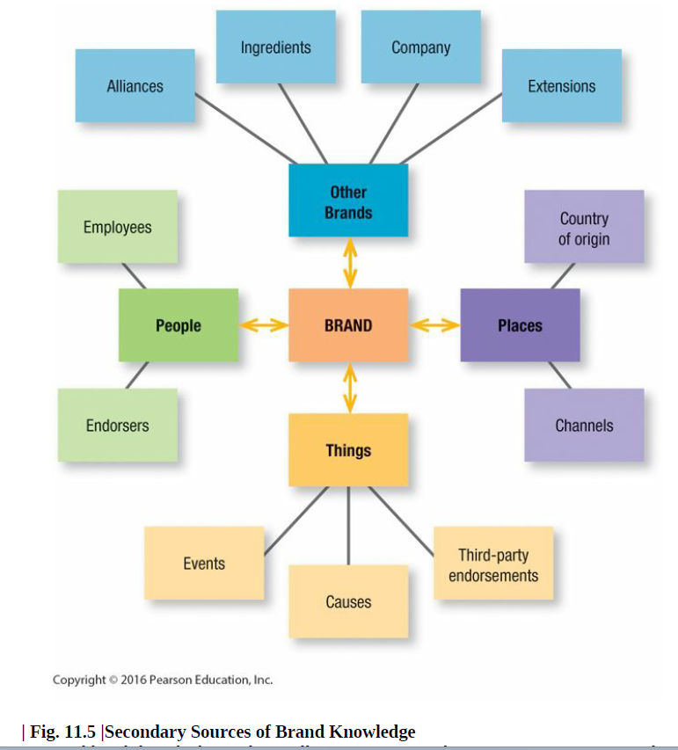
Setting Product Strategy
VI- Branding
3- Brand Equity
Other associations indirectly transferred to the brand by linking it to some other entity (a person, place, or thing)

Slide 99
Setting Product Strategy
VI- Branding
3- Brand Equity
A brand can be stretched. All the segments the firm would like to target may not view the same brand equally favorably. Marketers often need multiple brands in order to pursue these multiple segments.
Some other reasons for introducing multiple brands in a category include:

Slide 100
Setting Product Strategy
VI- Branding
3- Brand Equity
1. Increasing shelf presence and retailer dependence in the store
2. Attracting consumers seeking variety who may otherwise have switched to another brand
3. Increasing internal competition within the firm
4. Yielding economies of scale in advertising, sales, merchandising, and physical distribution

Slide 101
Setting Product Strategy
VI- Branding
4- Brand portfolio
The brand portfolio is the set of all brands and brand lines a particular firm offers for sale in a particular category or market segment.

