Slide 1
Lecture
Dr. Benacer Hamza
2024-2025

Slide 2
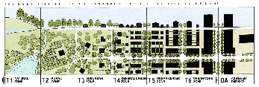
4. The principles of urbanism ?

Slide 3
4. The principles of urbanism
Sustainability
Urban development should be sustainable, taking into account the environmental impact of cities.
Accessibility
Cities should be designed to be accessible to everyone, regardless of their age, ability, or income.
Diversity
Cities should be diverse, with a mix of different land uses, housing types, and people.
Connectivity
Cities should be well-connected, with a network of streets, sidewalks, and public transportation that allows people to move around easily.
Placemaking
Cities should be designed to create places that are attractive, comfortable, and safe
the most important ones

Slide 4
5. What are the key concepts in urbanism?
Urban design
The city as a system
Sustainable urban development
Urban planning
built environment
Urbanization
Urban form
New Urbanism

Slide 5
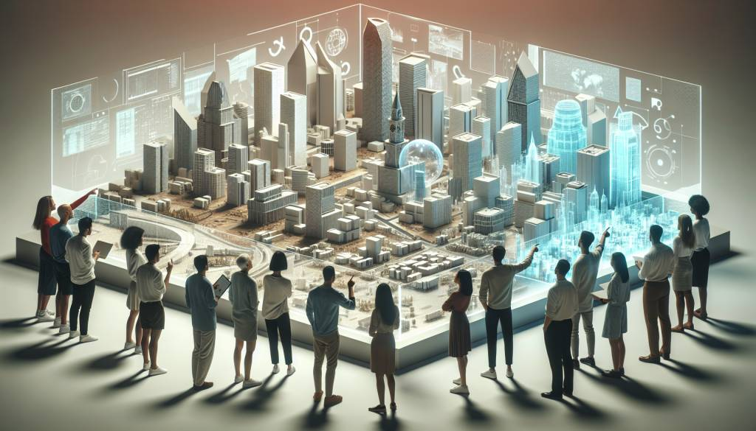
The future of urbanism ?

Slide 6
