Slide 1
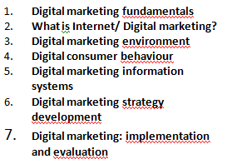
Digital Marketing
Digital marketing fundamentals:
ICT ; Internet; Marketing
What is Internet/ Digital marketing?
the digital marketing environment
the digital consumer behaviour
Digital marketing information systems
Digital marketing strategy development
Digital marketing strategy
digital marketing mix
E-Relationship marketing
Digital marketing: implementation and practice
Digital marketing: Evaluation and Improvement

Slide 2
The digital marketing environment
I- Definitions
The digital marketing environment refers to the contexts in which firms operate. It involves two major elements:
Micro-environment: (The operating environment). It focuces on the players (stakeholders) and their interactions which influence how an organisation responds in its marketplace.
Macro-environment: (the remote environment) Broad forces affecting all organisations in the marketplace, including social, technological, economic, political, legal and ecological influences.

Slide 3
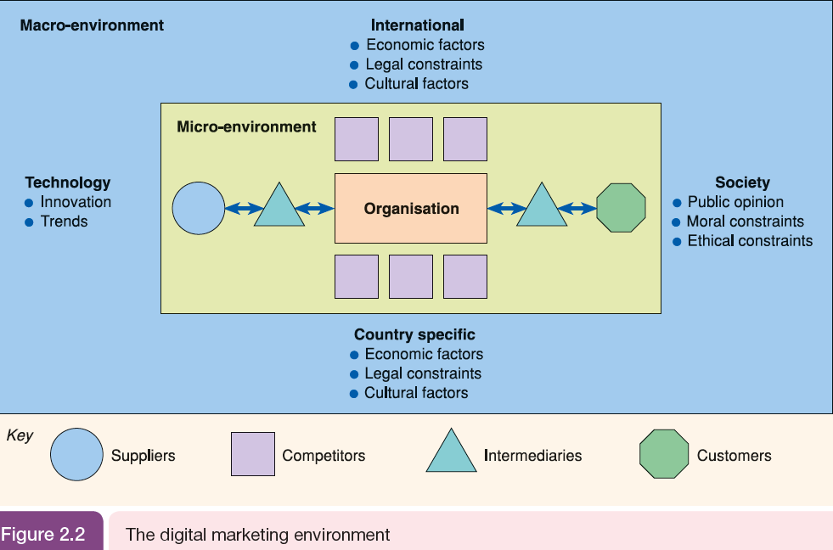
The digital marketing environment

Slide 4
The digital marketing environment
Market analysis: The environment can have a profound impact on performance; consequently an organisation should continually monitor the environment (micro and macro). This process is called environmental scanning, or market analysis.
Online market analysis: helps to define the nature of the e-competitive market (the click ecosystem).

Slide 5
The digital marketing environment
Click Ecosystem describes the flow of online visitors between search engines, media sites, other intermediaries to an organisation and its competitors.
Online market ecosystem is the connection of websites through data exchange, giving opportunities to enhance the customer experience and extend their reach and influence.
Facebook platform is an ecosystem that enables other site owners to incorporate information about consumer Facebook interactions into their own websites and apps and share social objects across the Facebook ecosystem to extend their reach
Google Android ecosystem is Google`s ecosystem

Slide 6
The digital marketing environment
Companies have to evaluate the
relative importance of these ecosystems and the resources they need to put into integrating
their online services with them.

Slide 7
The digital marketing environment
II- Customer journeys
Customer journeys is a term used to describe ‘touchpoints’ or different types of paid, owned and earned media which influence consumers as they access different types of website and content when selecting products and services.
Customer journey maps: to help understand different customer journeys to purchase, customer journey maps are a technique used to model behaviour of different audience personas
An example of a customer journey map

Slide 8
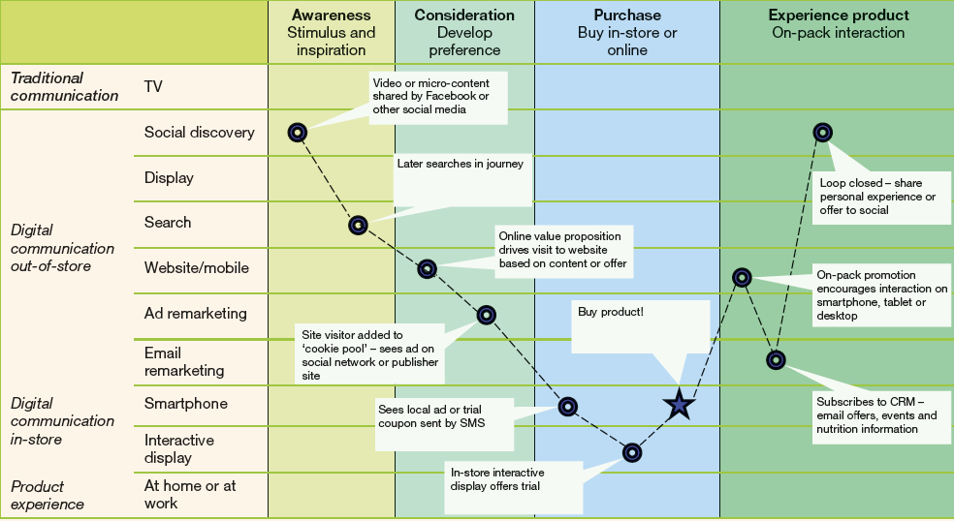
The digital marketing environment
II- Customer journeys

Slide 9
The digital marketing environment
II- Customer journeys
Google has developed a retail-specific model for understanding customer journeys, widely discussed in marketing known as the Zero Moment of Truth
(ZMOT) A summary of today’s multichannel consumer decision making for product purchase where they search, review ratings, styles, prices comments on social media before visiting a retailer.

Slide 10
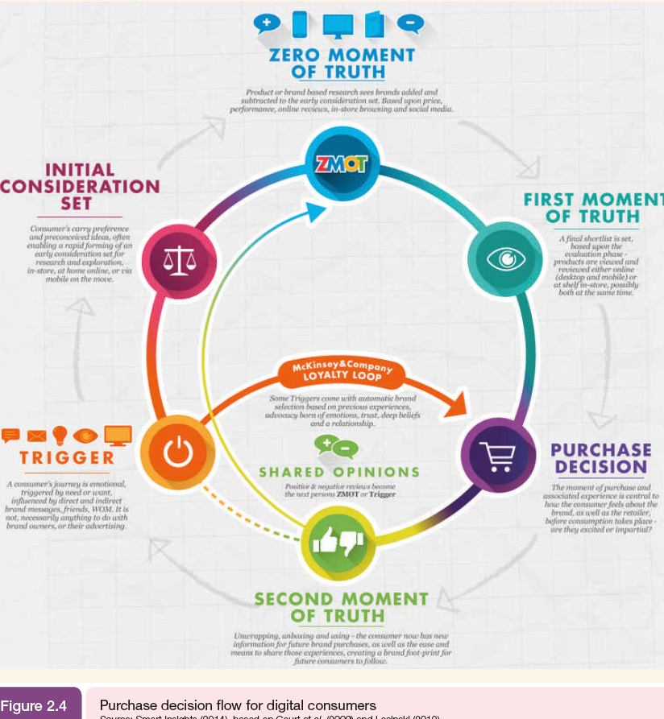

Slide 11
The digital marketing environment
II- Customer journeys
A consumer`s journey is emotional, trigged by need or want, influenced by direct and indirect brand messages, friends, WOM. It is not necessarily anything to do with brand owners, or their advertising
رحلة المستهلك هي عاطفية، تنشأ بفعل الحاجة أو الرغبة، وتتأثر بالرسائل المباشرة وغير المباشرة للعلامة التجارية، والأصدقاء، وتداول الخبرات الإيجابية أو السلبية حولها. ولا يرتبط ذلك بالضرورة بأصحاب العلامات التجارية أو إعلاناتهم

Slide 12
The digital marketing environment
II- Customer journeys
Consumer`s preconceived ideas, often enabling a rapid forming of an early consideration set for research and exploration, in store, at home online, or via mobile on the move
الأفكار المسبقة لدى المستهلكين، في كثير من الأحيان تمكن من تكوين مجموعة من التفكير المبكر للبحث والاستكشاف، في المتاجر أو عند البيت عبر الإنترنت أو عن طريق الجوال أثناء التنقل

Slide 13
The digital marketing environment
II- Customer journeys
Product or brand based research ssss brands added and subtracted to the early consideration set. Based upon price, performance, online reviews, in-store brousing and social media
البحث المستند إلى المنتج أو العلامة التجارية يؤدي إلى إضافة وإزالة العلامات التجارية من مجموعة التفكير المبكرة، استنادًا إلى السعر والأداء والمراجعات عبر الإنترنت وتصفح المتاجر ووسائل التواصل الاجتماعي.

Slide 14
The digital marketing environment
II- Customer journeys
A final shortlist is set. Based upon the evaluation phase, products are viewed and reviewed either online {desktop and mobile} or at shelf in store, possibly both at the same time
تتم تحديد قائمة مختصرة نهائية. استنادًا إلى مرحلة التقييم، يتم استعراض المنتجات إما عبر الإنترنت {على أجهزة سطح المكتب والجوال} أو في الرف في المتجر، وربما يتم القيام بكليهما في نفس الوقت.

Slide 15
The digital marketing environment
II- Customer journeys
The moment of purchase and associated experience is central to how the consumer feels about the brand, as well as the retailer, before consumption takes place, are they excited or impartial
لحظة الشراء والتجربة المرتبطة بها تعتبر محورية فيما يتعلق بمدى إحساس المستهلك بالعلامة التجارية، وكذلك بالنسبة للبائع، قبل حدوث الاستهلاك، فهل يشعر المستهلك بالحماس أو بالانزعاج؟

Slide 16
The digital marketing environment
II- Customer journeys
Unwrapping, unboxing and using, the consumer now has new information for future brand purchases, as well as the case and means to share those experiences, creating a brand foot print for future consumers to follow
بعد فتح العبوة، واستخدام المنتج، يكتسب المستهلك معلومات جديدة للمشتريات العلامات التجارية المستقبلية، بالإضافة إلى القدرة والوسائل لمشاركة تلك الخبرات، مما يخلق آثارًا دائمة للعلامة التجارية ليتبعها المستهلكون المستقبليون.

Slide 17
The digital marketing environment
II- Customer journeys
Some triggers come with automatic brand selection based on previews experiences, advocacy born of emotions, trust, deep beliefs and relationship
تأتي بعض الحوافز مع اختيار العلامة التجارية التلقائي استنادًا إلى الخبرات السابقة، والدعم الناتج عن العواطف، والثقة، والمعتقدات العميقة، والعلاقة.

Slide 18
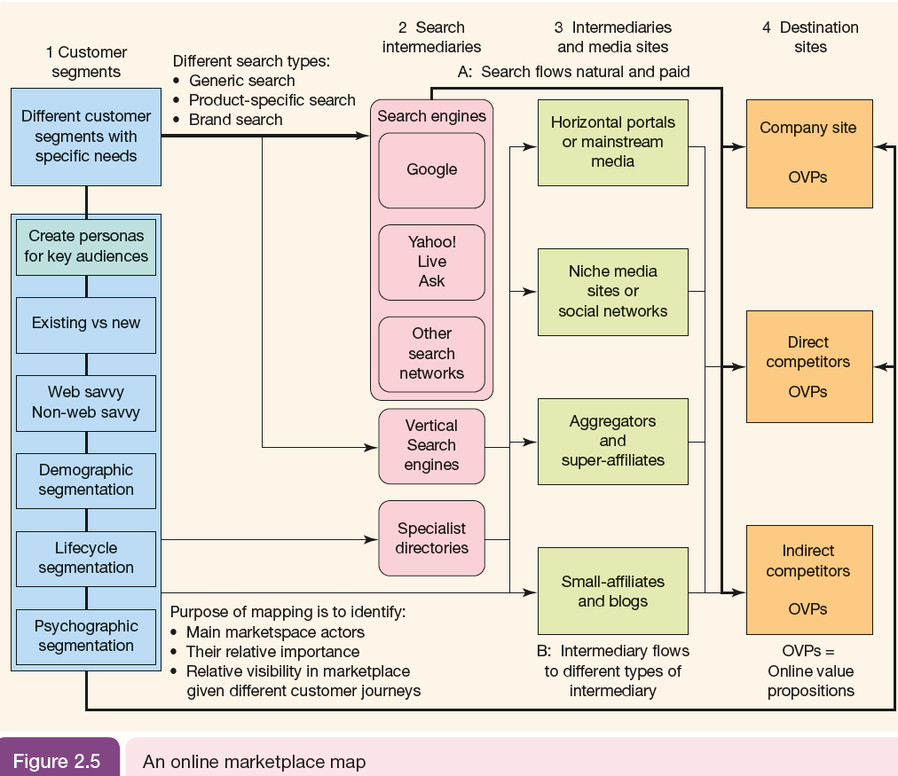

Eater
TechCrunch

Slide 19
The digital marketing environment
II- Customer journeys
Lifecycle segmentation is a marketing strategy that involves dividing a target audience into distinct groups based on where they are in the customer journey or product lifecycle. The customer lifecycle typically consists of several stages, such as awareness, consideration, purchase, retention, and advocacy.
The purpose of lifecycle segmentation is to create targeted marketing campaigns and messages that are relevant to each stage of the customer journey. For example, customers in the awareness stage may require different messaging than those in the retention stage. By tailoring marketing messages to each stage, marketers can improve engagement, increase conversions, and build stronger relationships with customers.

Slide 20
The digital marketing environment
II- Customer journeys
Vertical search engines, also known as specialized or topical search engines, are search engines that focus on specific industries, topics, or types of content. Unlike general search engines like Google or Bing, which index and search the entire web, vertical search engines limit their scope to a particular niche. (LinkedIn, Expedia….)
Specialist directories are online directories that focus on a specific industry, topic, or type of content. These directories are similar to vertical search engines, but they often function as a more structured way to organize and display information about a particular niche. (Business directories like Yelp or Yellow Pages, industry-specific directories like Thomas Net or TechCrunch, which focus on particular industries or technologies….)

