Slide 1
Lecture 2:
Dr. Benacer Hamza
2024-2025

Slide 2

2.Drawing and Planning strategies
Central Point
Example of Garden City
Axial Repartition

Slide 3
Urbanists are interested in the physical, social, and economic dimensions of urban life. They study how the built environment shapes our lives, and how our lives in turn shape the built environment. They also consider the environmental, political, and cultural aspects of urbanism.
Urbanism is a rapidly growing field, as the world's population continues to urbanize. Urbanists play an important role in shaping the future of our cities, and in making them more livable, sustainable, and equitable places to live.

Slide 4
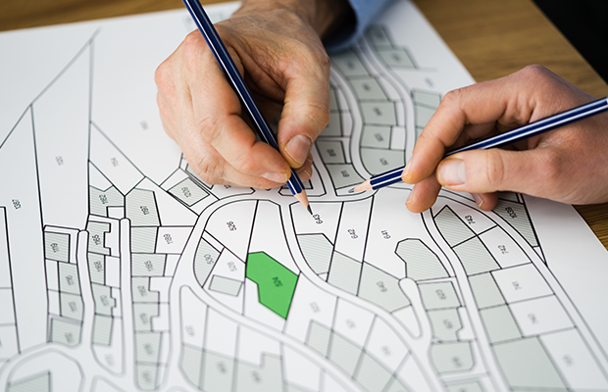
Planner/ Designer/ Architect
Different scales different Intervention

Slide 5
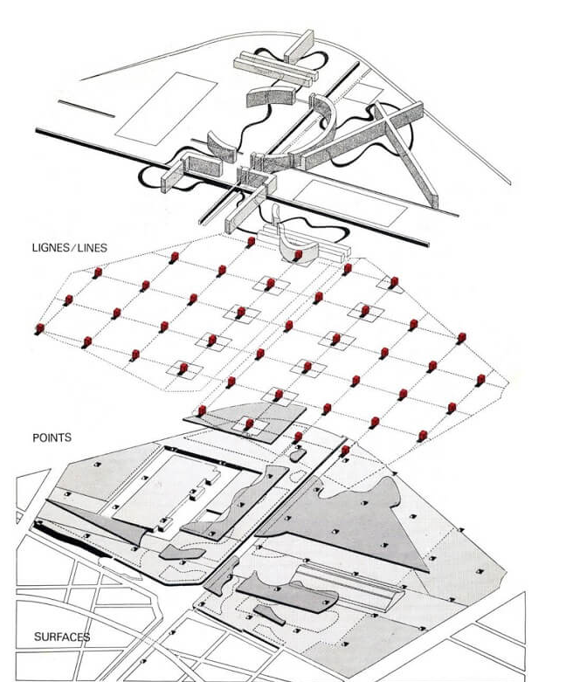
Roads/ Patters
Points
Surfaces
Path

Slide 6
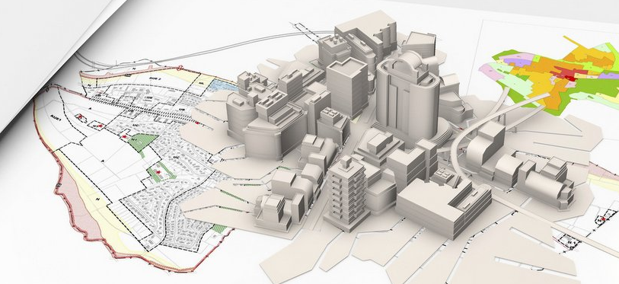
rapidly growing field, as the world's population continues to urbanize. Urbanists play an important role in shaping the future of our cities, and in making them more
livable,
sustainable,
and equitable
places to live.

