Slide 1
Lecture 1: Details on urbanism
Dr. Benacer Hamza
2023-2024

Slide 2
5. What are the key concepts in urbanism?
Urban design
The city as a system
Sustainable urban development
Urban planning
built environment
Urbanization
Urban form
New Urbanism

Slide 3
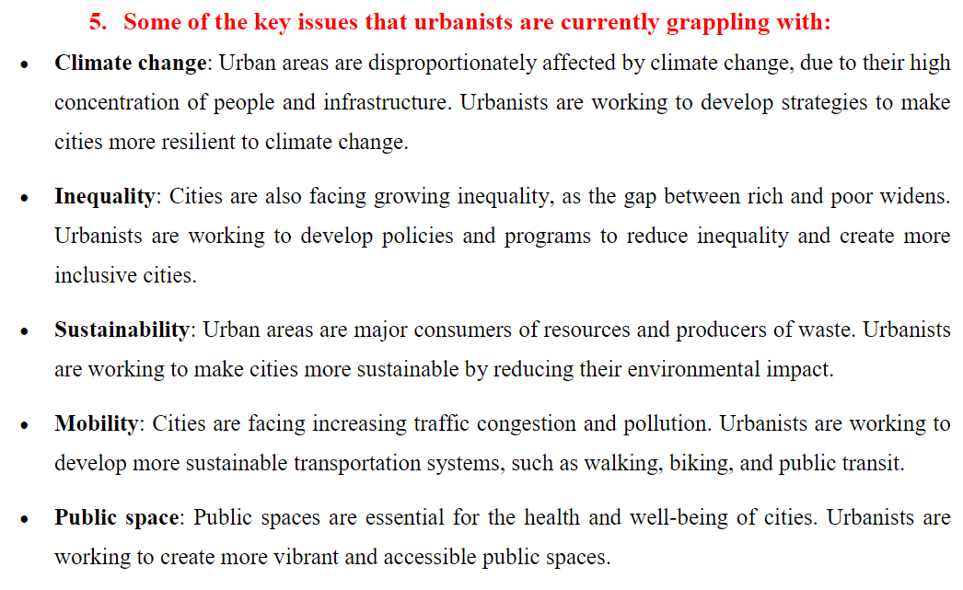

Slide 4
