Slide 1

Course Title: Ethnography of Communication (EoC)
S.P.E.A.K.I.N.G Grid

Slide 2
Objectives of the course:
Demystify the notions of: Communicative repertoire, Speech situation, speech event and Speech act
2. Discuss the S.P.E.A.K.I.N.G framework and its basic goals
in the EoC enquiry
3. Discuss an example of EoC : The Kuna Gatherings (Sherzer)

Slide 3
Code switching
Non verbal features
Lexis,
phonology,…etc
Ethnolects
languages
Communicative Repertoire
Speaking styles
Register
Greetings, address forms

Slide 4
So,
How can we examine the components of Communicative repertoire?

Slide 5
Speech Situation
Speech events
Speech acts

Slide 6
Speech situation:
situational factors:
Physicality
topic
interlocutors
Examples: marriage party, political party, stand up comedy,

Slide 7
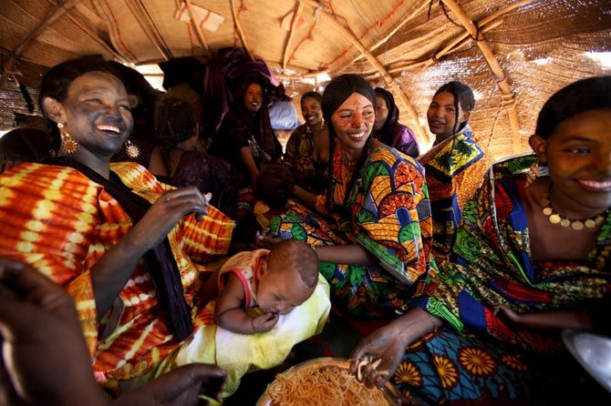
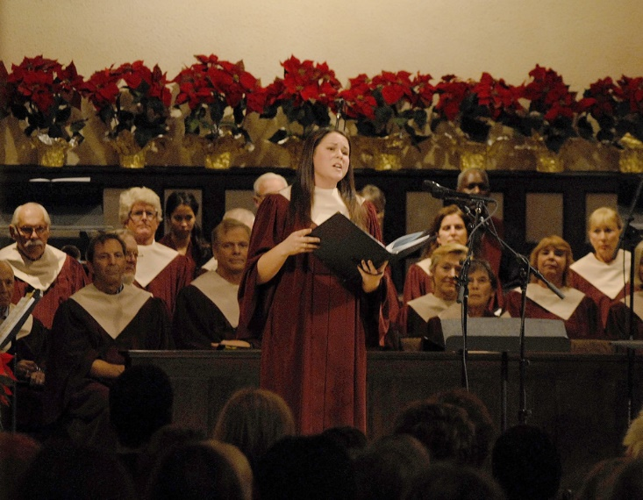
Naming rituals
Church Choir

Slide 8
Speech events
What is meant by a Speech event?
examples: greetings; telling jokes; job interview, Duaa (invocation)
Characteristics:
-Same purpose of communication
-same topic
-same participants
-same language (variety)

Slide 9
Speech act:
Actions performed via utterance (complimenting, apologizing, request, pre request
E.g., “you are fired”; dude! “you are looking good”!
Speech act vs simple grammatical sentence!

Slide 10
What is meant by S.P.E.A.K.I.N.G Grid
Trial / Lecture / Marriage party

Slide 11
S.P.E.A.K.I.N.G
Setting:
Or the physical setting, including the place/ time and any other relevant descriptions
Scene:
The “‘psychological setting’ or the cultural definition of an occasion as a certain type of scene.”

Slide 12
S.P.E.A.K.I.N.G
Participants:
Refers to the people involved in the communication event. Such participants are identified not by their names, but by their role or status or station. Addressor- addressee- speaker, hearer, receiver, sender.

Slide 13
S.P.E.A.K.I.N.G
END/ OUTCOMES:
Ends are the purposes involved in the speech event.
There are the outcomes of the speech event.

Slide 14
S.P.E.A.K.I.N.G
Act sequence: form and content.
-STYLISTIC FACTORS: e.g., directness vs. indirectness
-TOPIC

Slide 15
S.P.E.A.K.I.N.G
Key:
(“tone, manner, or spirit” of the event.”) General emotional feeling or emotion of the speech event.
Is the tone serious or joking, or playful, light-hearted, precise, mocking, sarcastic, pompous?

Slide 16
S.P.E.A.K.I.N.G
Instrumentalities:
Channels: written, oral, gestural
Modes: singing, chanting, dancing, printed,…etc

Slide 17
S.P.E.A.K.I.N.G
Norms:
rules of interaction and interpretation.

Slide 18
S.P.E.A.K.I.N.G
Genre:
Categories of talk (or communication)
  e.g., prayer, fable, poem, myth, tale, proverb, adage, riddle, curse, oration, lecture, commercial, form letter, editorial, etc.
  Movies: crime, romance, SCI-FIC,…..etc
  Articles: books reviews, ,…..etc

