Slide 1
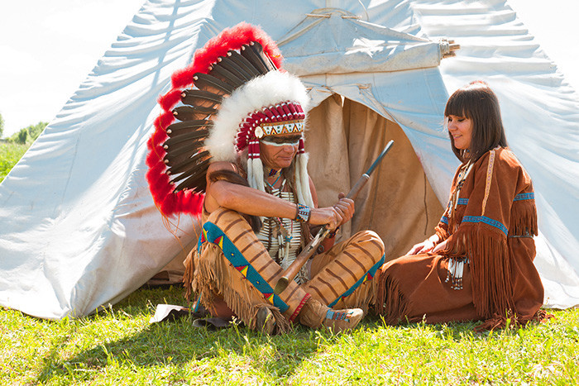

Course Title: Ethnography of Communication (EoC)

Slide 2
Objectives of the course:
Demystify the notions of EoC and Speaking
Highlight the main goals of EoC and its scope
Overview the use of Ethnography in EoC

Slide 3
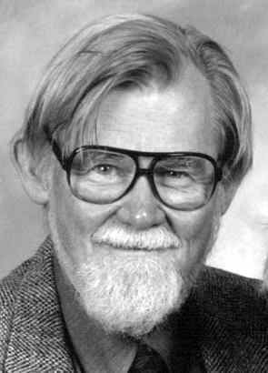
DELL
HYMES
-Born in June 7, 1927
Died in November 13, 2009
-Research Interests: Anthropology, Native American mythology, Ethnography of communication

Slide 4
What is meant by Ethnography of Communication?
“The ethnography of speaking is concerned with describing such ways of speaking and with interpreting the meanings they have for those who participate in them. It is concerned further with developing cross culturally valid concepts and theories for interpreting and explaining the interaction of language and social life.” G. Philipsen (2009)

Slide 5
Writing
Silence vs talk
Body motion
horn calling
Ways of Speaking
speech-derived whistling
Singing/
dancing
drumming

Slide 6
More information about EoC?
Contextualization: language and culture
Focus: speech communities (tribes, pubs, schools, religious and political institutions, workplace)
Ethnography of communication (goals)
Descriptive
Comparative
Theoretical (communicative competence; patterns)

Slide 7
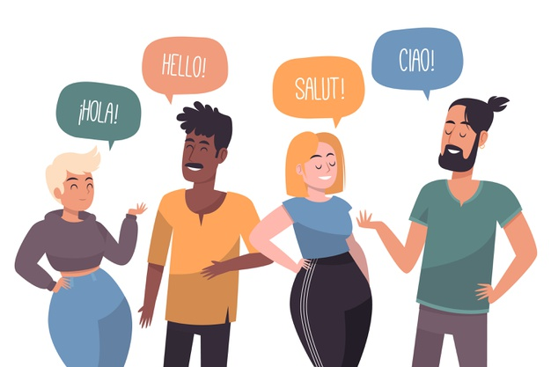
Ways of speaking (modes of communication)
Ways of speaking:
Verbal and non verbal;
Gestural, spoken, written;
Words, phonology, grammar
Intonation, silence vs talk, greetings,
Address forms, politeness,
honorific expressions, electronic chat
Culture:
Beliefs, Stereotypes, mores, customs, food, traditions, local rules, social organizations, religion
Connection

Slide 8
Silence vs. Talk
“We spent some days in a borrowed sod house in the village of Rensjoen … Our neighbors would drop in on us every morning just to check that things were all right. We would offer coffee. After several minutes of silence the offer would be accepted. We would tentatively ask a question. More silence, then a ‘yes’ or a ‘no’. Then a long wait. After five or ten minutes we would ask another. Same pause, same ‘yes’ or ‘no’. Another ten minutes, etc. Each visit lasted approximately an hour --all of us sitting formally. During that time there would be six or seven exchanges. Then our guests would leave to repeat the performance the next day.” Reisman ( 1974)

Slide 9
Doing Ethnography
Ethno (A tribe, a race or a nation) and Graphos (written down) a written report about people.
Ethnographic methods were borrowed by Dell Hymes from cultural anthropological studies
Ethnography is: descriptive, cultural, focused, comparative and theoretical.
In ethnographic fieldwork, researchers use Participant Observation, note-taking and interviews with people
Insider and/or outsider
Naturalistic stance ( not in a laboratory); discovery
Ethnographic research is energy and time consuming

Slide 10
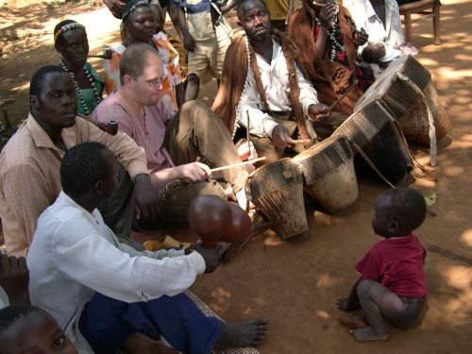
Participant Observation (African communities)

Slide 11
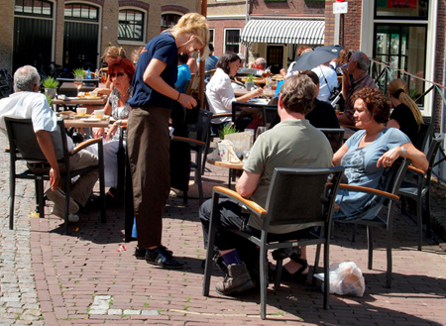
Participant Observation (Western Communities)
Is she a working waitress or a sociologist conducting a study using participant observation?

Slide 12
Doing Ethnography in EoC: Examples
a.The use of address forms & politeness expressions in the CLASSROOM
b.Powerful speech style vs Powerless speech style in COURTROOMS
  Individuals with low power and low social status vis-à-vis the court tend to make frequent use of:
  Intensifiers: ("so," "very”, "surely," as in "I surely did.")
  Hedges: ("kinda," "I think," "I guess," etc.)
  Formal grammar: (the use of bookish grammatical forms)
  Hesitation forms: ("uh”, "well," "you know," etc.)
  Up-talk: (the use of rising, question intonation in declarative contexts)
  Polite forms: ("please”, "thank you," etc.); Gestures.

Slide 13
Course Title: Ethnography of Communication (EoC)
PART 2

Slide 14
Objectives of the course:
Address some examples of EoC
Highlight the historical impetuses of EoC
explain the construct of Communicative competence

Slide 15
Rcap
EoS program GOALS:
Descriptive: (two purposes)
Purpose one: the framework should be able to be used to compare the ways of speaking used by different cultures for the same or similar speech events.
Theoretical: (theory of language) theorizing communicative competence.

Slide 16
Historical Impetuses
Dell Hymes overviewed gaps in linguistics and anthropology studies
Linguistics: decontextualization
Anthropology: Frans Boas, Language was subsidiary

Slide 17
Historical Impetuses
Anthropology: Language was treated as subsidiary: anthropologists had long conducted ethnographic studies on different aspects of culture, ranging from kinship, cultural systems, indigenous views of medicine and curing, etc.
No comparative studies of speaking along comparative politics, comparative religion.
Linguistics: language as an abstract, decontextualized

Slide 18
Historical Impetuses
Dell Hymes developed an Innovative program in early 1960S
Why innovative?
Combined two desciplines
Language use in daily interactions
Speech situation; speech event; speech act.

Slide 19
Communicative Competence
G. Philipsen (2009) “refers to an ability to use language appropriately in The social situations of a speech community.”
Or: what people need to know in order to communicate more appropriately in a given speech event.
how do speakers acquire C.C.

Slide 20
Communicative Competence
Communicative Competence vs. Linguistic Competence
appropriateness vs. correctness

Slide 21
Communicative Competence
Communicative Competence encompasses:
Linguistic competence
Sociolinguistic competence
Strategic competence

Slide 22
Communicative (IN)Competence
In some situations, however, some speakers TEND to sound appropriately “incompetent”.
powerless speech style
Speaking in tongues: (glossolalia)
Women in predominantly patriarchy based communities

