Slide 1
Lecture 3:
Dr. Benacer Hamza
2024-2025

Slide 2
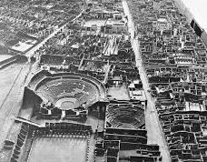
3. The history of urbanism?

Slide 3
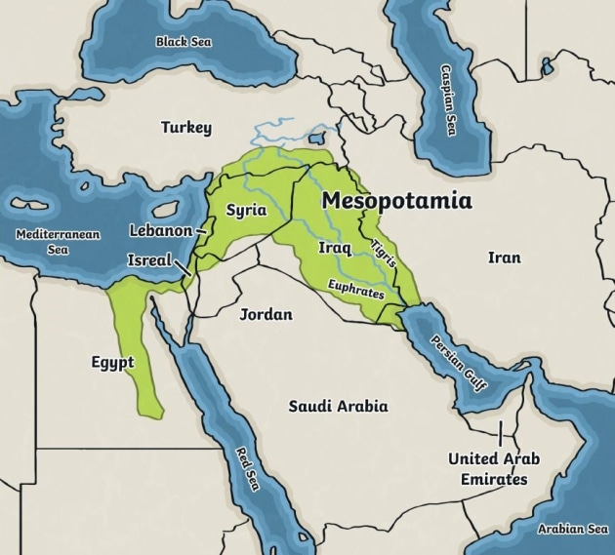
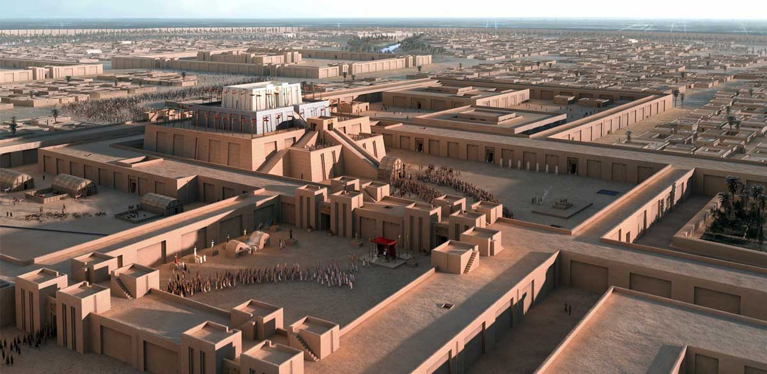
3. The history of urbanism
The history of urbanism can be traced back to the earliest human settlements. The first cities emerged in Mesopotamia and Egypt around 5,000 years ago.

Slide 4
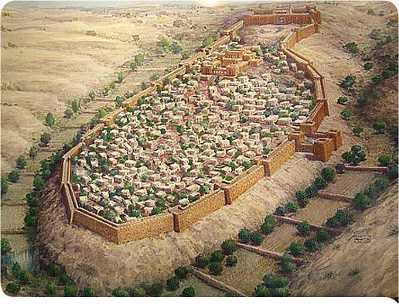
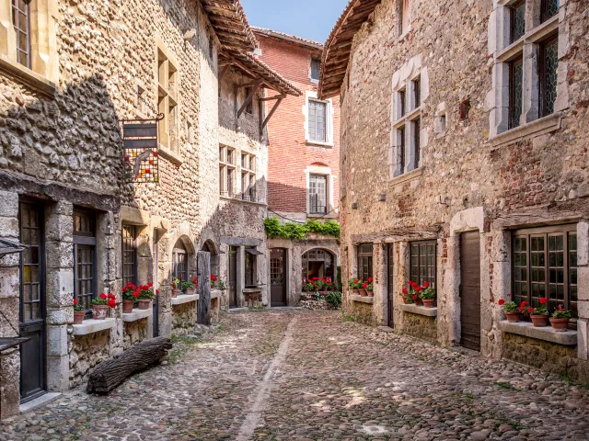
The early cities were typically small and compact, with a central marketplace and a surrounding residential area. Over time, cities grew larger and more complex. By the Middle Ages, many European cities had developed into walled fortifications with a complex system of streets and canals.

