Slide 1
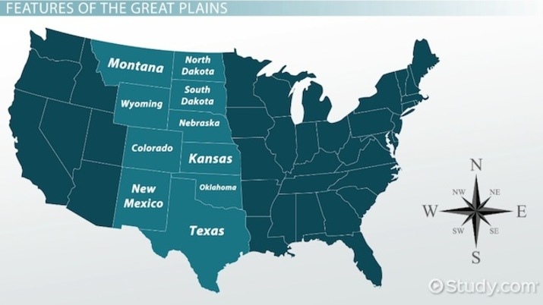
Westward Expansionism and the Great Plains

Slide 2
Lecture II
Westward Expansionism and the Great Plains

Slide 3
Railroads and other industrial technologies made the settlement of the Great Plains possible.
A. The Homestead Act (1862) granted a 160-acre quarter section to any family that occupied and improved the land for five years.
B. Many families began with subsistence farming but switched to commercial farming as soon as possible, sending bulk shipments of grain back East by rail and importing wood, coal, and other necessities.
Towns developed along the railroads, dominated by great grain elevators.

Slide 4
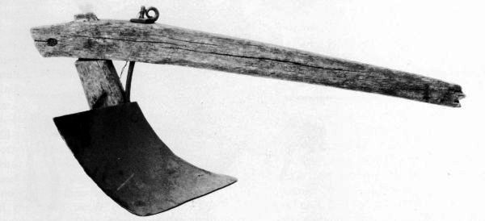
C. Rapid improvements in farm machinery made Plains farming possible.
1. The hard steel blade of the John Deere plow enabled farmers to cut through the dense prairie sod.

Slide 5
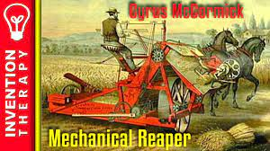
2. The McCormick reaper reduced the number of men needed for the harvest.

Slide 6
D. Farmers and cattle ranchers often competed for land.
1. The great cattle trails from Texas to the early railheads, such as Abilene, Kansas, preceded the farmers.
2. Another technological development, barbed wire (1874), had important consequences for the transformation of the Plains, spelling the end of the open range.

Slide 8
II. Settlers, from back East and from abroad, had to overcome the formidable hardships of Plains farming.
A. Lack of wood forced newcomers to build sod houses and dug-out.
1. Their thickness contributed to moderating temperature extremes.
2. Windows and doors were often ordered from Sears, Roebuck.
Notes:
Salad bowl and melting pot Multiethnic (German, Bohemian, slavs) one ethnicity (Norway to Minnesota)

Slide 9
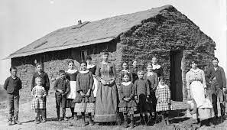

Slide 10
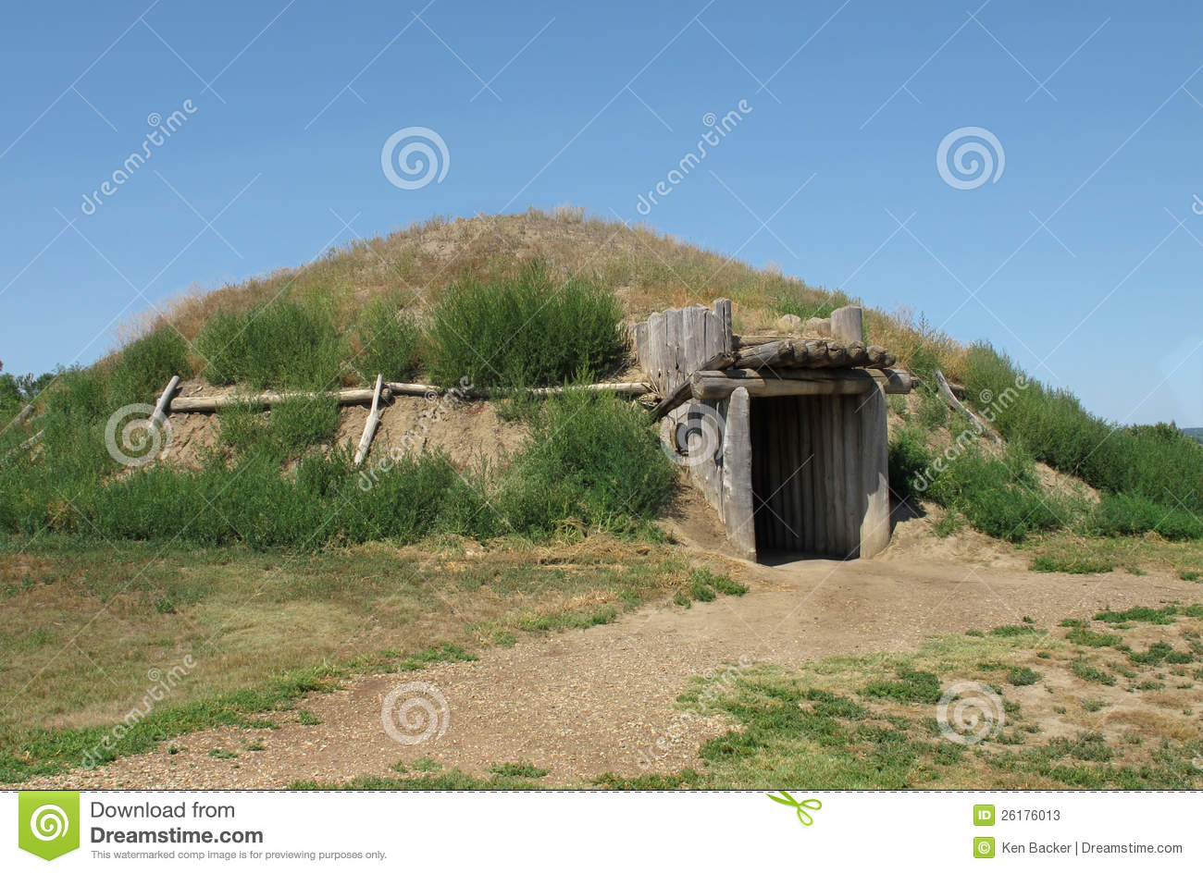
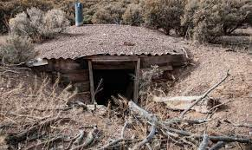

Slide 11
B. Buffalo chips were an acceptable fuel alternative to wood.
C. Winters were extremely harsh.
D. Ecological upheavals threatened farmers’ security.
1. Grasshoppers thrived on settlers’ crops and sometimes destroyed entire districts.
Notes:
1874 grasshoppers infestation in Minnesota forced many farmers to bankruptcy and evacuate their lands altogether

Slide 13
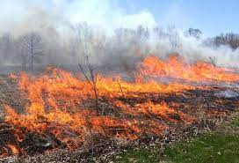
2. Prairie fires regularly swept the Plains, as they had done for generations.

Slide 14
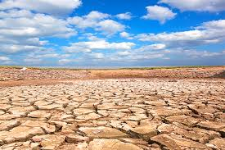
3. Variations in rainfall destroyed farms in marginal areas, especially beyond the 100th meridian.
4. Settlers’ hopes that " rain follows the plow " were ill-founded, and attempts at "rainmaking" were unreliable.

Slide 15
E. Isolation and loneliness defeated some settlers.
1. Ole Rolvaag’s Giants in the Earth (1927) depicts a Norwegian farmer’s wife descending into madness from loneliness.
2. Western historian Wallace Stegner’s Beyond the Hundredth Meridian (1954) evokes the material and psychological hardships of the life.
Notes:
Pen Hensa freezes to death in the midst of one of his ambitious winter expeditions/ Mr Shimerda so depressed commited a suicide in the middle of the winter

Slide 16
III. The success of Plains farming permanently transformed the conditions of food production in America.
A. Abundance of cattle, wheat, and corn drove down prices for American consumers, while improving the quality of their diet.
1. Refrigerated railroad cars after 1880 also increased working-class people’s access to fresh meat and vegetables.
2. Low prices for their products tempted individual farmers to expand their production further but worsened the problem of overproduction.

Slide 17
B. The system of a rectangular land survey had always had drawbacks. West of the 100th meridian, these drawbacks were disabling.
1. Nature itself does not think in squares.
2. Low rainfall made 160 acres insufficient land for a subsistence farm in the High Plains.

Slide 18
C. John Wesley Powell’s Report on the Arid Regions (1878) suggested a new approach to land use in the High Plains and Great Basin.
1. The key commodity was water, access to which should be the principal consideration.
2. He proposed farms of 2,560 acres, 20 of which should be intensively irrigated.

