Slide 1
The Pre-school Years

Slide 2
In fact, it is generally accepted that by age four, children have mastered the basic structures of the language or languages spoken to them in these early years.
Three- and four-year-olds continue to learn vocabulary at the rate of several words a day.
They begin to acquire less frequent and more complex linguistic structures such as passives and relative clauses.

Slide 3
By the age of four, most children can:
ask questions
give commands
report real events
Much of children’s language acquisition effort in the late pre-school years is spent in developing their ability to use language in a widening social environment. They use language in a greater variety of situations:

Slide 4
They acquire the aggressive or cajoling language that is needed to defend their toys in the playground.
They interact more often with unfamiliar adults.
create stories about imaginary ones-using correct word order and grammatical markers most of the time.
They begin to talk sensibly on the telephone to invisible grandparents.
They show that they have learned the difference between how adults talk to babies and how they talk to each other, and
In this way, they explore and begin to understand how and why language varies.

Slide 5
'cake the eat‘
'drink the chair‘
In the pre-school years, they also develop METALINGUISTIC AWARENESS, the ability to treat language as an object separate from the meaning it conveys.

Slide 6
The School Years

Slide 7
‘Train’
‘Caterpillar’
1/ Children learn to read and seeing words represented by letters and other symbols on a page leads children to a new understanding that language has form as well as meaning.
Children develop more sophisticated metalinguistic awareness. Learning to read gives a major boost to this aspect of language development.

Slide 8
-Literal and Figurative Language:
2/ Metalinguistic awareness also includes the discovery of such things as ambiguity.
-Word jokes, trick questions and riddles:
Q-Why can’t fishermen be generous?
A- Because their business makes them sell fish.
Q-Did you hear about the guy whose whole left side was cut off?
A-He’s all right now.
Q. Why can’t a man living in New York be buried in Chicago?
A. Because he’s still living!
Q. What five-letter word becomes shorter when you add two letters to it ?
A. Short
“Nobody invites Edward to parties because he is a wet blanket”
“That car of mine is a real lemon”

Slide 9
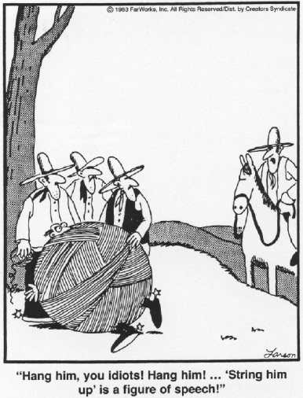

Slide 10
3/ One of the most impressive language developments in the early school years is the astonishing growth of vocabulary.
4/Another important development in the school years is the acquisition of different language REGISTERS.

