Slide 1
People’s Democratic Republic of Algeria Ministry of Higher Education and Scientific Research University of Oum El Bouaghi Faculty of Letters and Foreign Languages Department of English
2-Colonial Echoes: Exploration, Travel Writing & Faith
Presented by: Dr. Salah Eddine AAID

Slide 2
II. Colonial Echoes: Exploration, Travel Writing & Faith

Slide 3
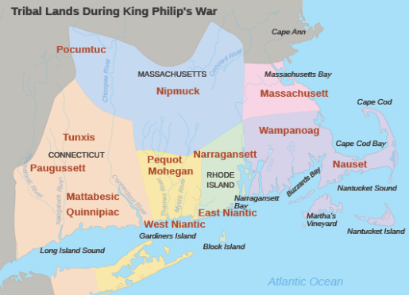

Slide 4
Englishmen describing exploration and the settlement in the New World: Facts & fantasy are fused: advertisement, travel guides, adventure and excitement.
1-Thomas Hariot: Breife and True Report of the New Found Land Virginia (1588)
2- William Wood / Lions in Massachusetts

Slide 5
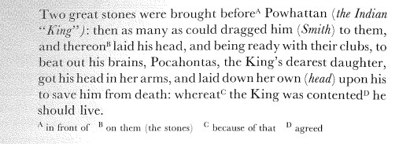
3-John Smith (1580-1631) True Relation of Virginia (1608), Description of New England (1616)
Captain, prisoner, slave, founder of Jamestown (1607)
=) Puritans / “advertisements”/ guide for settlement in New England (1620).
The beautiful princess & the Elizabethan Style

Slide 6
New England & the Puritan Settlers: the birth of colonial literature
Fighting for a society based on a strict Christian beliefs & the laws of God.
Sense of unity & “shared purpose”
Harvard/ 1636/ Near Boston/ New Puritan Ministers
The First Printing Press (1638)/ 1st Newspaper 1704

Slide 7
Characteristics of Puritan Literature
Histories and God’s plan: New England as the Promised Land
History as a central struggle between Christ and Satan. I.e.: the snake & the church.
Plain style, “clear light of truth” perspective, sources: bible, everyday life of farmers and fishermen.
1- William Bradford (1590-1657)/ Of Plymouth Plantation
“It pleased God to…..”

Slide 8
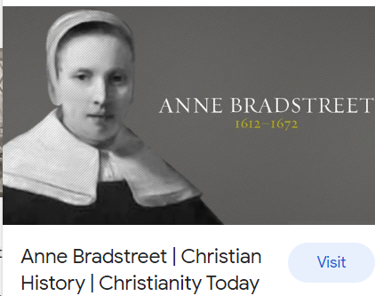
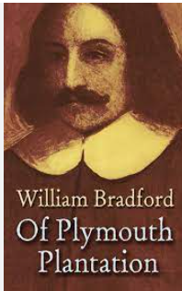
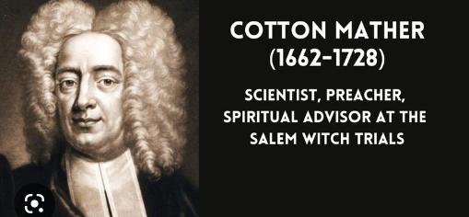

Slide 9
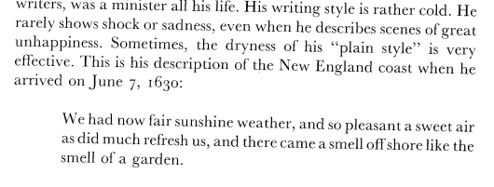
2- John Winthrop (1588-1649) / The History of New England – The 1st Governor of Massachusetts Bay Colony

Slide 10
3- Thomas Hooker/Puritan Theocracy vs. Anne Hutchinson & Roger Williams/ the Rise of Democracy : Rhode Island =) freedom is a necessary condition for “the growth and development of the soul”.
4- Transition from “plain style” and strict laws to “cloth of God” style.
Richard Mather (1596-1669) and his son , Increase Mather (1639-1723)
North Church – Boston , Witch Craft Panic (1690s), Salem, Massachusetts.
Remarkable Providences (1684)
Cotton Mather (1663-1728) =) 450 works: Made Easy and Happy, Way of Living, Which is to Die Daily, Magnalia Christi Americana (1702)

Slide 11
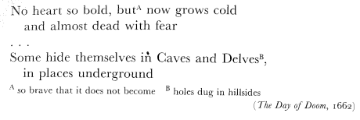
Puritan Poets
Religious themes ie, Anne Bradstreet (1612-1672), “Her Tenth Muse Lately Sprung Up in America” (1650).
Michael Wigglesworth (1631-1705) : frightening images about the judgement day /
Edward Taylor (1645-1729): The rebirth of the Puritan way
“Black Swans in milk white rivers”

Slide 12
References
High, Peter B. An Outline of American Literature. Longman, 1986.
Native American Literature, FA 2013, https://www.slideshare.net/mrsabercrombie/native-american-literature-30877737.

