Slide 1
SSH LESSON

Slide 2
HS: (Humanities) Academic disciplines that study aspects of human society and culture, using primarily analytical or critical methods, with significant historical elements.
❑ It includes Language (Ancient and modern languages), History, Literature, Philosophy, Religion,
Visual arts (Media types, Drawing, Painting, Film) and Performing arts such as music, dancing and theatre, etc.
❑ Humanist: He/she is the one who works in the field of humanities
SS (Social Sciences): A branch of science that deals with the institutions and functioning of human society
and with the interpersonal relationships of individuals as members of society.
❑ It includes Sociology, anthropology, economics, human geography, linguistics, communication,
political sciences, psychology, law and education, etc.
❑ Social Scientist: He/ she is the one who works in the field of social sciences.

Slide 3
The importance of SHS : The main aims of SHS studies are:
• To promote civic competence.
• To understand society, and to define science in its social sense.
• To deeply analyze social problems and issues.
• To help people develop their ability to make informed and reasoned decisions for the public good.
• It provides the necessary background knowledge to develop values and reasoned opinions.
• It helps people develop a knowledge base and the right attitude for their behavior in society and the real world.
• It helps create perceptions of the future. • It bridges the gap between people and society and provides insight into the essence of a problem so that there are no barriers to communication.

Slide 4
Why Study Humanities and Social sciences?
The Humanities and Social Sciences are critical to human cultures across the world. Their study can facilitate a greater understanding of different cultures, human relations and lay a framework for a civically engaged life. They can also prepare you to think creatively, critically and enable you to be relevant in a rapidly changing world.

Slide 5
Some of the common branches of social science include the following:
Psychology studies the human mind and draws conclusions about the human psyche.
Economics is the study of trade, resource accumulation, and production. Economics aims to understand how societies make their economic decisions and manage scarce resources.
Sociology is the study of human interaction, culture, and institutions. It examines the ways that various social groups interact and the problems created and solved by this interaction.
Political Science studies the relationships of power and government within societies. The field is concerned with how governments function, how power changes hands, and studying the behavior of citizens.

Slide 6
Below are some reasons why you should choose to study humanities and social Sciences
Humanities and social sciences will help you develop analytical thinking skills you need to be a successful student and employee.
Humanities and social sciences will improve your skill at oral and written communication.
Humanities and social sciences will help you to discover the interconnectedness of all areas of knowledge and how it all fits together.
Humanities and Social sciences will enable you to develop a global perspective by studying different cultures throughout the world.
Social sciences will also help you to deepen your understanding and appreciation of other people’s cultures and points of view.
Humanities and Social Sciences will strengthen your artistic talents by sharpening your creativity.
Humanities and social sciences will help clarify your values by comparing and contrasting them to other people’s values and thoughts.
Humanities and Social sciences will help deepen your sources of wisdom by learning how others have dealt with failures, success, adversities, and triumphs.

Slide 7
The History of SHS:
1- History of Social Sciences: It begins in the Age of Enlightenment after 1650, which saw a revolution
within natural philosophy, changing the basic framework by which individuals understood what was
"scientific". Social sciences came forth from the moral philosophy of the time and was influenced by the Age of Revolutions, such as the Industrial Revolutions and the French Revolution. The term "social science" may refer either to the specific sciences of society established by thinkers such as Kante, Durkheim, Marx, and Webber.
2- History of Human Sciences: In the West, the study of the humanities can be traced to ancient Greece, as the basis of a broad education for citizens. A major shift occurred with the Renaissance Humanism of the fifteenth century, when the humanities began to be regarded as subjects to study rather than practice, with a corresponding shift away from traditional fields into areas such as literature and history. In the 20th century, this view was in turn challenged by the postmodernist movement, which sought to redefine the humanities in more egalitarian terms suitable for a democratic society.

Slide 8
The Differences Between Humanities and Social Sciences:
❑ Humanities are considered more philosophical than social sciences.
❑ Humanities is a branch of science that deal with the heritage and the question of what makes us human, but social sciences deal with the interpersonal relationships of individuals as members of society
❑ The study of humanities can be traced back to ancient Greece, but social sciences were influenced by the French revolution and the industrial revolution.

Slide 9
Comparison between Natural Sciences and SHS:
❑ Natural science is a branch of science that deals with the natural world whereas social science is a
branch of science that deals with human society and social relationships.
❑ Natural science studies natural events whereas social science studies human society.
❑ Natural Sciences are objective, but SHS are subjective and objective.
❑ Natural Sciences are exact whereas SHS are not exact.
❑ Natural Sciences have a specific language but SHS haven’t.
❑ Natural Sciences are communicative whereas SHS is communicative and non-communicative.
❑ Both of them two are effective and important for human life

Slide 10
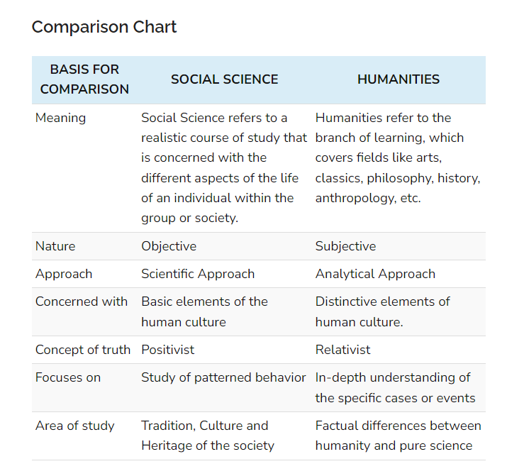

Slide 11
Difference Between Sociology and Anthropology
Humans and their behaviour within their societies is always a subject of study for many researchers, especially for the sociologist and anthropologist. Anthropology is a branch of knowledge in which we learn about humans and their evolution, with respect to culture, physical traits, interactions, language, behaviour, etc.
Anthropology is a broad field of study, whose subject matter is ‘Man’, both past and present. Many think that sociology is same as anthropology, but the fact is sociology is a sub-domain of anthropology.
Sociology is a social science which studies organized groups, their functions, origins, interactions, problems etc. In this article excerpt, we are going to discuss the differences between anthropology and sociology.

Slide 12
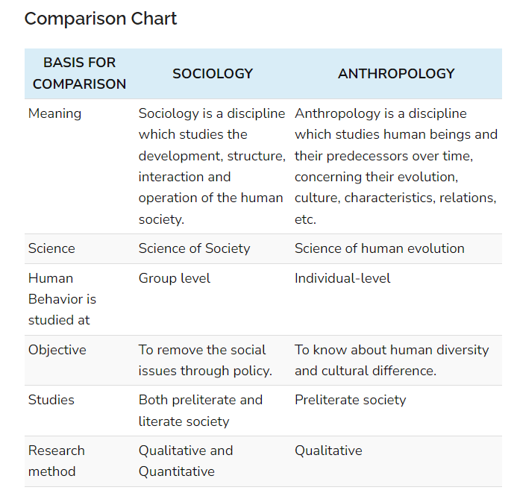

Slide 13
Definition of Sociology
Sociology is a behavioural science which deals with the social lives, changes, interaction, causes and outcomes of human behaviour. Basically, sociology studies how people interact with one another in society, as well as how an individual’s behaviour is swayed according to the social structure, categories, etc.
The sociologists study the structure, patterns, processes, organization, culture and behaviour of society by observing and surveying the changes in the significant elements of organized groups such as communities, societies, etc.
Sociology is a scientific field of study in which, we get to know about human society, social behaviour, interactions, structure, processes, the pattern of relationships and its forms. The individuals who study sociology are called as sociologists. The social facts collected by the sociologists include the attitudes, values, beliefs, norms, traditions, institutions and so forth, constituting the social order.
Sociology helps in addressing a number of social issues such as community belief and practices, social mobility, stratification, changes, disorder/unrest, etc.

Slide 14
Definition of Anthropology
Anthropology refers to a methodical study of human beings concerning their evolution and development, the way they behave and communicate, the culture they follow, how they adapt to the dynamic environment, how they socialize, etc. physically, socially and culturally.
Further, it also deals with the prehistoric origins, the distinctiveness of human beings as species, and modern human diversity. In finer terms, anthropology is the study of a ‘man’ in terms of biological and sociocultural facets.
The individual who studies anthropology is known as an anthropologist. Anthropologists attempt to explore more about human origin and antiquity, as to what makes us human beings. And they do so by researching our ancestors by way of archaeological survey and by analyzing the culture around the world.

Slide 15
Conclusion
In a nutshell, anthropology is the study of a ‘man’. It studies all aspects and characteristics of human beings, including sociology of the ancestors. On the other hand, in sociology, we study patterned and shared behaviour of human beings, and their social lives, social change, social mobility etc.

Slide 16
Difference Between Psychology and Sociology

Slide 17
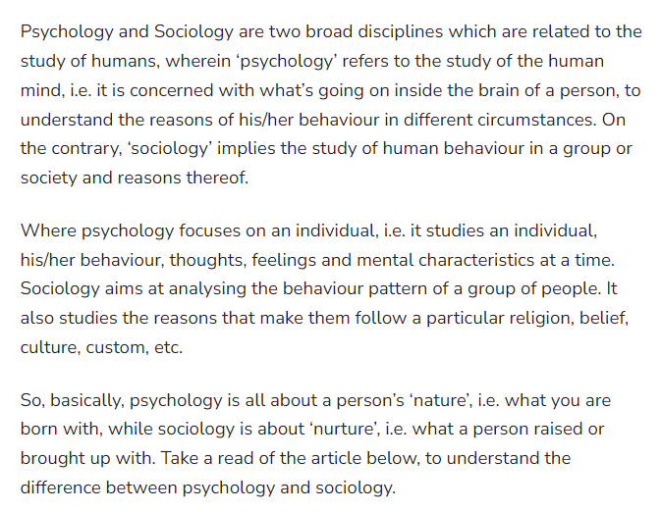

Slide 18
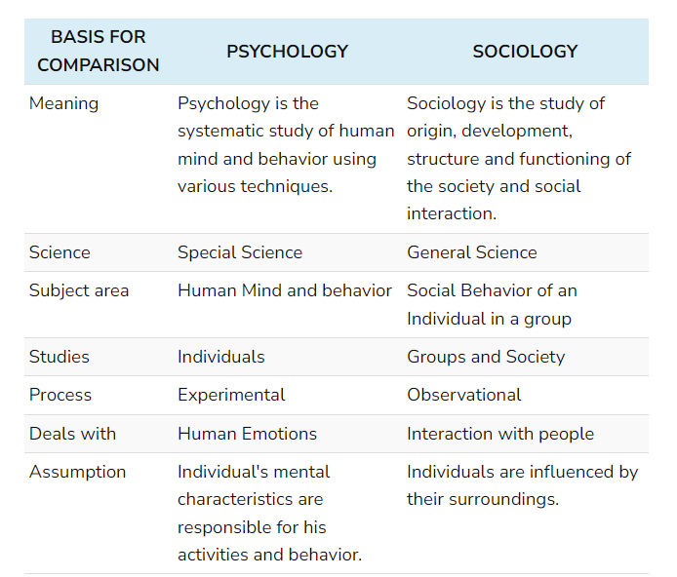

Slide 19
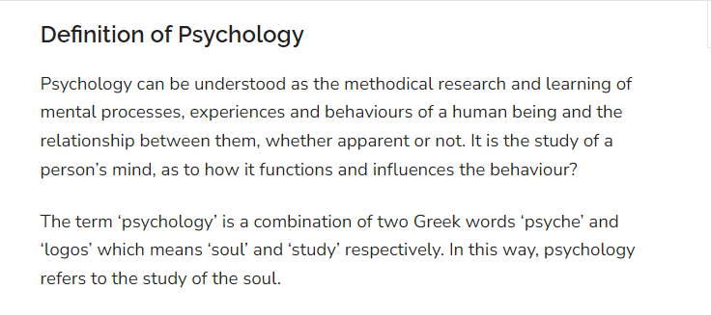

Slide 20
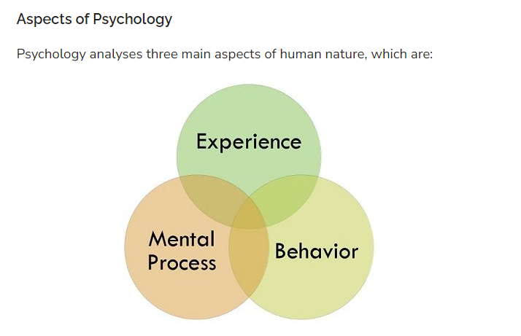

Slide 21
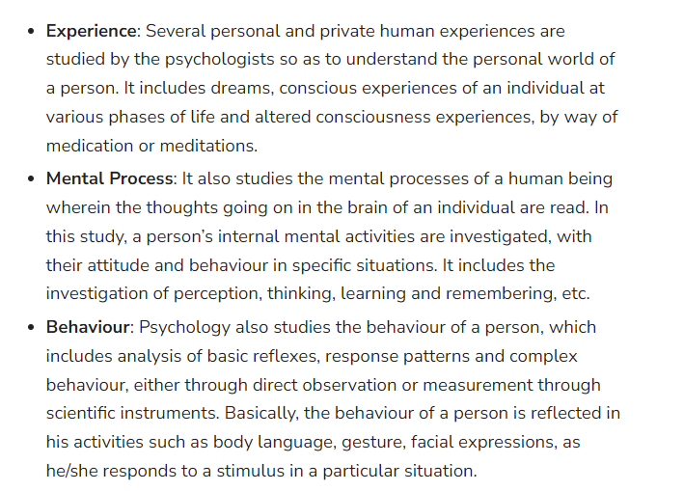

Slide 22
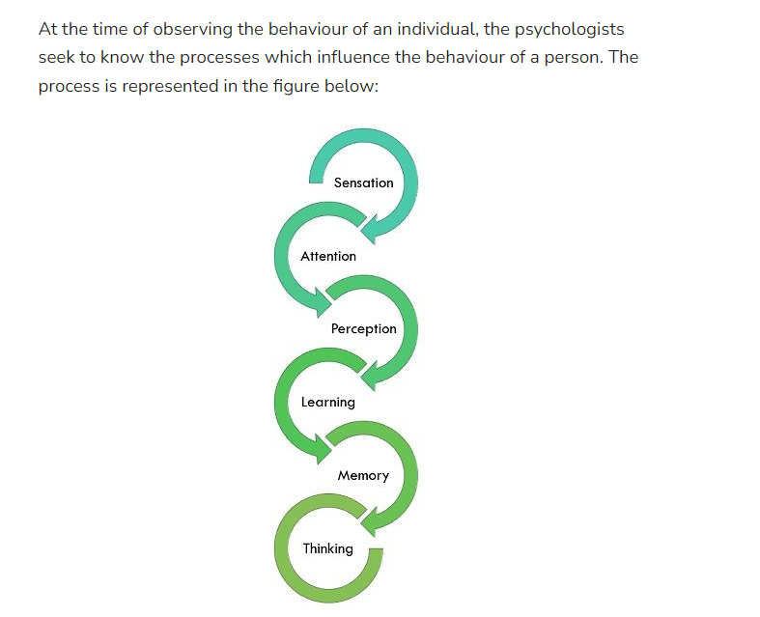

Slide 23
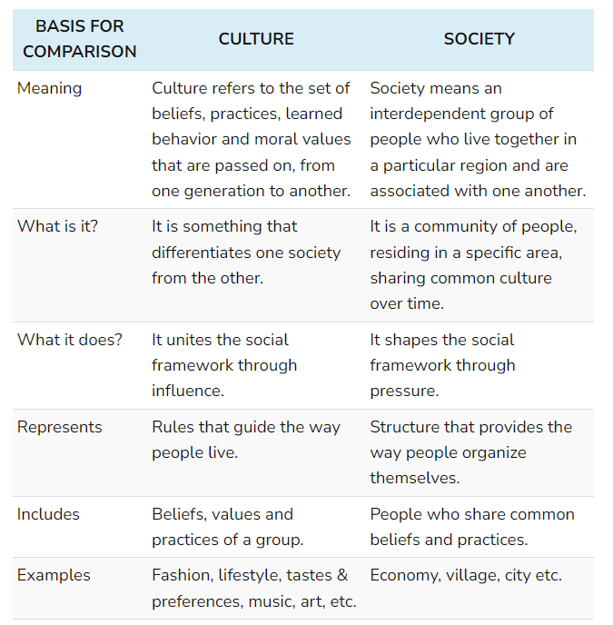
Difference Between Culture and Society

Slide 24
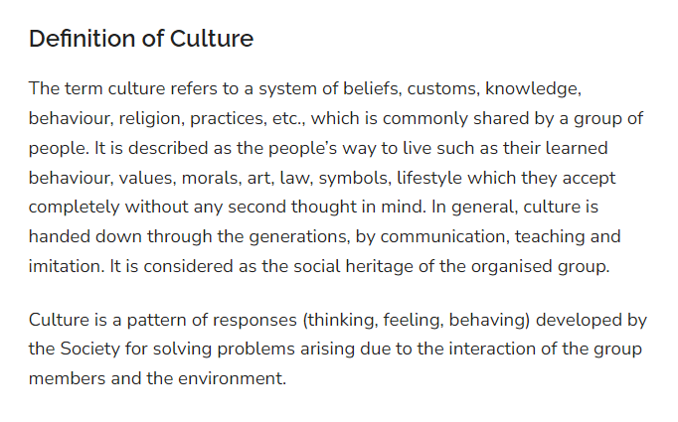

Slide 25
Conclusion
As a way to greet people in different countries, the different cultural trait is followed. For instance, in the United States people used to shake hands when they meet someone, in India people join their hands, in Japan and China people bow down from the waist, in Belgium kiss on one cheek is a way to greet someone irrespective of the gender. This is how culture of one society differs from that of another. So it is true to say that different societies have different cultures.

