Slide 1
Lecture 4:
Dr. Benacer Hamza
2024-2025

Slide 2
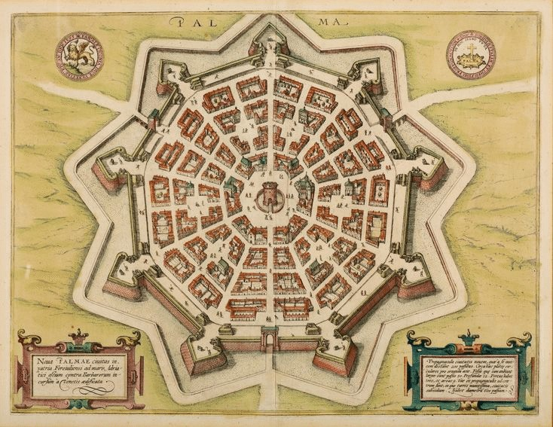
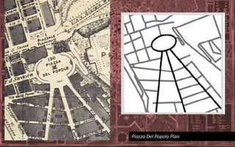
In the Renaissance, cities began to be redesigned with more emphasis on beauty and symmetry.

Slide 3
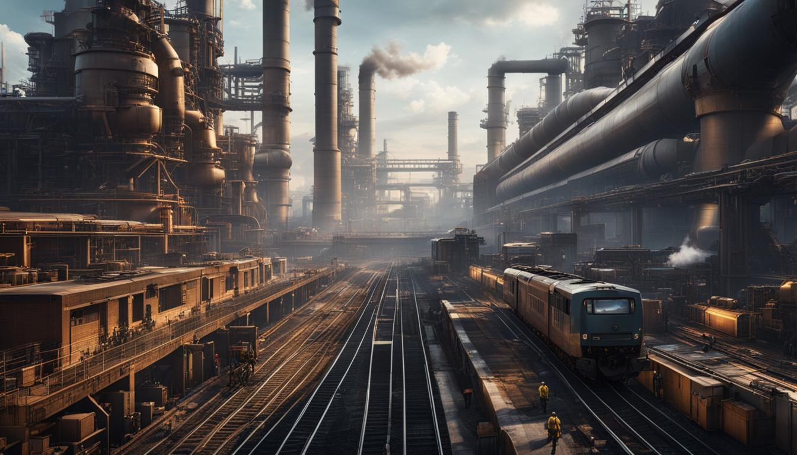
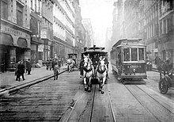
The Industrial Revolution led to a rapid growth in urban populations. New cities were built to accommodate the growing workforce, and existing cities expanded rapidly. This period also saw the development of new transportation technologies, such as the railroad and the streetcar, which made it easier for people to move around cities.

Slide 4
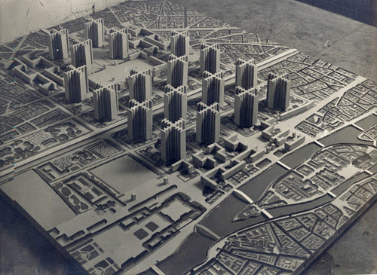
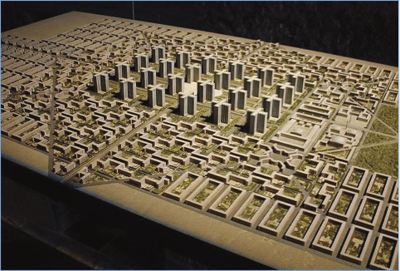
In the 20th century, urban planning became a more formal discipline. Planners began to develop new ways to manage the growth of cities and to improve the quality of urban life. This period also saw the development of new urban forms, such as the garden city and the new town.

