Slide 1
Lecture 1: Details of Urbanism
Dr. Benacer Hamza
2024-2025

Slide 2
1. What is urbanism? 2. What does urbanists do? 3. The history of urbanism? 4. The principles of urbanism ? 5. What are the key concepts in urbanism? 6. Some of the key issues that urbanists are currently grappling with? 7. The future of urbanism ?

Slide 3
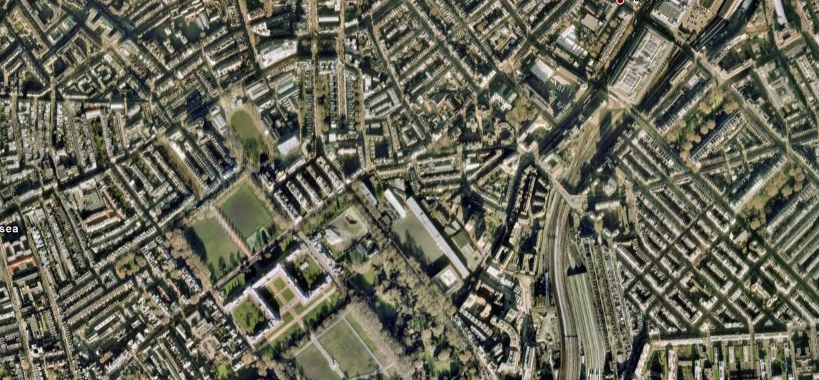
1. What is urbanism?

Slide 4
1. What is urbanism?
Urbanism is the study of how people interact with their built environments, such as towns and cities. It is a multidisciplinary field that draws on insights from sociology, economics, geography, planning, architecture, and engineering. Urbanism is the study of cities and the ways in which they are planned, designed, and developed. It is a broad discipline that encompasses a wide range of topics, including urban planning, architecture, transportation, and environmental design.

Slide 5
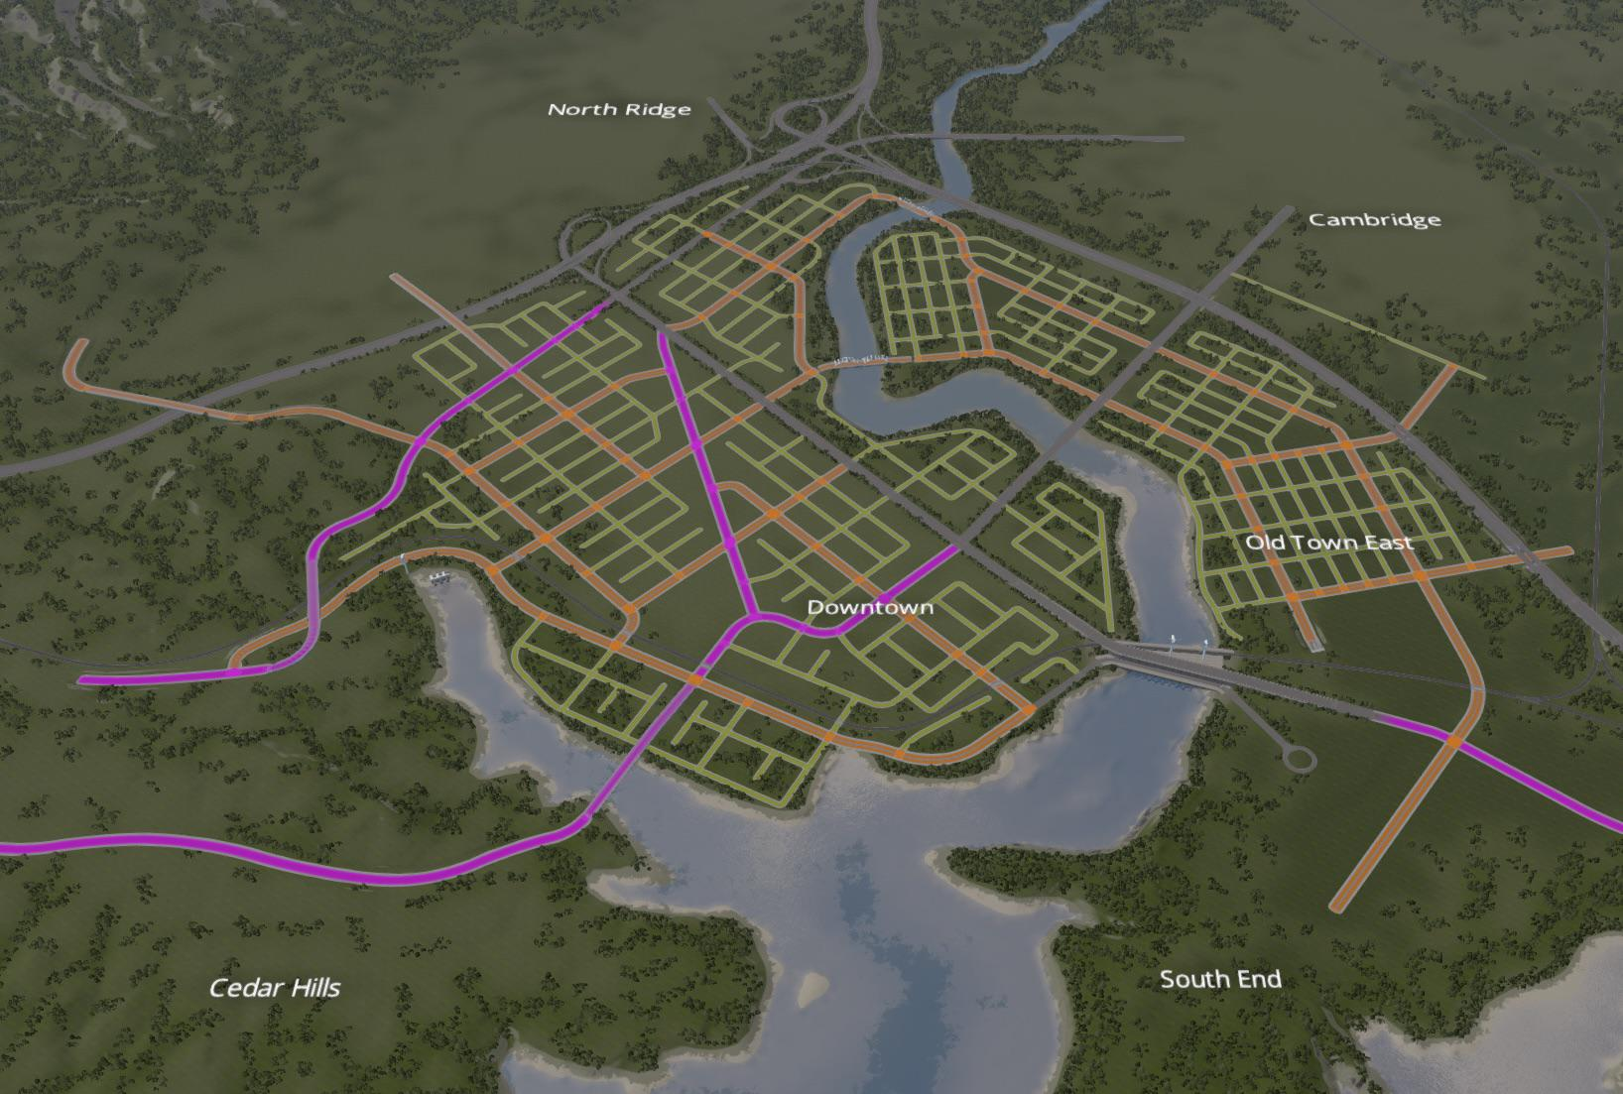
City Plan as a planning process Steps and process

Slide 6
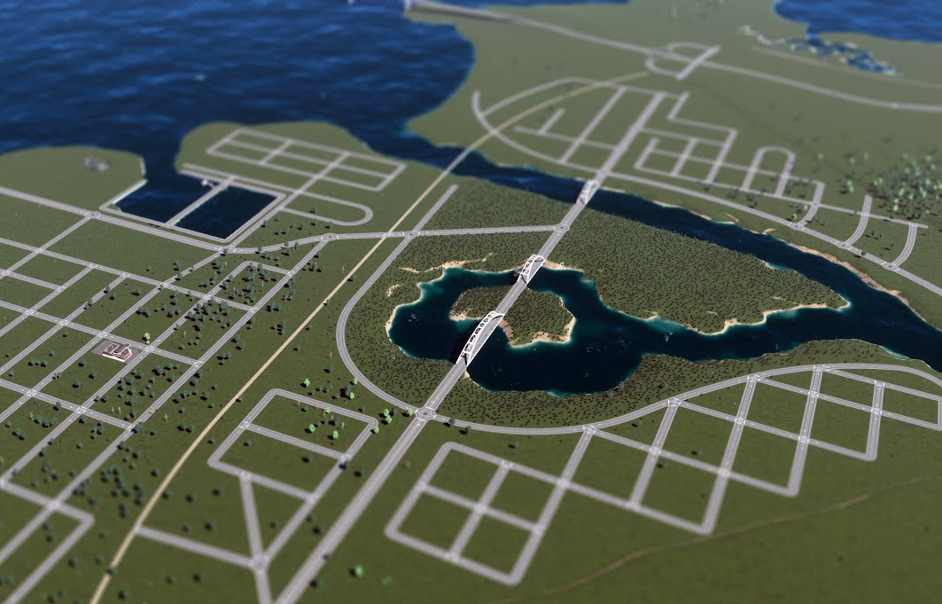
Drawing City Pattern

