Slide 1
Lecture 5:
Dr. Benacer Hamza
2024-2025

Slide 2
Benefits and challenges

Slide 3
The act is Urban planning, is the practice focusing on the physical design and management of urban structures and urban sociology.

Slide 4
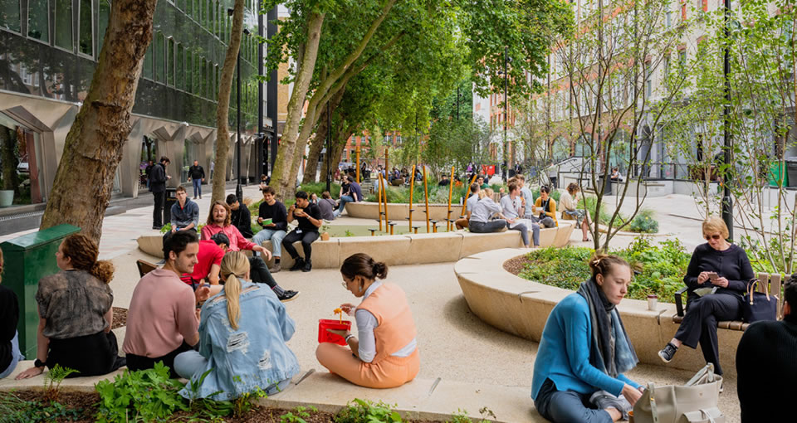
Benefits of urbanism
Benefits to residents
High quality of life.
Better places to live, work and play.
Higher and more stable property values.
Reduce traffic congestion and lack of driving.
A healthier lifestyle with more walking, less stress.
Close to the retail street and the main services.

Slide 5
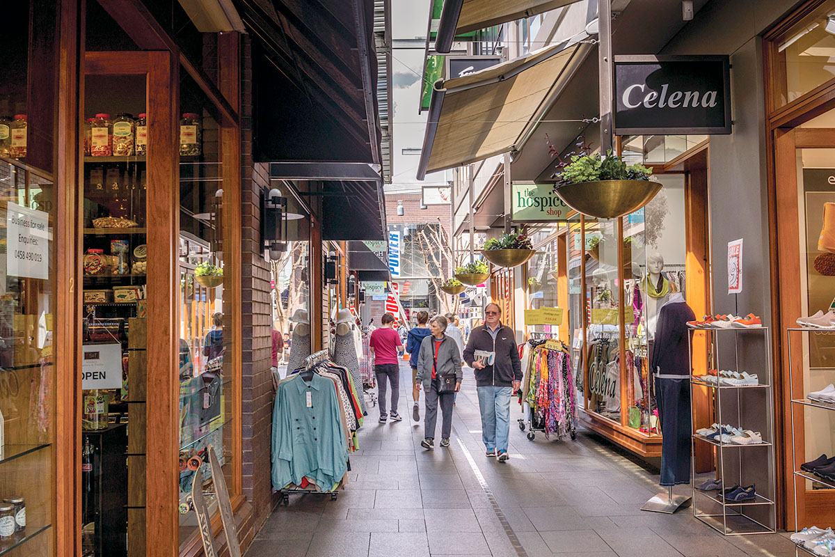
Benefits of urbanism
Benefits to businesses
Increased sales due to increased traffic and people spending less on cars and gas.
Earn more revenue because you spend less on ads and big tags.
A better lifestyle by living above a store in live work units – provides a stressful and costly transition.
Economies of scale in marketing because of their closeness and cooperation with other local companies.

Slide 6
Benefits of urbanism
Benefits to businesses
Small spaces encourage the incubation of small local businesses.
Lower rentals due to smaller spaces and small car parking. Lifestyle is healthier because of more walking and proximity to healthy restaurants.
More community participation than being part of the community and knowing the population

