Slide 1
Perception
Presented by : Minat Allah Smati / Alouen Roumaissa

Slide 2
What is Perception...
Perception is the process by which we interpret and make sense of sensory information from our environment.
It involves the brain receiving and processing sensory input, organizing it into meaningful patterns, and creating our subjective experience of the world around us. The perception process consists of several stages :
Sensation
Attention
Perception
Interpretation

Slide 3
Sensation & Perception
Sensation &
Perception
Sensation is the initial process of detecting and receiving sensory information through our senses, such as sight, hearing, taste, smell, and touch.. It involves the activation of sensory receptors in the body, such as the eyes, ears, nose, tongue, and skin, to detect and respond to different types of stimuli.
Perception is the process by which we interpret and organize sensory information to create meaningful experiences. It involves the integration of multiple sensory inputs, such as vision, hearing, touch, taste, and smell, to form a coherent and meaningful perception of the world around us.

Slide 4
The Importance of Recognizing the Difference
It is important to recognize the difference between perception and reality in order to avoid biases and misconceptions. Our perceptions are often influenced by our past experiences, cultural background, and personal beliefs, which can lead to distorted or inaccurate interpretations of reality. By recognizing the difference between sensation and perception, we can become more aware of our own biases and work to overcome them in order to gain a more accurate understanding of the world around us.

Slide 5
Perception Theories.
03
-Gestalt theory
- Signal Detection Theory
- Top-Down and Bottom-Up processing

Slide 6
The Gestalt Theory
Gestalt ,as a German term, means “Unified Whole”
It is a psychological theory founded by Wertheimer in Germany (1920).
It describes how humans see objects by grouping similar elements, recognizing patterns & simplifying complex images.
Its main premise is “The whole is greater than the sum of its part”
In SLA, Gestalt theory emphasizes the holistic perception and organization of language input by learners.

Slide 7
Gestalt Principles
Principle of Proximity:
Objects that are close to each other are perceived as belonging together.
Eg :Grouping together related vocabulary words like "cat," "dog," and "pet" when studying animals

Slide 8
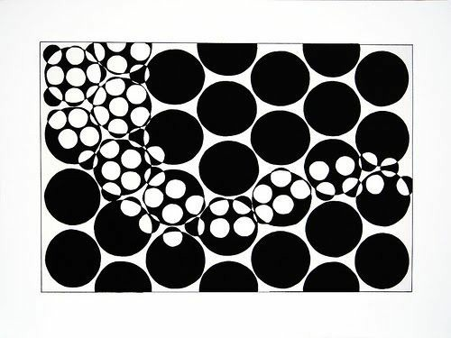
Principle of Similarity:
Objects that are similar in appearance are perceived as belonging together
This similarity can be based on shape, color, size, or other visual attributes
Grouping together words with similar endings, such as "-tion" words like "communication," "information," and "education”.

Slide 9
Principle of Figure-Ground:
We tend to perceive objects as either figures (the main focus of attention) or ground (the background against which the figure stands out). This principle helps us distinguish between objects and their surroundings.
The cat chased the mouse through the garden

Slide 10
Principle of Common Fate:
Objects that move in the same direction or have a similar motion are perceived as belonging together. This principle helps us perceive groups of objects that are moving together as a single entity.
Pragnanz Principle
The mind perceives complex stimuli as simple, coherent, and meaningful patterns whenever possible.. In other words, reality is often reduced to the simplest form.

Slide 11
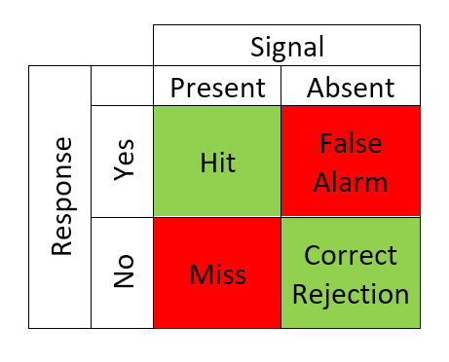
Signal Detection Theory:
It was developed by the American psychologist John A. Swets and his colleagues in 1950.
This theory is about how we make decisions about what we hear or see, especially when there's uncertainty or noise.
Response Criteria: Liberal & Conservative.
Eg : When listening to a conversation in Korean, a learner is uncertain if they heard "감사합니다" (gamsahamnida - thank you) or "화요일" (hwayoil - Tuesday).

Slide 12
Top-Down and Bottom-Up Processing Theory:
a)Bottom-up processing ● Bottom-up processing (data-driven processing) has its roots in the early work of researchers such as David Marr and James J. Gibson in the 1960. ●Bottom-up processing involves the analysis of sensory information from the environment to form perceptions without relying heavily on prior knowledge or expectations.
b)Top-down processing ●Top-down processing (conceptually driven processing) has its origins in the work of researchers such as Jerome Bruner and Richard Gregory. ●Top-down processing involves the use of higher-level cognitive processes, such as expectations, knowledge, and context, to guide perception and interpretation.

Slide 13
Bottom – Up Top - Down

Slide 14
Types of Perception
Auditory
perception
Tactile
perception
Visual
Perception
Auditory perception refers to the cognitive processes involved in the interpretation and understanding of sounds in the environment. It involves the reception, processing, and interpretation of auditory stimuli, enabling individuals to make sense of various sounds and distinguish between them.
Tactile perception refers to the interpretation and understanding of information received through the sense of touch. It involves the brain's processing of tactile stimuli, allowing individuals to perceive and make sense of the characteristics of objects and surfaces they come into contact with.
Visual perception is the process by which the brain interprets and organizes visual information received through the eyes. It involves the integration of various visual cues to form a coherent and meaningful representation of the surrounding environment

Slide 15
Examples
Visual
perception
Tactile
Perception
Visual
Perception
Imagine you are sitting in a park on a sunny day. As you enjoy the tranquility of nature, you hear the distinct and melodious song of a bird.
Imagine you are in a clothing store, and you come across a display of different fabrics. You decide to explore the tactile qualities of a few garments.
Imagine you are in a busy public place, like a park or a shopping mall. Among the crowd, you spot a friend you haven't seen in a while.

Slide 16
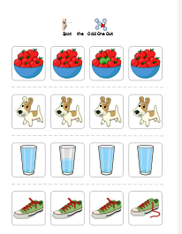
subcategories of visual perception are:
Visual Discrimination:
Definition: The ability to distinguish and identify differences between various visual stimuli based on their characteristics, such as shape, color, size, or pattern.
Example: Differentiating between letters, recognizing distinct facial features, or identifying objects with similar shapes.

Slide 17
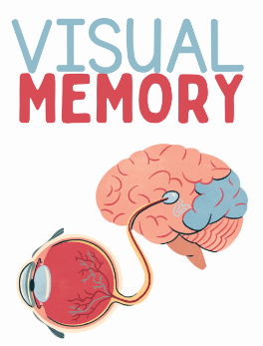
2. Visual Memory:
Definition: The capacity to store and recall visual information over time, allowing for the recognition of previously encountered objects, scenes, or patterns.
Example: Recalling the appearance of a friend's face, remembering the layout of a room, or recognizing a familiar logo.

Slide 18
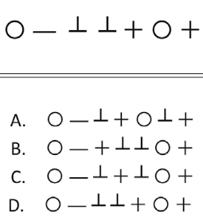
3.Visual Sequential Memory:
Definition: The skill of remembering and reproducing a sequence of visual stimuli in the correct order.
Example: Recalling the order of a series of numbers, reproducing a sequence of shapes in the correct arrangement, or remembering the steps in a process.

Slide 19
4 .Visual Form Constancy:
Definition: The ability to recognize that a particular form or object remains constant, regardless of changes in its size, orientation, or position.
Example: Identifying a circle whether it's large or small, recognizing a specific letter in various fonts, or understanding that a person remains the same individual from different viewing angles.
5.Visual Spatial Skills:
Definition: Understanding and interpreting the spatial relationships between objects, including their position, distance, and orientation in space.
Example: Navigating through a crowded environment, understanding the arrangement of items on a shelf, or solving spatial puzzles.

Slide 20
Perception Models:
1
The Speech Learning Model (SLM) :
developed by James Flege et al., focuses on how second language learners perceive and produce speech sounds, particularly in relation to their native language.
SLM Focuses on how a learner's native language influences their perception and production of sounds in a second language
Eg : Spanish speaker learning English may have difficulty distinguishing between the English /θ/ and /ð/ sounds because Spanish lacks these phonemes, leading to pronunciation errors such as 'tink' instead of 'think'.

Slide 21
2) Perceptual Assimilation Model (PAM):
developed by Catherine Best and her colleagues & focuses on how learners categorize and assimilate non-native sounds into their existing phonological system based on perceptual similarities.
• It emphasizes the influence of native language phonology on second language acquisition.
Eg:A Mandarin Chinese speaker learning English might have difficulty distinguishing between the English /r/ and /l/ sounds.

Slide 22
3) The Native Language Magnet model (NLM) :
It was developed by Patricia Kuhl and her colleagues.
NLM: focuses on the role of early exposure to language in shaping infants' perception and acquisition of speech sounds, particularly in relation to their native language.
It suggests that infants have a "magnet" for their native language sounds, which influences their perception and acquisition of language.

Slide 23
The Relationship between Perception & Production
the relationship between perception and production in L2 is dynamic and reciprocal. Successful language acquisition involves a continuous interplay between understanding linguistic input and producing language output. Exposure to authentic language, practice, and feedback are crucial components of this interactive process.
This is where you section ends. Duplicate this set of slides as many times you need to go over all your sections.

Slide 24
In simple terms
The relationship between perception and production in second language (L2) learning can be understood as a two-way street:
Listening Shapes Speaking:
When learning a new language, what you hear (perception) influences what you say (production). Listening to native speakers helps you pick up correct pronunciation, intonation, and language patterns, providing a foundation for accurate speaking.
Speaking Reinforces Listening:
As you try to speak in the new language (production), it reinforces what you've heard. The process of trying to articulate words and phrases enhances your ability to recognize them when spoken by others (perception).

Slide 25
Factors that influence perception in SLA
1. Individual Differences:
Explanation: People are different in how they approach language learning. Factors like age, cognitive abilities, and learning styles can affect how individuals perceive and process a second language.
2. Motivation and Attitude:
Explanation: How motivated someone is to learn a second language and their attitude towards the language and its culture can significantly impact their perception. Positive attitudes and strong motivation often lead to more effective language learning.
3. Cultural Background:
Explanation: One's cultural background influences how they perceive the sounds, structures, and social aspects of a second language. Cultural awareness can enhance the understanding and interpretation of linguistic and contextual cues.
4. Prior Language Knowledge:
Explanation: Previous knowledge of languages, including the learner's native language, can influence how they perceive and interpret linguistic elements in the second language. Similarities or differences between languages impact perception.

Slide 26
Thank you!
Do you have any questions?

