Slide 1
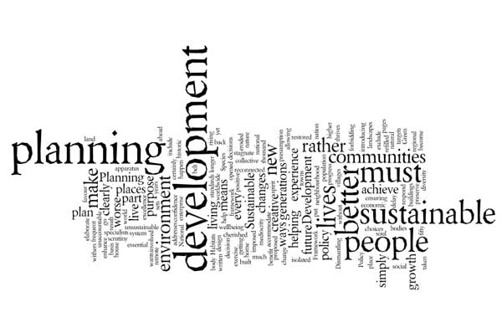
English for Urban Technic Management
Dr Hamza Benacer

Slide 2
“Modern urban planning is intertwined with pressing global challenges. The significance of sustainable development is paramount as cities grapple with environmental concerns. From introducing public transport systems that reduce carbon emissions to fostering a social mix in residential areas, modern urban planning aims to create inclusive, sustainable, and resilient urban environments. As technology advances, so does the approach to designing urban spaces, integrating green spaces, and promoting walkability.”
Termes essentiels
Sustainable development (développement durable)
Public transport (transports en commun)
Social mix (mixité sociale)

Slide 3
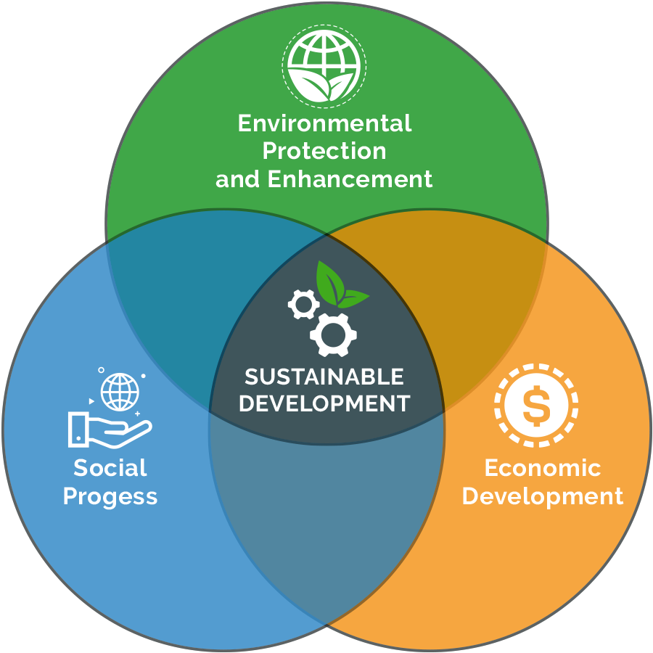
Sustainable development (développement durable)

Slide 4
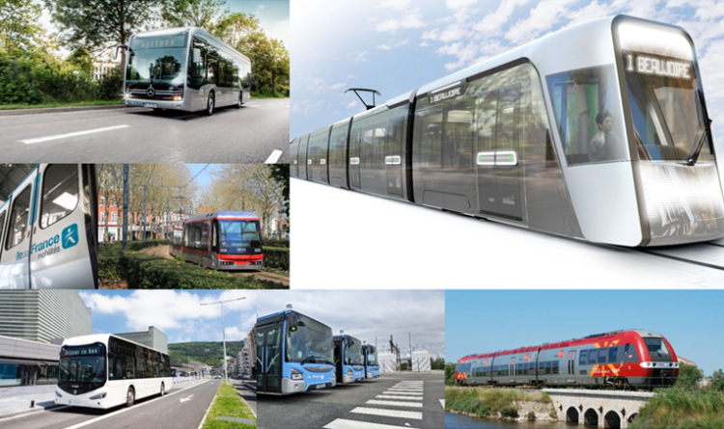
Public transport (transports en commun)

Slide 5
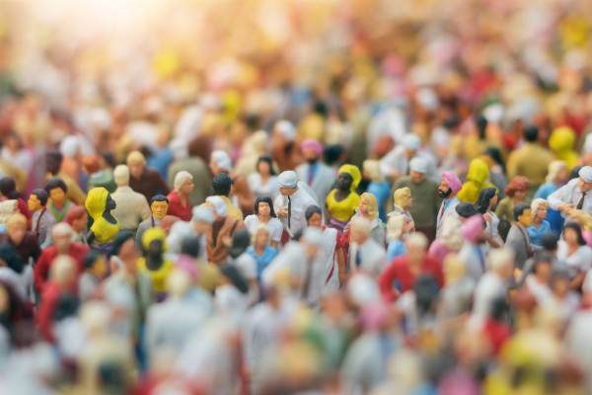
Social mix (mixité sociale)

Slide 6
Exercices
Question de simplification de phrase: Which of the following best summarizes the architectural styles mentioned in the passage?
Modern cities focus solely on aesthetics.
Urban planning now prioritizes sustainable and inclusive designs.
All cities have fully achieved sustainable development.
Walkability is the only concern of modern urban planning.
Question de vocabulaire: In the passage, the term “resilient” most likely means:
Fragile
Rigid
Recovering quickly
Static
Réponses et commentaires
B. Urban planning now prioritizes sustainable and inclusive designs (Le texte met en évidence l’importance du développement durable et de la conception inclusive dans l’urbanisme moderne.)
C. Recovering quickly (“Resilient” signifie la capacité à récupérer rapidement des difficultés.)

