Slide 1
People's Democratic Republic of Algeria
Ministry of Higher Education and Scientific Research
University Larbi Ben M’Hidi – Oum El Bouaghi
Course Universal History of Biological Sciences
U.H.B.S
Level: 1st year common core Natural and Life Sciences
Presented by:
Dr. RAHMANI
University year: 2024-2025

Slide 2
module content
I. Prehistoric times
-Nineteenth century;
Cell theory, Embryology, Immunology, Genetics and Molecular biology
II. The emergence of biology in antiquity
III. Middle Ages: occident and orient (Muslim civilization)
VII. Twentieth century: Gene therapy and molecular cloning
IV. Sixteenth and seventeenth centuries
V. Eighteenth century (18th) : Darwin

Slide 3
Lesson N°01
Introduction to the Universal History of Biological Sciences

Slide 4
The first step in developing a history of the biological sciences is to broaden our knowledge of the origins of:
Science
Biology
Derived from the Latin word scientia, meaning "knowledge", science is a whole set of systematic methods for acquiring knowledge, as well as a way of approaching and understanding the world around us
composed of two Greek words, "bios", meaning "life", and "logos", meaning "study", so biology is the science of life, which is concerned with the study of living things; animals and plants

Slide 5
The definition of biology is simple and clear, but it covers a fascinating and diverse world, including the :
Composition of living organisms,
How they function,
Their evolution and the continuation of this development.
All the information, hypotheses and theories presented in your manual are the fruit of the work of innumerable scientists who ask questions, collect data, propose, test and refine hypotheses, and formulate theories.

Slide 6
Types of science
include mathematics and mathematical sciences such as theoretical physics
The Exact Sciences
Physico-Chemical and experimental sciences
natural and material sciences, biology, medicine
which concern human beings, their history, behavior, language, social aspects, psychology and politics
The Human Sciences

Slide 7
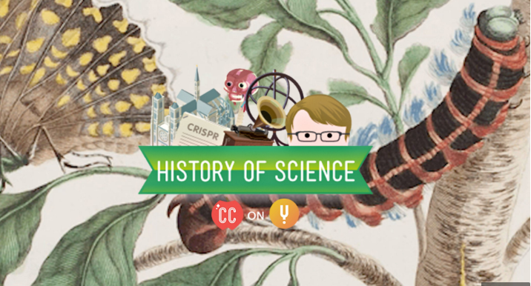

Slide 8
History of science
Is a discipline that focuses on the gradual transformation of certain speculations and the accumulation of acquired knowledge
The history of science is complex
The history of science is closely related to the history of societies and civilizations.

Slide 9
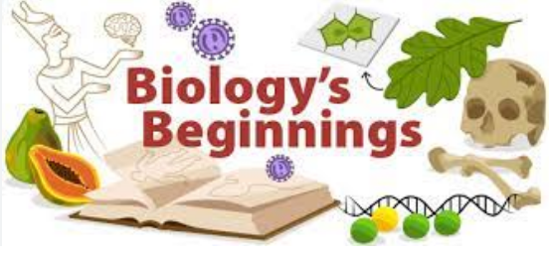
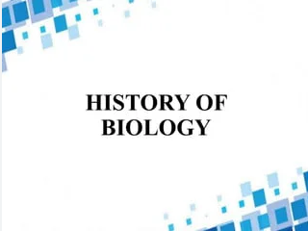

Slide 10
History of biology
1766
Michael Christoph Hanou
Theodor Georg August Roose
1797
1800
Karl Friedrich Burdach
Gottfried Reinhold Treviranus
1802
Jean-Baptiste Lamarck

Slide 11
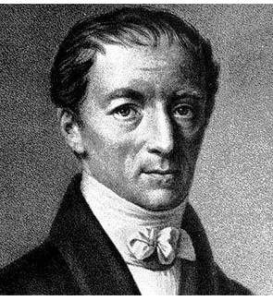
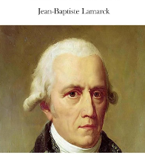
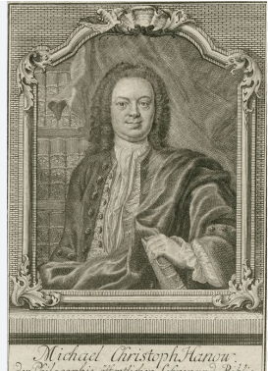
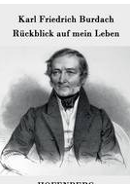
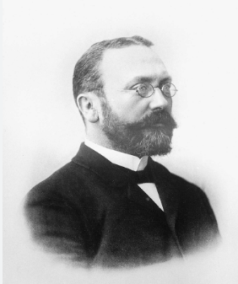
Theodor Georg August Roose
Gottfried Reinhold Treviranus

Slide 12
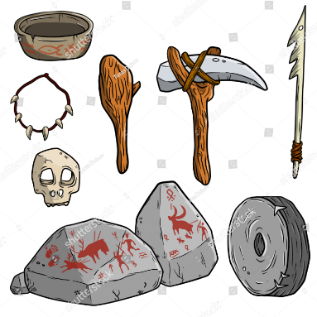
First Inventions
Prehistoric man invented tools made of:
Wood
Bone
Stone

Slide 13
Key word definitions
Study of the individual development of a species
Ontogeny
Palaeography
Knowledge, science of ancient writings
History of living species in geological time
Phylogeny
Paleolithic period
The first period of prehistory characterized by the use of stone and hunting
The last period of prehistory, corresponding to the polishing and cutting of stone and the beginning of agriculture
Neolithic period

Slide 14
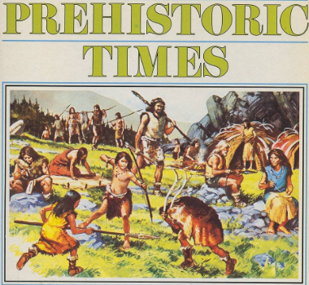
Lesson N°02

Slide 15
Prehistory
Is generally defined as the period between the appearance of humanity (2.5 million BC) and the appearance of writing
The sciences that have contributed to providing evidence of this period are :
Archaeology
Anthropology

Slide 16
Prehistory is divided into different periods characterized by particular techniques :
Paleolithic
Neolithic
This term derives from the Greek palaios: ancient and / lithos (stone). This period is characterized by the technique of sculpted stone, and represents the oldest and longest period of prehistory (5 to 6 million years)
Is a period of prehistory marked by profound technical, economic and social changes, linked to the adoption by human groups of a subsistence model based on agriculture and animal husbandry, and usually involving sedentarization.

Slide 17
Caracteristics of Paleolithic period
Like many animals, they sleep at night in a cave, a refuge.
They never set up camp too far from a pond or river to drink,
And always spent a lot of time in search of food: wild fruits, roots, the meat of dead animals or small animals they had captured.
They also defend themselves from large carnivores that chase them to eat them.
Humans were unaware of agriculture and animal husbandry, and lived a nomadic lifestyle based on collecting and killing.
Among the techniques developed during the Paleolithic period were the domestication of fire, the manufacture of clothing and containers from animal skins, and the production of hunting tools and canoes.
Early prehistoric humans lived naked in the nature

Slide 18
Origins of contemporary Biology
These origins begin with an enumeration of the plants and animals found on historical sources
These can be grouped into two categories :
Prehistoric man used plants for a variety of purposes because plants:
Constitute a source of alimentation (food).
Have secret therapeutic properties
Man became a cultivator of plants in the Neolithic period.
Prehistoric data related to
The animal world
The plant world

Slide 19
The main types of human
It's generally acknowledged that there have been 4 main types of human up to the present day
Even if we are genetically very close to certain apes (+ or - 99% common DNA with the chimpanzee), the evolutionary differences with our "cousins" are enormous: bipedalism, increasingly precise tool manufacture, control of fire, speaking... the list is very long

Slide 20
The first hominids appeared in Africa 7 million years ago. The study of fossils shows a progressive evolution into the Homo genus, localized in Africa, with
who, appearing almost 2 Ma ago, ventured as far as Asia.
Homo habilis
Homonergaster (craftsman)

Slide 21
Homo sapiens
Has physical characteristics identical to our own
The first appearance of sapiens traits (learned man) was between 500 and 200,000 years ago in Africa, and around 100,000 years ago in the Middle East and Asia; while Cro-Magnon Man appeared in Europe 40,000 years ago. The anatomy of the human species 40,000 to 90,000 years ago is indistinguishable from our own.

Slide 22
The lifestyle of humans at that time
By becoming farmers, men settle down and multiply their innovations. They build houses for their families, schools for their herds. They spun the sheep's wool. They drank sheep's milk.
10,000 years ago, our ancestors made an important discovery: they harvested wheat and barley they had sown themselves, and farmed goats and sheep
40,000 years ago, they were sculpting stone or wood. They could not yet write, but they could speak and bury their dead
B. Producing food
C. Living in a village
A. These men look like us

Slide 23
Lesson N°03

Slide 24
Antiquity
Antiquity (Latin: antiquus/ anterior, ancient) is an epoch that follows prehistory. Antiquity is characterized by the development of writing
Occidental antiquity
Oriental antiquity
Extreme Orient
Near and Middle Orient

Slide 25
Extreme Orient
A. China: (4700-3000 BC)
The Chinese already knew a great deal about the biology of various animals, such as silkworms (vers à soie), which they bred to produce precious textiles.
They also showed an early interest in other insects, birds used for fishing and hunting, fish and domestic mammals. Finally, they were the first to carry out Vaccination "the old-fashioned way".

Slide 26
Extreme Orient
B. India: (4700-3000 BC)
They also had more or less empirical biological knowledge of various animals :
Cross-breeding of various domestic mammals
Adaptation of freshwater fish to their habitats and observation of their reproduction periods
Ecological requirements of certain insects

Slide 27
Near and Middle Orient
Inventors of writing (cuneiform)
Rough knowledge of general and functional biology, but very precise anatomy: they made terracotta (terre cuite) organs of various viscera (notably the liver foie), which proves that they practiced animal dissection.
Selective crossing methods: crossing between horses (chevaux) and donkeys.
Distinction between different breeds (races) of horse.
For them, the heart is the seat of intelligence and the liver the seat of blood circulation.
A. Mesopotamia
Region in Irak (Babylonian, Sumerian and Assyrian civilizations) :
It was the source of ancient civilizations with diverse biological practices :

Slide 28
Near and Middle Orient
B- Egypt
The contribution of the ancient Egyptians, who are well known for their highly advanced and refined civilization, to biology consists essentially of :
Use of selection for animals.
Has a very good knowledge of human and animal anatomy thanks to the practice of embalming (l’embaumement) corpses and successfully performing surgical operations.
Identification and description of a wide range of diseases

Slide 29
Occidental antiquity
1- Thales (640-548 BC) wrote in his "Cosmology" that water is the origin of all life.
2- Anaximander (610-546 BC), the first Greek physiologist, believed that animals were born in the sea (nés dans la mer), that man came from another species and that life originally came from water and evolved to adapt to life on land (terrestre).
3- Pythagoras (circa 530 BC) with the idea of sea-level change.
4- Alcméon (circa 500 BC) was the first Greek to perform systematic dissections. He relates the brain and the senses.
5- Hippocrates (-560 to -477 BC) wrote several medical treatises under the name of "Corpus Hippocratis", which would serve as a reference for some time to come, on embryology, pathology, physiology and gynecology
A. Greece
Greek civilization is the result of an important mix of cultures: Chinese, Indian, etc. It is characterized by :
The emergence of scientific thought, the manuscripts and thoughts that dominated the history of science until the 17th century.
A number of personalities have made major contributions to Greek biology. The most notable are :

Slide 30
1-Pliny the ancient, Roman chief (procurator then admiral) wrote "Natural Histories", a very large book taking inventory of current knowledge in biology. It was to serve as a reference for a long time to come, even if his writing was heavily influenced by religious beliefs.
2-Gallien, was interested in anatomy and made many anatomical plates (planches), but using animals because of religion. He was also an experimental physiologist who understood the role of motor nerves and knew that arteries carry blood (not air).
According to Hippocrates :
The heart is the center of intelligence
For him, nerves serve as tendons for the organs.
Breathing cools the heart, which is where blood and air meet.
B- Rome
During the Roman Empire, the biological sciences began to decline. The Romans' contribution to biology was far less important than that of the Greeks:

Slide 31
Lesson N°04

Slide 32
Middle Ages
This is a period extending over almost a thousand (1000) years, between the capture of Rome by the Barbarians (5th century) and the capture of Constantinople by the Turks (1453: capture of Constantinople, capital of the Byzantine Empire, by the Ottomans).
The term Middle Ages (considered pejorative) is often replaced by Medieval.

Slide 33
Astronomy : Muhammad ben Geber (Djefar) al-Battani, an Arab astronomer born in Baten (hence his name) in Mesopotamia (850-929). He began his observations around 264 A.H. (877 B.C).
Geography : Al Edrisi (1099, 1165 or 1175), who grew up in Cordoba, drew a large map of the world oriented south and divided into seven "climates" in latitude and ten sections in longitude.
5. Geometry : The introduction of trigonometric functions is attributed to Nasir ad-Din at-Tusi (1201, Tus, Iran - 1274), a Persian mathematician from Khorassan. (800 Al-Khwarizmi)
6.,Chemistry : Jâber Ibn Hyyan (721-815), a Muslim alchemist of Yemeni origin known for his treatises on alchemical subjects, in which he described processes such as crystallization, distillation, calcination, sublimation and evaporation.
Biology in the Middle Ages
3. Optics : Kamal al-Din Abul-Hasan Muhammad Al-Farisi (1267-1320 B.C) was a Persian Muslim physicist, mathematician and savant. He made two major contributions to science, on optics and number theory.
4. Mathematics : Al-Khwarizmi (780-850) in Baghdad, a Persian mathematician, geographer, astrologer and astronomer, member of the Baghdad House of Wisdom. Founder of algebra.
7. Medicine :
Avicenna (Ibn Sîna) (980,1037), father of modern medicine.
Ibn Al Nafis (1213-1288) described the process of blood circulation.
Avenzoar (Ibn Zuhr) (1073-1162), known for practice and experimentation.
Rhazès (Abu Bakr Muhammad ibn Zakariya al-Razi (860-925)), developed the clinical method, with clinical signs and symptomatology leading to diagnosis and therapy.
A. In the Orient
Islam was born in the 7th century BC. Within a century, Muslims had annexed territories from Spain to China and the Philippines. The Middle Ages proved to be the apogee of the Muslim empire. The Middle Ages saw the apogee of Islamic civilization: many Arab savants left an important contribution to biology and medicine.
Scientists in the Muslim empire included :

Slide 34
B. In the Occident
⇨Juan of Seville
⇨Gérard de Crémone: Rhazès and Avicenna's Canon
⇨Domingo Gonsalvez
⇨Constantin the African
In the West, the Middle Ages were characterized by :
Marked religious evolution (Christian conquest, apogee and decline of the Christian religion).
Dominant influence of the Church for 10 centuries.
In the 12th century, European savants travel to Andalusia and study Arabic to translate scientific texts. Beginning of translations from Arabic into Latin:

Slide 35
B.1. First savants in Europe
Leonardo Pisano, known as "the Fibonacci" (1170-1250):aged 12, taken by his father to Bejaïa, to learn Arabic and arithmetic.
Robert Grosseteste (1168-1253): Oxford, physical sciences (optics).
Roger Bacon (1214-1293): Priest (Prêtre), teaches at Oxford, Paris. Studied Greek, Arabic and optics, mathematics, astronomy...experimentation.

Slide 36
B.2 The rare authors who have contributed to Biology are :
Albert the Great or Albertus Magnus (1193-1280): Originally from Germany, he wrote a 26-book treatise on animals, 21 of which are concerned with the comparative anatomy of man and animals.
Frederick II of Hohenstaufen (1194-1250): was emperor, king of Sicily and later emperor of Germany, and author of a Encyclopédie Ornithologique on the morphology, physiology, etc. of various birds (oiseaux). he promulgated a law authorizing the dissection of human cadavers

Slide 37
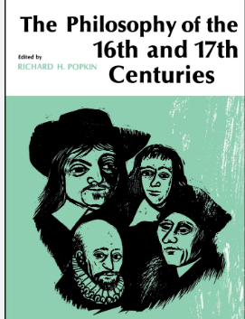
Lesson N°05

Slide 38
The Renaissance [16th century: 1450-1600]
The birth of a new state of mind (état d’esprit)
Criticism (critique) of the old conceptions that had dominated biology
The systematic use of observation, experimentation and quantification
In biology, the invention of the microscope at the end of the 16th century and its development during the 17th century.
This is the period in which modern, experimental science was born, and is identified with the Renaissance, a broader social transformation that also included changes in society, culture and, in particular, art. The 16th and 17th centuries involve (impliquent) :

Slide 39
We will differentiate two periods with quite different characteristics :
1. Sixteenth century (16th) :
Biological and medical sciences underwent (connaissent) two major developments during this period :
Progress in the description of human anatomy
The publication of numerous illustrated works on zoology and botany

Slide 40
2. The 17th century :
In the 17th century, the "scientific revolution" was made possible by the mathematization of science.
This century was characterized by
the significant growth of experimental methods and mechanistic interpretations of the living world
by the introduction of the microscope to biological observations.

Slide 41
Dissecting the human body
Printing (l’imprimerie)
Astronomy: Nicolas Copernicus demonstrated that the Earth is not at the center of the universe (as was believed in the Middle Ages) and that it revolves around the Sun.
Zoology, botany, medicine and other natural sciences in particular developed during this period.

Slide 42
The very first microscope was created in 1595, during the reign of King Henry IV. It was Zacharias Janssen, a Dutch eyeglass manufacturer, who came up with the idea of superimposing two lenses (the spectacles of the time) in sliding tubes, in order to zoom in on very small things.
80 years later, Antoine van Leeuwenhoek and Robert Hooke made a number of modifications, to observe things that were invisible to the naked eye! In particular, they observed human cells, protozoa and bacteria.

Slide 43
Savants | Years | Theory and discovery
Léonard de Vinci | 1452-1519 | Dissects animals and human cadavers Recognizes the 4 cavities of the heart
André Vésale | 1514-1564 | The greatest anatomist of the century: revolutionizing anatomy
Michel Servet | 1511-1553 | Perfects the description of "small circulation"
Gabriel Fallope | 1523-1562 | studies the nervous and reproductive systems
Fabrice d'Acquapendente | 1533-1619 | Gives the first (Western) description of human venous valves
Bernard Palissy | 1510-1589 | Father of paleontology
Von Leeuwenhoek | 1632-1723 | describes red blood cells, bacteria and spermatozoa
Robert Hook | 1635- 1703 | describes a fly's (mouche) eye and a plant cell
Marcello Malpighi | 1628-1694 | demonstrated that the animal comes from the egg (fertilization of the spermatozoon and an ovum in the Fallopian tubes (preformation theory)
Nehemiah Grew | 1641 – 1712 | plant sexuality
Andréa Césalpin | 1519-1603 | uses analysis of the entire plant, in particular flower, fruit and seed (graine)
John Ray | 1627-1705 | physiologist, classifies over 18,000 plants
Joseph Pitton de Tournefort | 1656-1708 | of a natural system (plants), senses the genus of the current system

Slide 44
Lesson N°06

Slide 45
Characteristics of the 18th century
Scientists and intellectuals focused on botany, zoology, exotic plants, invertebrates (Jean-Baptiste de Lamarck) and ornithology.
The 18th century was the Age of Light, a period of the modern age characterized by great intellectual and cultural development in Europe and the United States.
the publication of the Encyclopedists. In 1751, the philosopher Denis Diderot and the mathematician d'Alembert published the Encyclopédie, des arts et des métiers, which took stock of the state of knowledge at the time. The Encyclopédie thus became a hymn to scientific progress.
It was the source of many discoveries, inventions and revolutions. It was a fundamental period for the study and understanding of the living world.

Slide 46
Charles Darwin in 1809 to 1882
The English naturalist Charles Robert Darwin was one of the most eminent biologists of all time.
He established the notion of biological evolution, revealing one of its essential mechanisms, natural selection; his works, notably The Origin of Species, marked a new era in human thought.
The theory of evolution suggests that all living species are in perpetual transformation, evolving morphologically and genetically over time and generations. This concept was introduced by Charles Darwin in his book The Origin of Species, published on November 24, 1859. Since then, it has revolutionized biology, providing the key to explaining instability and variation in living organisms.

Slide 47
According to the British naturalist's theory, evolution can lead, over varying periods of time, to the appearance of new species and the disappearance of others. This is achieved through various phenomena, including natural selection.
Natural selection refers to the mechanism by which, within a given species, the individuals best adapted to their environment reproduce more rapidly than others.

Slide 48
Theories | savants | Years
Evolution | Jean-Baptiste-Pierre-Antoine de Monet et chevalier de Lamark (transformisme) Georges Cuvier (fixisme) Charles Darwin (natural selection) | 1744-1829 1769-1832 1809-1882
Cellular | Mathias-Jacob Schleiden for the plant kingdom Théodore Schwann for the animal kingdom | 1804-1881 1810-1882
Genetics | Johann Gregor Mendel | 1822-1884
Experimental physiology | François Magendie Claude Bernard | 1783-1855 1813-1878
Microbiology | Louis Pasteur et Koch | 1822-1895
Biochemistry | Justus Von Liebig | 1803-1873

Slide 49
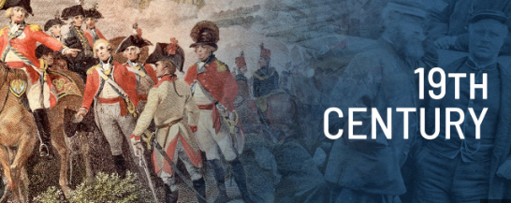
Lesson N°07

Slide 50
Cell theory
Cell theory is a universally recognized historical theory based on three principles or postulates. Several scientists contributed to the development of cell theory from the early seventeenth century to the mid-nineteenth century.
The invention and production of simple, compound microscopes, which enabled scientists to see the microscopic world clearly for the first time, contributed significantly to the development of cell theory.

Slide 51
Cell theory
The three postulates of cell theory are as follows
All living organisms consist of at least one cell
All cells originate from pre-existing cells
The cell is the basic unit of life

Slide 52
Cell theory
The historical development of cell theory begins with Robert Hooke, who invented the term "cell" in 1665. Hooke was an English scientist and architect. He built his own rudimentary compound microscope (a microscope with three sequential lenses), with which he made several observations that he published in a book entitled "Micrographia". In his book, Hooke presents a microscopically observed drawing of a very thin section of a cork used to close the neck of a bottle. The material was filled with regular, delimited cavities that he named "cells", after the Latin word cellula, meaning small part.
While a cell is the basic unit of life, and the smallest element considered independently alive in an organism, it is itself composed of smaller structures, called organelles. Thus, cells are not the smallest structures present in organisms

Slide 53
The next step in the development of cell theory was the discovery of the fundamental living nature of cells. This was the work of Antoni van Leeuwenhoek, often referred to as the "father of microbiology".
Antoni van Leeuwenhoek was a businessman, politician and microscope devotee. He learned to make his own glass lenses and built a simple microscope, essentially a single powerful magnifying lens, capable of magnifying objects to over 200 times their original size.
Cell theory

Slide 54
The next major advance in cell theory is attributed to Matthias Schleiden, whose work is often cited in collaboration with Theodore Schwann. In fact, Schleiden and his close friend Schwann are often referred to as the "founders of cell theory". Matthias Schleiden was a German botanist renowned for studying the structure of plants under the microscope. In a book published in 1838, he declared that "all plants are composed of cells and cellular products". He also noted the importance of the nucleus, which he believed to be essential for the production of new cells, and observed that new cells seemed to originate from the nucleus of ancient cells.

Slide 55
The last discovery in our chronology of cell theory, that all cells originate from pre-existing cells, is attributed to a German pathologist and politician named Rudolf Virchow.

Slide 56
Embryology
The origins of embryology go back to Antiquity, when many physicians and philosophers were interested in the evolution of the embryo. Their technical resources were limited to observing the eggs of various animals, especially the chicken. Speculation and hypothesis replaced the inadequacy of techniques. The most varied and erroneous doctrines were put forward in an attempt to explain the formation of organisms.
Aristot wrote the first known treatise on embryology, as well as the first classification of animals into oviparous, viviparous and ovoviviparous species. But his fanciful hypotheses, steeped in finalism, were to prove detrimental to the development of science until the Middle Ages.
Embryology is the science devoted to the study of embryonic development, i.e. the period of life between fertilization of the egg and birth or hatching. Describing and explaining embryo formation, and studying the mechanisms and causes of embryonic development.

Slide 57
Immunology
Immunology is defined as the science of immunity. The word "immunity" comes from the Latin immunitas, meaning "exemption, dispensation, remission". In the 19th century (around 1865), the word was taken up in biology to designate the property possessed by an organism of being refractory to certain pathogenic agents. Immunology thus appeared as the study of the means by which an organism escapes the pathogenic effects of certain substances.

Slide 58
Immunology
It wasn't until the 19th century, however, that immunization became "scientific", in the sense that it was carried out on a large scale and led to the eradication of several diseases. The three major figures of this era are :
The Englishman Edward Jenner (1749-1823): the originator of "vaccination", in the sense of the inoculation of humans with cowpox virus ("vaccinia") to prevent human smallpox.

Slide 59
Immunology
The German Robert Koch (1843-1910): it was he and his team who showed that infectious diseases are caused by micro-organisms, each of which is responsible for a particular pathology.
France's Louis Pasteur (1822-1895) : uses the term "vaccination", but generally to designate any inoculation of germs attenuated or inactivated by laboratory procedures that prevents the outbreak of a disease.

Slide 60
Genetics
As a recognized scientific discipline, genetics itself only emerged at the beginning of the 20th century, its beginnings dating back to the 19th.
Grégor Mendel's aim was to elucidate the laws governing the origin and formation of plant hybrids. Working on pea varieties with clear and distinct phenotypic traits such as color and shape, he demonstrated that hereditary factors exist in pairs and behave independently, coming together or separating at the random of generations. Above all, Grégor Mendel accurately introduces the major concepts of dominance and recessivity.

Slide 61
Molecular biology
Molecular biology began with two major discoveries:
Oswald Avery showed in 1944 that genes are made up of DNA,
Francis Crick and James Watson proposed the DNA double helix model in 1953, based on X-ray diffraction data.

Slide 62
Molecular biology
The foundations of modern biology are based on the ideas of:
Charles Darwin, who in 1859 presented a new theory of the evolution of living species through natural selection: species continually adapt to the different environments they encounter, and therefore evolve.
Hugo de Vries discovered mutations in 1900.

Slide 63
August Weismann, who in 1885 formulated the "theory of the continuity of germ plasm", in which he distinguished between germ cells, which transmit life throughout generations, and somatic cells, which constitute "perishable" bodies.
Gregor Mendel, who discovered the laws of heredity. He introduced the concept of dominant and recessive traits, which were to form the basis of genetics in its infancy, but his work, published in 1866, remained ignored until the dawn of the 20th century.

Slide 64
Lesson N°08

Slide 65
Gene therapy
The aim of gene therapy is to provide a sick individual with a gene in good working order, in order to :
Gene therapy involves introducing genetic material into cells to treat a disease. It was initially conceived as a therapeutic approach for monogenic diseases (i.e. linked to the dysfunction of a single gene), delivering to cells a "healthy" gene capable of replacing the "sick" gene.
c) Supply the diffusible substance whose absence is at the root of symptoms
a) Bypass the blockage of a metabolic pathway (e.g. lactose intolerance, etc.)
d) Fight cancer by releasing tumor cell-destroying factors in situ
b) Alleviate the consequences of a genetic disease (e.g. hyper-fragility of red blood cell walls following microspherocytosis, etc.)

Slide 66
Molecular cloning
Molecular cloning involves producing recombinant DNA molecules and using them to transform a host organism, in which they are replicated.
Principle
A molecular cloning reaction generally involves the following two elements:
The DNA fragment of interest to be replicated;
A plasmid vector containing all the components required for replication in the host organism.

Slide 67
The DNA of interest (a gene, regulatory elements or operon, for example) is prepared for cloning in a variety of ways: it can be excised from the source DNA using restriction enzymes, amplified by PCR (polymerase chain reaction) or assembled from individual oligonucleotides.
In parallel, a linearized plasmid vector is prepared by restriction enzymes or PCR. A plasmid is a small fragment of circular DNA replicated within the host and independent of the host chromosome or genome.

Slide 68
The DNA of interest is inserted into the plasmid vector via phosphodiester bonds to form a new recombinant plasmid that will be replicated by the host During the cloning process, the ends of the DNA of interest and the vector must be modified to make them compatible, so that they can be linked by a DNA ligase, a recombinase or an in vivo DNA repair mechanism. These steps generally involve enzymes such as nucleases, phosphatases, kinases and/or ligases. Numerous methods and, more recently, cloning kits have been developed to simplify and standardize these processes.

