Slide 1
Larbi Ben M’hidi University
Faculty of Exact Sciences, Natural Sciences and Life Sciences
Department of Mathematics and Computer Science
Physics 1
Mechanics of the material point
Dr. Souheyla Gagui
souheyla.gagui@univ-oeb.dz
Online courses

Slide 2
Mechanics of the material point
Chapter 1: Kinematics of a material point
Movement characteristics
Rectilinear motion
Motion in a Plane
Movement in space
Online courses

Slide 3
Motion in a Plane (2D)
If the trajectory of a moving point lies within a plane, we can describe its position using either Cartesian coordinates (𝑥, 𝑦)or polar coordinates (𝑟, $φ$).
Cartesian basis vectors ($\vec{i}$, $\vec{j}$) are fixed.
Polar basis vectors ($\vec{U_{r}}$, $\vec{U_{φ}}$) depend on the position θ.
Study of movement in polar coordinates
Mobile position
The position of the mobile in Cartesian coordinates (𝑥, 𝑦) is defined by :
$$\vec{OM}=\vec{r}=x\vec{i}+y\vec{j}$$

Slide 4
Position vector in Cartesian coordinates (𝑥, 𝑦)
$$\vec{OM}=\vec{r}$$
$$=x\vec{i}$$
$$+y\vec{j}$$
Y
y
Position vector in Polar coordinates (𝑟, $φ$)
Trajectory
$$\vec{OM}=\vec{r}=r\vec{{ U}_{r}}$$
M
$$\vec{r}$$
r: is the distance from the origin O to the point M.
r=f(t)
$$\vec{j}$$
x
$$φ$$
$$\vec{U_{r}}$$
$φ$ : is the angle between the position vector $\vec{r}$and a the x-axis.
$φ$=g(t)
$$\vec{U_{φ}}$$
$$φ$$
$$\vec{i}$$
X
$\vec{U_{r}}$
Figure 1: Position vector
Unit vectors
$\vec{U_{φ}}$

Slide 5
Expression of Unit vectors
$\vec{U_{r}}$
and
$\vec{U_{θ}}$
$\vec{U_{r}}=\vec{U_{rx}}+\vec{U_{ry}}$
$$\left(∗^{′}\right)$$
Y
Trajectory
$\vec{U_{r}}=U_{r}\vec{U_{r}}$
$$(1)$$
M
$$\vec{U_{rx}}=U_{rx}\vec{ i}$$
$$(2)$$
$$\vec{r}$$
$$\vec{U_{ry}}=U_{ry}\vec{ j}$$
$$(3)$$
$$\vec{U_{ry}}$$
$$\left(1\right),\left(2\right)and \left(3\right)→\left(∗^{′}\right)$$
$$⇒$$
$$\vec{j}$$
$$\vec{U_{r}}$$
$$φ$$
$U_{r}\vec{U_{r}}=U_{rx}\vec{ i}+U_{ry}\vec{ j}$
$$\left(∗^{"}\right)$$
$$\vec{U_{θ}}$$
$$φ$$
$cosφ=\frac{U_{rx}}{U_{r}} ⇒$ $U_{rx}=U_{r}$ cos$φ$
$$(4)$$
$$\vec{i}$$
$$\vec{U_{rx}}$$
X
sin$φ=\frac{U_{ry}}{U_{r}} ⇒$ $U_{ry}=U_{r}$ sin$φ$
$$(5)$$
$$⇒$$
$U_{r}\vec{U_{r}}=U_{r}cosφ\vec{ i}+U_{r}sinφ\vec{ j}$
$$⇒$$
$$\left(4\right),\left(5\right)→\left(∗^{"}\right)$$

Slide 6
$\vec{U_{r}}=cosφ\vec{ i}+sinφ\vec{ j}$
$\vec{U_{φ}}=−sinφ\vec{ i}+cosφ\vec{ j}$
$$\left(∎\right)$$
$\vec{U_{r}} and$ $\vec{U_{φ}} are variable$
$$\left(∎\right)→$$
$$⇒$$
$$\vec{OM}=\vec{r}=r (cosφ\vec{ i}+sinφ\vec{ j})$$
$$\vec{{ U}_{r}}$$
Position vector in Polar coordinates (𝑟, $φ$)

Slide 7
Relation between Cartesian coordinates (𝑥, 𝑦) and polar coordinates (𝑟, $φ$) is:
Polar$→→→→\text{Cartesian}$
Y
$cosφ=\frac{x}{r} ⇒$ $x=r$ cos$φ$
y
Trajectory
$sinφ=\frac{y}{r} ⇒$ $y=r$ s$in φ$
M
$\text{Cartesian}→→→→$Polar
$$\vec{r}$$
$$r=\sqrt{x^{2}+y^{2}}$$
$$\vec{j}$$
x
$$φ=arc cos \frac{x}{r}$$
$$φ$$
$$\vec{U_{r}}$$
$$\vec{U_{φ}}$$
$$φ$$
$$φ=arc sin \frac{y}{r}$$
$$\vec{i}$$
X
$$φ=arc tan \frac{y}{x}$$

Slide 8
Relation between Cartesian basis ($\vec{i}$, $\vec{j}$) and polar basis ($\vec{U_{r}}$, $\vec{U_{φ}}$) is:
The polar unit vectors ($\vec{U_{r}}$, $\vec{U_{φ}}$) can be expressed in terms of the Cartesian unit vectors ($\vec{i}$, $\vec{j}$) as:
$\vec{U_{r}}=cosφ\vec{ i}+sinφ\vec{ j}$
$\vec{U_{φ}}=−sinφ\vec{ i}+cosφ\vec{ j}$
$\vec{U_{r}} and$ $\vec{U_{φ}} are variable$
And conversely, The Cartesian unit vectors ($\vec{i}$, $\vec{j}$) can be expressed in terms of the polar unit vectors ($\vec{U_{r}}$, $\vec{U_{φ}}$) as:
$\vec{ i}=cosθ\vec{{ U}_{r}}−sinθ$ $\vec{U_{φ}}$
$\vec{ j}=sinθ \vec{U_{r}}+cosθ$ $\vec{U_{φ}}$
Online courses

Slide 9
Expression of velocity
In Cartesian coordinates:
$$\vec{v}=\dot{\vec{r}}=\dot{x}\vec{i}+\dot{y}\vec{j}$$
In polar coordinates
We have :
$$\vec{OM}=\vec{r}=r\vec{{ U}_{r}}$$
and
$\vec{U_{r}}=cosφ\vec{ i}+sinφ\vec{ j}$
$$\left(6\right)$$
$$\dot{r}=\frac{dr}{dt}$$
$$\vec{v}=\dot{\vec{r}}=\frac{dr}{dt}\vec{U_{r}}+r\frac{d\vec{U_{r}}}{dt}$$
$$⇒$$
$$\dot{φ}=\frac{dφ}{dt}$$
$$\left(7\right)$$
with
$$\dot{\vec{U_{r}}}=\frac{d\vec{U_{r}}}{dt}$$
$$⇒$$
$$\frac{d\vec{U_{r}}}{dt}=−\frac{dφ}{dt}sinφ\vec{ i}+\frac{dφ}{dt}cosφ \vec{j}$$
$$⇒$$
$$\frac{d\vec{U_{r}}}{dt}=\dot{φ} (−sinφ\vec{ i}+cosφ \vec{j})$$
$$\left(6\right)$$
$$\frac{d\vec{U_{r}}}{dt}=\dot{φ} \vec{U_{φ}}$$
$$\vec{U_{φ}}$$
$$⇒$$
$$\left(8\right)$$

Slide 10
$$\frac{d\vec{U_{r}}}{dt}=\dot{φ} \vec{U_{φ}}$$
$$\frac{d\vec{U_{φ}}}{dt}=−\dot{φ} \vec{U_{r}}$$
Online courses

Slide 11
$$\left(8\right)→\left(7\right)$$
$$⇒$$
$$\vec{v}=\dot{\vec{r}}=\dot{r}\vec{U_{r}}+r\dot{φ} \vec{U_{φ}}$$
$$v_{r}$$
$$v_{φ}$$
$$⇒$$
In polar coordinates
$$\vec{v}=\vec{v_{r}}+ \vec{v_{φ}}$$
Magnitude of the Velocity Vector
$$v=\sqrt{{v_{r}}^{2}+{v_{φ}}^{2}}$$
$$v=\sqrt{{\dot{r}}^{2}+{\left(r\dot{φ}\right)}^{2}}$$
$$⇒$$
The radial velocity ${ (v}_{r })$ is defined as the rate of change of the radial distance “r” with respect to time. Mathematically, it is expressed as: $v_{r}=\dot{r}.$This component indicates how quickly the particle is moving towards or away from the origin.
The transverse velocity ($v_{φ}$), also known as tangential velocity, represents the component of velocity that is perpendicular to the radial direction. It is given by:${ v}_{φ}=r\dot{φ}.$This component reflects how fast the particle is moving along its circular path at a given radius.

Slide 12
$$\vec{v}$$
Y
$${\vec{v}}_{φ}$$
$${\vec{v}}_{r}$$
$$\vec{U_{φ}}$$
$$\vec{U_{r}}$$
$$\vec{r}$$
M
$$\vec{j}$$
Trajectory
$$φ$$
$$\vec{i}$$
X
Online courses

Slide 13
Expression of Acceleration
In Cartesian coordinates:
$$\vec{a}=\dot{\vec{v}}=\ddot{\vec{r}}=\ddot{x}\vec{i}+\ddot{y}\vec{j}$$
In polar coordinates
We have :
$$\vec{v}=\dot{r}\vec{U_{r}}+r\dot{φ} \vec{U_{φ}}$$
$$\vec{a}=\dot{\vec{v}}=\frac{d\dot{r}}{dt}\vec{U_{r}}+\dot{r}\frac{d\vec{U_{r}}}{dt}+\frac{dr}{dt}\dot{φ}\vec{U_{φ}}+r\frac{d\dot{φ}}{dt}\vec{U_{φ}}+r\dot{φ}\frac{d\vec{U_{φ}}}{d}$$
$$⇒$$
$$\ddot{r}$$
$$\dot{φ}\vec{U_{φ}}$$
$$\dot{r }$$
$$\ddot{φ}$$
-$\dot{φ}\vec{U_{r}}$
$$⇒$$
$$\vec{a}=\ddot{r}\vec{U_{r}}+\dot{r}\dot{φ}\vec{U_{φ}}+\dot{r}\dot{φ}\vec{U_{φ}}+r\ddot{φ}\vec{U_{φ}}+r\dot{φ}\left(−\dot{φ}\vec{U_{r}}\right)$$
$$\vec{a}=\left(\ddot{r}−r{\dot{φ}}^{2}\right)\vec{U_{r}}+\left(2\dot{r}\dot{φ}+r\ddot{φ}\right)\vec{U_{φ}}$$

Slide 14
$$⇒$$
$$\vec{a}=\left(\ddot{r}−r{\dot{φ}}^{2}\right)\vec{U_{r}}+\left(2\dot{r}\dot{φ}+r\ddot{φ}\right)\vec{U_{φ}}$$
$$a_{r}$$
$$a_{θ}$$
$$\vec{a}=\vec{a_{r}}+\vec{a_{φ}}$$
Acceleration Vector in Polar Coordinates
$a_{r }:$The radial component of acceleration.
$a_{ω }:$The tangential component of acceleration.
Magnitude of the acceleration Vector
a$=\sqrt{{a_{r}}^{2}+{a_{φ}}^{2}}$
$$⇒$$
$$a=\sqrt{{\left(\ddot{r}−r{\dot{φ}}^{2}\right)}^{2}+{\left(2\dot{r}\dot{φ}+r\ddot{φ}\right)}^{2}}$$
Online courses

Slide 15
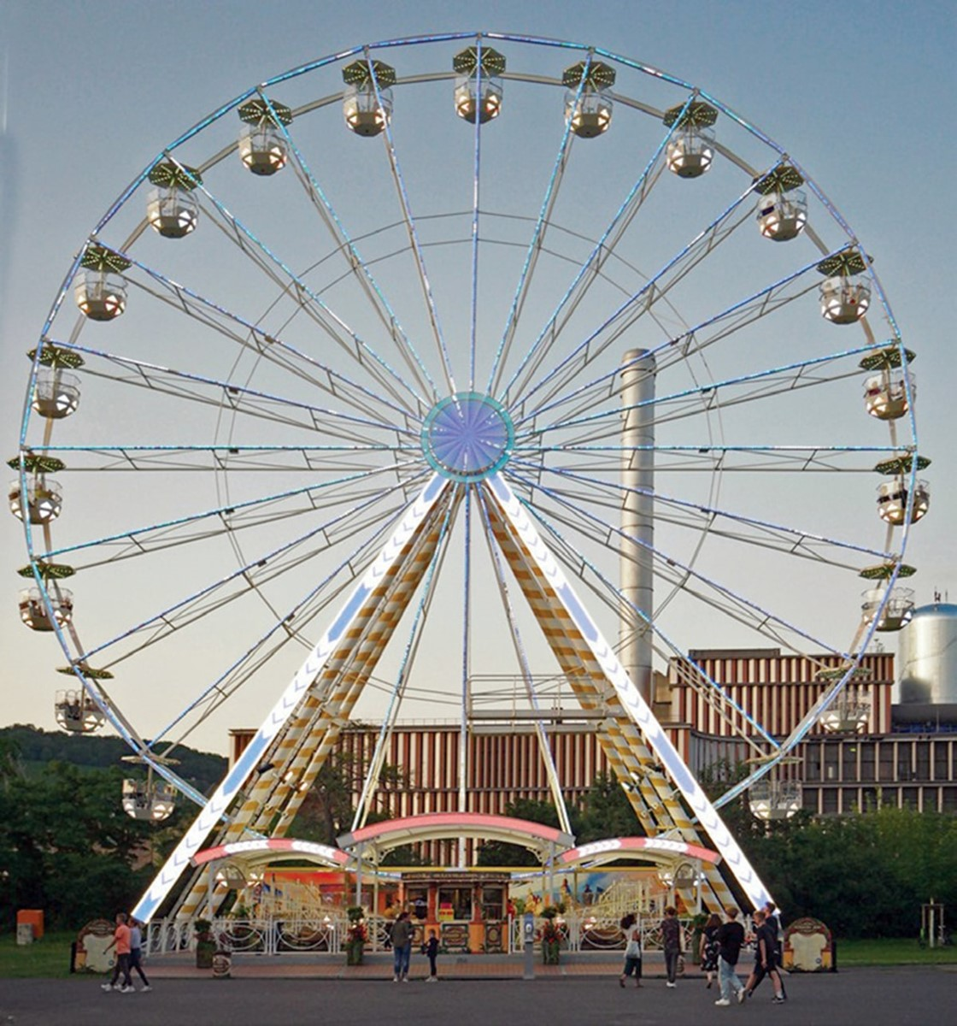
Special Cases 1: Circular Motion (Motion in a Plane (2D)
$$\left\{\begin{aligned}\dot{r}=0 \\ \ddot{r}=0\end{aligned}\right.$$
y
r=R=C
M
We have
$$\vec{r}$$
The velocity vector is therefore:
0
$$φ$$
$$\vec{v}=\dot{r}\vec{U_{r}}+r\dot{φ} \vec{U_{φ}}$$
O
x
$$⇒$$
$$\vec{v}=R\dot{φ} \vec{U_{φ}}$$
The velocity vector in Circular Motion
And the expression for the acceleration vector is:
0
0
$$\vec{a}=\left(\ddot{r}−r{\dot{φ}}^{2}\right)\vec{U_{r}}+\left(2\dot{r}\dot{φ}+r\ddot{φ}\right)\vec{U_{φ}}$$

Slide 16
Acceleration vector in Circular Motion
$$⇒$$
$$\vec{a}=−R{\dot{φ}}^{2}\vec{U_{r}}+R\ddot{φ}\vec{U_{φ}}$$
$$a_{N}$$
$$a_{T}$$
$a_{N }$ : The normal acceleration always points towards the center of the circular path, which means it is directed radially inward ${(a}_{N}=a_{r}=R{\dot{φ}}^{2})$. It is responsible for changing the direction of the velocity vector without altering its magnitude.
$a_{T}:$Tangential acceleration is the component of acceleration that acts along the direction of motion, affecting the speed (magnitude) of the velocity vector. It measures how quickly an object's speed changes as it moves along its path. It can either be in the same direction as the velocity (increasing speed) or opposite to it (decreasing speed) ($a_{θ}=a_{T}=R\ddot{φ})$.
Online courses

Slide 17
Another special case, uniform circular motion
the uniform circular motion is characterized by the constant velocity (constant in module V=C) while its direction continuously changes.
We have
$$\vec{v}=R\dot{φ} \vec{U_{φ}}$$
$$\dot{φ}=ω$$
$$⇒$$
$\ddot{φ}=\frac{dω}{dt}$=0
and
$$⇒$$
$$V=R\dot{φ}=Rω=C$$
$$⇒$$
module
$Angular velocity ω \left({rad}/s\right)=$C
For acceleration :
0
$$\vec{a}=−R{\dot{φ}}^{2}\vec{U_{r}}+R\ddot{φ}\vec{U_{φ}}$$
We have
$$ω$$
$$⇒$$
$$\vec{a}=−Rω^{2}\vec{U_{r}}$$
$$⇒$$
a$=Rω^{2}$
module
Online courses
$$a_{N}$$

Slide 18
$$a=a_{r}=a_{N}=Rω^{2}=\frac{V^{2}}{R}$$
$$⇒$$
Normal and Tangential Components of Velocity and Acceleration
in the Frenet Frame
In the study of motion along a curved path, the Frenet frame provides a systematic way to analyze the motion by breaking down velocity and acceleration into tangential and normal components.
The Frenet frame consists of two orthogonal unit vectors:
Tangent vector (T): in the direction of motion.
Normal vector (N): in towards the center of curvature.
Online courses

Slide 19
$$\vec{v}=v{\vec{u}}_{T}$$
T
$$\vec{a}=\vec{a_{T}}+\vec{a_{N}}$$
$$⇒$$
$\vec{a}=a_{T}{\vec{u}}_{T}$+ $a_{N}{\vec{u}}_{N}$
$$\vec{v}$$
$$\vec{a}$$
$$\vec{a_{T}}$$
$$\vec{a}=\frac{dv}{dt}{\vec{u}}_{T}+\frac{v^{2}}{R}{\vec{u}}_{N}$$
$${\vec{u}}_{T}$$
N
$$\vec{a_{N}}$$
M
$${\vec{u}}_{N}$$
$$\vec{a}=\dot{v}{\vec{u}}_{T}+\frac{v^{2}}{R}{\vec{u}}_{N}$$
$$⇒$$
Velocity and acceleration in the Frenet frame
Online courses

